Slide 1
POLICY BRIEF ON NATIONAL SOCIAL PROTECTION POLICY TO THE MAYOR OF LUSAKA CITY COUNCIL
AUTHORS:
Simmy Chapula
Ministry of Community Development and Social Welfare
Mrs. Beatrice Musichili Mwape
Ministry of Community development and Social Welfare
Oliver Mweemba
University of Zambia

Slide 2
Context and importance
In Zambia, Poverty and vulnerability has continued to persist recording a high rate of poverty among female headed households which stands at 46% in Lusaka (1.2 million)
In Lusaka City, one in every ten household is poor and vulnerable.
Mainly due to rural urban migration
This leads to limited access to basic social services such as health, education, water and sanitation, nutrition and housing

Slide 3
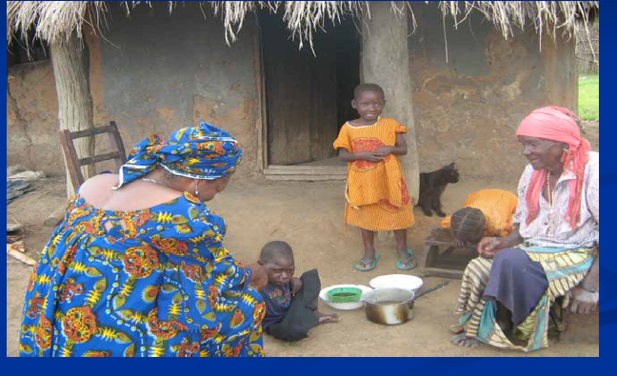
Minister Visiting Beneficiaries of SCT

Slide 4
Argument for current approach
Social cash transfer programs are important in moving the poor and vulnerable female headed households from poverty to increased capacity of investment in productive activities.
This will lead to improved nutrition, education, health and well-being of the households.
Positive impact in reducing high levels of stunting, increased school enrollment, improved health outcomes and enhanced economic productivity of the households.

Slide 5
Impact of Cash Transfers
First Evaluation show that :
Education: enrollment rate went up by 3%.
Nutrition: % of HH not satiated after one meal went down
from 56.6% to 35.2%; food intake is more varied
Health: incidence of illnesses decreased from 43% to 35%.
Livelihood: number of HH making investments quadrupled to
50% and average amount invested doubled; 71% of all HH
stated to have invested part of the cash transfer; asset ownership
increased from 8.5% to 42%)
Future perspective: more households are hopeful (increase
from 37% to 49%) and have more plans (increase from 50% to
73%)
Community: incidence and frequency of begging reduced
However more rigid and strictly controlled impact evaluation is underway and will produce more conclusive evidence on impacts of the scheme

Slide 6
Purpose of the Policy
The social Cash Transfer will protect and promote the livelihoods and welfare of female-headed households from high levels of poverty
The policy will also improve the health and well-being of the orphans and vulnerable children in female-headed households
It will break the intergenerational transmission of poverty, promote human rights and reduce social and economic inequalities.

Slide 7
Key recommendations for action
Allocate enough resources on social cash transfer targeting women taking care of orphans and vulnerable children.
Provide regular and predictable cash transfers to the female headed households
Establish a coordinating unit in order to avoid duplication, overlaps in the disbursement of cash transfers
Promote collaborative and multi-sectoral partnership among key stakeholders and strengthening linkage with other partners.
Enhance good governance and accountability of resources to derive maximum benefits.
Develop a management information system to monitor the impact of social cash transfer s on the health, education and nutrition of the households
Conduct awareness and sensitization programs
Conduct capacity building programs for targeted groups

Slide 8
Key stakeholders
Stakeholder | Negotiation
MoF | Budgetary Allocation
MoH | Health outcomes and nutritional status
MCDSW | Implementers of the Social Cash Transfer (SCTs) programs
MLGH | Housing, Water and Sanitation
MoGE | Bursary, primary and secondary education
MoJ | Legal framework
MoG | Promotion of gender equity
Media | Advocacy, sensitization and awareness of the programs
CSO/NGO/FBO | TA, partnership implementation of programs
Cooperating Partners | Additional resources (financial, material, human)

Slide 9
Approaches to Intersectoral arguments
By collaborating with the various sectors, there will be an added value to the social cash transfer program in terms of its impact on health, education, nutrition, and economic productivity of the female headed households
Improved health and equity contribute to wider public gain

Slide 10
Evidence and general strategies
Collect and analyze data in all female headed households taking care of orphans and vulnerable children
Develop a selection criteria
Map-out the pay points in the city and identify the pay point managers
Conduct training of the community welfare assistant committees
Capacity Building of Social Welfare Officers

Slide 11
Strengths and weakness for policy
Strengths | Weakness
Improved livelihoods | Dependency syndrome
Improved health outcomes | Lack of graduation
Improved school enrolment | Long-term investment (no immediate benefits)
Improved nutrition
Political Will

Slide 12
Final decision at National Policy
Adopt the policy aimed at providing social cash transfers to the female headed households
Strengthen partnership mechanism
Improve household productivity
Monitor impact on health and equity
Contribute towards the achievement of the SDGs
Better Coordination of the Cash Transfer Prgramme.
THANK YOU

