Slide 1
HiAP - implementation and case studies

Slide 2
Learning objectives of the session
1. Key aspects implementation
2. Case studies – South Australia, Norway

Slide 3
Implementation
1.Two faces
2. Types strategies
3. Lessons
4. Emerging practice

Slide 4
Two faces
HiAP is a goal and a means to change the content of policies and the way decisions in society affecting health are made.

Slide 5
Health in All Policies impact chain
Output
Impact
Outcome 1
Outcome 2
WHAT
*Interventions on SDH "Healthy policy“
HOW
* Strategic partnerships
*Governance of systems of decision-making
Exposure risk factor
Attribute risk factor
Well-being, morbidity, and mortality (level and distribution)
Determinants
Outcome 3

Slide 6
Types of HiAP strategies
Health at the core: e.g. seat-belts
Win-win: e.g. providing healthy school lunches that promote learning and health
Co-operation: benefits the government as a whole
Damage limitation
Ollila 2011

Slide 7
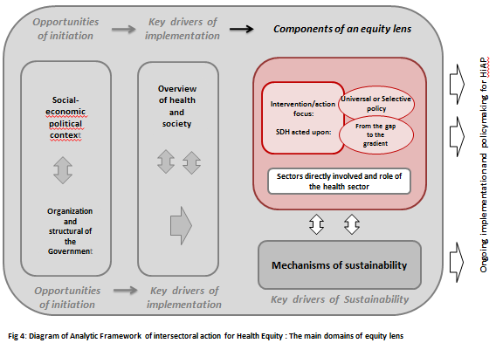
HiAP for equity

Slide 8
The New role for the Health Sector
(including Ministry of Health)
Leader
- Work with other arms of government to achieve their goals
- Understand other sectors' political and administrative imperatives
Partner
- Sectors other than health
- Evaluate the effectiveness
- Integrated policy-making
- Build capacity
- Resource mobilization
Partner
Leader
Negotiator
- Technical knowledge but no control
- Intersectoral platforms - Evidence base
- Policy, legislative coherence
Negotiator

Slide 9
Key lessons
a) How do we communicate this approach to other sectors?
Not use the term
Quality improvement tool.
b) What opportunities exist for beginning HiAP?
From the health sector’s perspective, close link with community health
Noncommunicable Disease Actions // urban health//air pollution
c) How do we maintain the sustainability of HiAP processes?
Developing and sustaining partnerships, commitment, community
Good quality information relevant to the country
d) What are the main barriers to be addressed?
Siloed structures and funding
Capacity to see and coordinate activity beyond these silos
Lack of knowledge why necessary and what outcomes

Slide 10
Practical Lessons – 13 country study
Political leadership
Social vision
Ministry of Health and health department
Participatory governance

Slide 11
Emerging practice
Governance
Partnerships based on co-design, co-delivery and co-benefits
Dedicated capacity and resources
Use of evidence and evaluation.

Slide 12
Governance (and..for HiAP)
1. collaboration
2. citizen engagement
3. a mix of regulation and persuasion
4. independent agencies and expert bodies
5. adaptive policies, resilient structures and foresight
“Smart governance for health” – Kickbush,EURO 2014

Slide 13
Distinguishing features
Vision of systematic governance structures, sustained partnerships
Other sector’s priorities, maximizing the health benefits of that priority
Collaboration and navigation …Partnership

Slide 14
Learning objectives of the session
1. Key aspects implementation
2. Case studies – South Australia, Norway

Slide 15
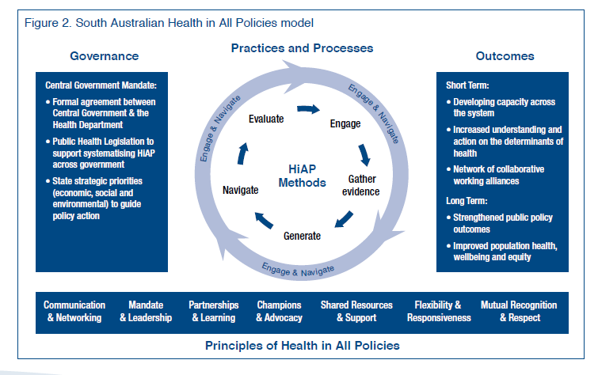
South Australia

Slide 16
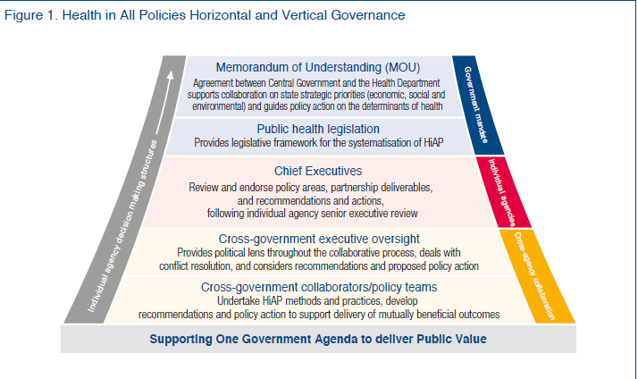
SA Governance

Slide 17
SA Challenges
Maintaining high level commitment
Weak capacity
Better monitoring and reporting

Slide 18
Norway
Local govt primary implementer through Public Health Action 2011
Health overview work
Health factors
Health care
Environment and society
Primary tool for planning
Urban planning central focus

Slide 19
Norway– local government
Organizational placement of officer for population health, equity
Unleashing competence and capacity
Method and data for health overview
Uncoordinated goals
Complexity of equity

Slide 20
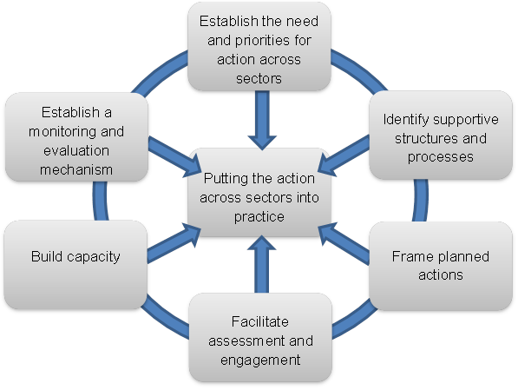
HiAP
Norway
Start health equity visibility
Public health legislation, inter/d
Co-benefit?
Relationships?
Flexible?
South Australia
Start development plan
Public health legislation, inter/d
Notes:
INTERSECTORAL ACTION- 2007
Intersectoral action is “a recognised relationship between part or parts of the health sector with part or parts of another sector which has been formed to take action on an issue to achieve health outcomes (or intermediate health outcomes) in a way that is more effective, efficient or sustainable than could be achieved by the health sector acting alone.” (WHO International Conference on Intersectoral Action for
Health 1997, p. 3).
http://www.who.int/social_determinants/media/iah_tor_case_studies.pdf
“intersectoral action for health” to refer to actions undertaken by sectors outside the health sector, possibly, but not necessarily, in collaboration with the health sector, on health or health equity outcomes or on the determinants of health or health equity
http://www.who.int/social_determinants/resources/health_equity_isa_2008_en.pdf?ua=1 p 3
Another earlier paper that has this type of thinking related to definitions of intersectoral action was one WHO and PHAC commissioned for the Commission on SDH – see: http://www.who.int/social_determinants/media/sdhe_csw_final_report.pdf?ua=1 and Norway intersectoral action report in this list : http://www.who.int/social_determinants/publications/isa/casestudies/en/
Norway's concept of the health sector's role in intersectoral action for health is normative - describing five responsibilities of the health sector:
• Describe social inequalities in health and make the link to their determinants
• Make visible the impact of other sector policies on health
• Support intersectoral collaboration and advocate for action in other sectors
• Strengthen preventive health service
• Ensure equity of health systems
The type of “leadership” role again is normative and based on assumed knowledge and mandate of health sector versus other sectors:
The Norwegian experience is that the extent to which the health sector itself can take the leading policy role depends on the issue at hand.
First there are issues where the health sector both have the knowledge about effective measures and control those means, like preventive services and measures to make health systems more equitable. Here the health sector has a natural leading role.
Second, there are issues where the health sector have knowledge about effective measures but do not control the arena or means for implementing the measures. Examples may be health promoting schools with physical activity, healthy school meals and, mental health programmes, smoking prevention programmes etc. In the development of policy in this field the health sector may take a lead role in promoting solutions but have to ensure close cooperation and ownership of the problem and solutions by the other sector.
Third, there are the determinants of health where the health sector have knowledge about the adverse health impacts of other sector policies, but where the health sector itself neither control the means for implementation nor has exact knowledge about how measures should be framed. Examples are inclusion to the labour market, reducing social inequalities in learning in schools etc. In the process of developing policies within these very up-stream policy areas the health sector may only play the role of a policy partner that on equal terms may inform the policy process with the health inequalities perspectives.

Slide 21
Thank you for your attention!
Q&A?
valentinen@who.int

Slide 22
Other

Slide 23
Intersectoral Intervention packages

Slide 24
Misvaluation of policy interventions
“Working across sectors offers new opportunities,.. if policies to meet targets for energy use, climate change, air quality and health were made together rather than separately, 40% of total costs could be saved, amounting to US$ 80 billion annually […] ..less than 1.5% of international funding for climate adaptation has been allocated to health projects”.
Report by the Secretariat on the “Progress in the implementation of the 2030 Agenda for Sustainable Development”, December 2016.
Source: McDaid, Wismar 2017

Slide 25
Discussion
"What ways of thinking about existing experiences of intersectoral action are most relevant and useful …
-To think about how to improve?
-To think about ways forward for establishing a Health in All Policies approach in countries?"
"How does evidence-informed policy and practice change happen?"
"How, or when, does intersectoral action contribute to addressing social determinants of health and improving health equity?"
"What ways of thinking about intersectoral action help to strategize on ways forward for establishing a Health in All Policies approach in countries?"

Slide 26
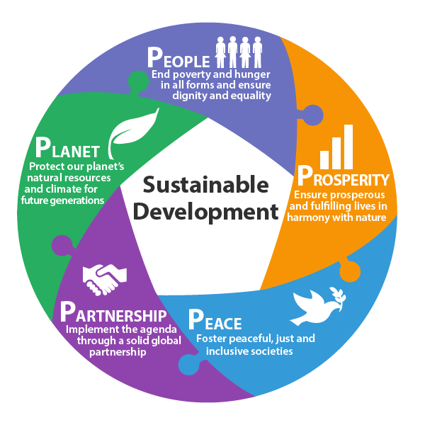
Unintended consequences
Health, greenhouse gas, social inequalities
 | Health benefits (deaths avoided per year) | GHG emissions (MtCO₂e per year) | Who benefits more health-wise | Who bears more costs
All car stages ≤ 5 miles replaced by cycling | 5000 | - 6 | High and medium Socio-economic groups | Lower Socio-economic groups
Everyone eats +5 portions of F&V per day | 5500 | + 6 | Lower Socio-economic groups | Lower Socio-economic groups

Slide 27
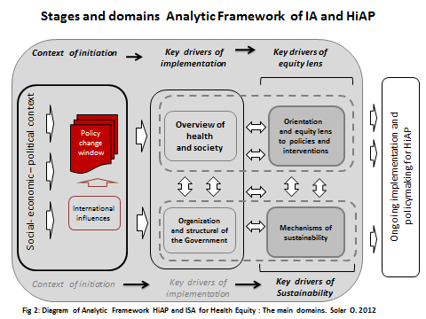
Social determinants actions, Health in All Policies, and changing practice..a map..
"How does evidence-informed policy and practice change happen?"
"How, or when, does intersectoral action contribute to addressing social determinants of health and improving health equity?"
"What ways of thinking about intersectoral action help to strategize on ways forward for establishing a Health in All Policies approach in countries?"

