Slide 1
State Level: California’s Health in All Policies Task Force
Lianne Dillon, MPH Deputy Program Director, Public Health Institute California Health in All Policies Task Force California Strategic Growth Council
Workshop Session 1.3.1. Health in All Policies in the SDGs era

Slide 2
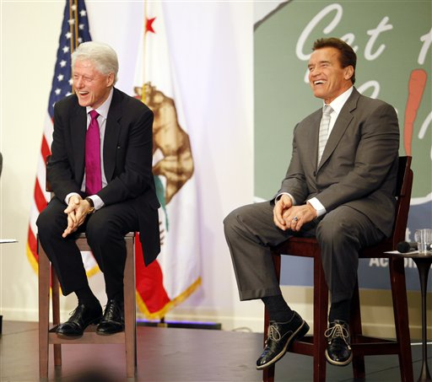
California HiAP Task Force Established 2010
EXECUTIVE ORDER S-04-10
WHEREAS the Strategic Growth Council (SGC) was established to enhance collaboration between state agencies ….
WHEREAS policies related to air and water quality, natural resources and agricultural land, affordable housing, infrastructure systems, public health, sustainable communities, and climate change all significantly influence the physical, economic, and social environments in which people live, shop, work, study, and play……
WHEREAS to improve health outcomes, agencies should collaborate with each other to ensure that health is considered when policies are developed.
NOW, THEREFORE, I, ARNOLD SCHWARZENEGGER, Governor of the State of California, by virtue of the power vested in me by the Constitution and statutes of the State of California, do hereby order effective immediately:
1. The SGC shall establish a Health in All Policies (HiAP) Task Force to collaborate with existing SGC working groups to identify priority programs, policies, and strategies to improve the health of Californians while advancing the SGC’s goals of improving air and water quality, protecting natural resources and agricultural lands, increasing the availability of affordable housing, improving infrastructure systems, promoting public health, planning sustainable communities, and meeting the state’s climate change goals. …
2. The Task Force shall be facilitated and staffed by the California Department of Public Health
3…. shall submit a report to the SGC outlining recommended programs, policies, and strategies for consideration, and the report shall also describe the benefits for health, climate change, equity, and economic well-being that may result if the recommendations are implemented.
IT IS FURTHER ORDERED that the agencies and departments under my direct executive authority shall cooperate in the implementation of this Order.
…establish a Health in All Policies (HiAP) Task Force…

Slide 3
California HiAP Task Force - Members
Facilitated by State Health Department
Accountable to Strategic Growth Council (Cabinet)
Mandate: Collaborate to advance health, equity, & sustainability

Slide 4
HiAP Task Force Vision (what we want) & Purpose (what we do)
VISION : California government advances health, equity, and sustainability in all policies.
PURPOSE
Promote a government culture that prioritizes the health and equity of all Californians across policy areas.
Infuse state agency and department practices with health and equity considerations.
Provide a forum for departments and agencies to identify shared goals and opportunities to enhance performance through collaboration.

Slide 5
California HiAP Task Force: Features of Current Structure
Participation is voluntary and not funded
Quarterly plenary meetings and smaller working groups
Consensus decision-making
Priorities driven by community stakeholders
Focus on making existing work stronger
Public accountability to the Strategic Growth Council
Backbone staff team – blended PHI and health department

Slide 6
Role of HiAP Task Force Staff
Support multi-agency collaboration
Convene & facilitate
Subject matter research
Stakeholder engagement
Consensus building
Support growth of the field
Curriculum, trainings

