Slide 1
Cultivating 21st Century HiAP Practice-Change Opportunities
C. Anneta Arno, PhD., MPH,
Director, Office of Health Equity
Workshop Session 1.3.1. Health in All Policies in the SDGs era

Slide 2
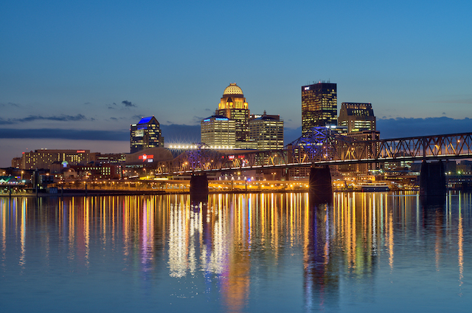
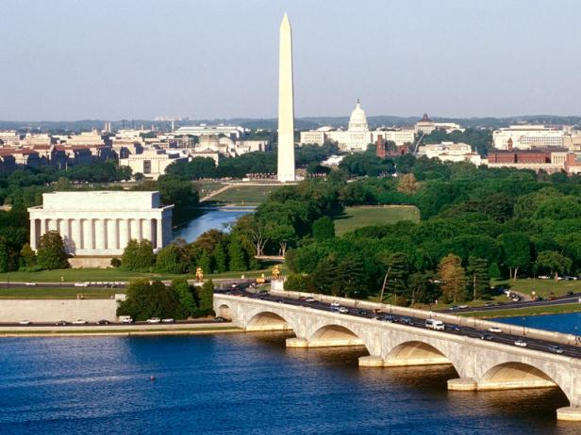
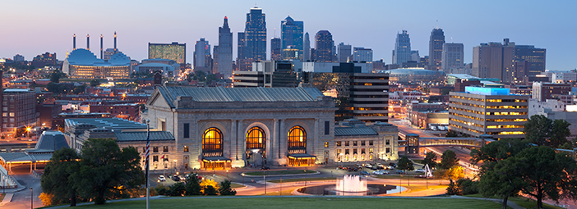
Louisville, KY
Washington, DC
Kansas City, MO

Slide 3
3 Cities & Contrasting Contexts USA ATIONAL CONTEXT
2010 America’s Top 50 Bike-Friendly Cities
Washington DC = #13
Louisville #21
Kansas City, Mo = #32
Notes:
SOURCE: Bicycling 2010: http://www.bicycling.com/rides/best-cities/americas-top-50-bike-friendly-cities

Slide 4
3 Cities & Contrasting Contexts
GOVERNMENTAL STRUCTURE & SIZE
Louisville, KY | City of Washington, DC | Kansas City, MO
City-County Metro Government Mayor & Council Structure | City-“State” Government Mayor & Council Structure | City Government (City Manager) Mayor & Council Structure
US City Size: US Rank* = 32 Largest | US City Size: US Rank* = 22 Largest | US City Size: US Rank* = 37 Largest
Population & Growth: Pop 2014: 612,780 Change 2010-2014: +2.59% | Population & Growth: Pop 2014: 658,893 Change 2010-2014: +9.50% | Population & Growth: Pop 2014: 470,800 Change 2010-2014: +2.40%
Area: 325 sq miles Pop. Density - 1,837 per sq mile | Area: 61 sq miles Pop. Density - 9,856 per sq mile | Area: 315 sq miles Pop. Density - 1,460 per sq mile
MSA 2015: 1,278,413 (#43) | MSA 2015: 6,097,684 (#6) | MSA 2015: 2,087,471 (#30)
*US City Rank by Population July 2014
Notes:
Source: https://en.wikipedia.org/wiki/List_of_United_States_cities_by_population
“List of United States cities by population” - From Wikipedia, the free encyclopedia
MSA 2015 Data : https://en.wikipedia.org/wiki/List_of_Metropolitan_Statistical_Areas
Louisville Jefferson County KY-IN MSA
Washington- Arlington- Alexandria DC-VA-MD-WV MSA
Kansas City, MO-KS MSA

Slide 5
3 Cities & Contrasting Contexts
PUBLIC HEALTH INFRASTRUCTURE
Louisville, KY | City of Washington, DC | Kansas City, MO
County Public Health Department Resident Pop 2015 : 763,263* | City Public Health Department Resident Pop 2015 : 672,228* | City Public Health Department Resident Pop 2015 : 475,378*
LM PH&W Budget: FY15 - $26,800,000 | DC DOH Budget: FY15 - $270,000,000 | KCMO Health Dept. Budget: FY15 - $22,000,000
Board of Health | NO Board of Health | Mayor’s Health Commission
Center for Health Equity – 2006 First of its kind in US Health Equity Report 2011 & 2014 Violence Prevention Workgroup 2012 Community Transformation Grant (2012 – 2014) | Office of Health Equity – 2015 Safer Stronger Advisory Committee Report, May 2016 Community Health & Safety Study (CHASS) (ETA July 2016) Health Equity Report (ETA Sept 2016) | No ‘Health Equity’ Division Aim for Peace City-Wide Business Plan 2015-2020 – “HE & HiAP Strategies” Culture of Health Prize, 2015
NACCHO | NACCHO & BCHC “Original” | NACCHO & BCHC “Recent”
*Health Dept. Resident Pop - ACS 2015
Notes:
Louisville Metro Budget: https://louisvilleky.gov/sites/default/files/management_budget/fy15budget/fy15-36publichealth.pdf
Source: https://en.wikipediaNACCHO Only
.org/wiki/List_of_United_States_cities_by_population
“List of United States cities by population” - From Wikipedia, the free encyclopedia
MSA 2015 Data : https://en.wikipedia.org/wiki/List_of_Metropolitan_Statistical_Areas
Louisville Jefferson County KY-IN MSA
Washington- Arlington- Alexandria DC-VA-MD-WV MSA
Kansas City, MO-KS MSA

Slide 6
3 Cities & Contrasting Contexts
SOICIATAL INDICATORS
Louisville, KY | City of Washington, DC | Kansas City, MO
Race & Ethnicity White Alone 73% | Race & Ethnicity White Alone 44.1% | Race & Ethnicity White Alone 59.2%
Black/African American 21% | Black/African American 48.3% | Black/African American 29.9%
Asian Alone 2.7% | Asian Alone 4.2% | Asian Alone (2010) 2.5%
Two or more races 2.3% | Two or more races 2.7% | Two or more races (2010) 3.2%
Hispanic / Latino Percent 4.9% Foreign Born 6.7 % | Hispanic /Latino Percent 10.6% Foreign Born 14% | Hispanic / Latino (2010) 10.0% Foreign Born 7.6 %
Education & Income Bachelors Degree or higher 30.8% | Education & Income Bachelors Degree or higher 53.4% | Education & Income Bachelors Degree or higher 31.6%
Poverty Rate 16.8% Median HH Income $47, 692 | Poverty Rate 17.7% Median HH Income $69,235 | Poverty Rate 19.4% Median HH Income $45,376
Notes:
US Census Quick Facts: Washington DC - http://www.census.gov/quickfacts/table/PST045215/11
US Census Quick Facts: Jefferson County, KY - http://www.census.gov/quickfacts/table/PST045215/21111
US Census Quick Facts: Kansas City MO - http://www.census.gov/quickfacts/table/PST045215/2938000

Slide 7
Changing the Context: HiAP Critical Success Factors
Job 1: City & Public Health Infrastructure
Understand the governance structure of your jurisdiction/organization
Seek & Leverage Opportunity
Start with your “Coalition of the Willing”
Job 2: Stakeholders & Potential Partners
Identify the right stakeholders
Engage the right players at the right time
Engage Strategic Partnerships
Job 3: Multi Sector “HiAP” Collaboration
Cultivate and maintain trust and respect
Defer to the subject matter expert
Share resources (human, financial)
Be humble but marketable
*Key Takeaway – RELATIONSHIPS!

Slide 8
HiAP Engagement Continuum
Cultivating 21st Century HiAP Practice
Key Ingredient = Pragmatism:
Coalition of the Willing
Coalition of the Curious
Coalition of the Necessary

Slide 9
Kansas City, MO
Council Goal: Neighborhoods & Healthy Communities (p15)
“Support the development, maintenance, and revitalization of sustainable, stable, and healthy communities in which neighborhoods are safe, clean, well maintained and consistently improved”
Departmental Strategic Objectives:
Increase overall life expectancy and reduce health inequities in all zip codes.
Establish multi-departmental committee or taskforce to identify underlying causes of the City’s inequities and recommend an implementation plan.
Produce the Community Health Improvement Plan
Council Goal: Finance & Governance (p13)
Establish a community/departmental panel or taskforce to investigate causes of the City’s racial divide and make recommendations on solutions
Notes:
SOURCE: http://kcmo.gov/finance/citywide-business-plan-2015-2020/
Update: 2016-2021 Business Plan

Slide 10
Louisville, KY: Mayor’s Healthy Hometown Movement (MHHM)
Louisville, KY Context
LMPHW
MHHL
Leadership
Team
MHHL
Community
Coalition
Public Health Department
Community Partners
Public Sector Partners

Slide 11
MHHM Leadership Team
Public Sector Partners
Public Health & Wellness = Chair
Metro Parks
Public Works
Codes & Regulations
Human Resources
Economic Growth & Innovation
Louisville Metro Police Department
Community Services and Revitalization
Transit Authority of River City
Jefferson County Public Schools
Human Relations Commission
Louisville Metro Council
Housing Authority
Emergency Management Agency
Air Pollution Control District

Slide 12
Public Health 3.0 – 21st Century Leadership
3-Pronged Role & 5 Strategic Priorities
Role Model
Regulator
Convener & Collaborator
Promote a Culture of Health and Wellness
Address the Social Determinants of Health
Strengthen Public-Private Partnerships
Close the Chasm between Clinical Medicine and Public Health
Apply Data Driven & Outcomes- approach to Program and Policy Development

Slide 13
OHE – Office of Health Equity
MISSION:
“The Office of Health Equity works to address the root cause of health disparities, beyond healthcare and health behaviors, by supporting projects, policies and research that will enable every resident to achieve their optimal level of health.
The Office achieves its mission by informing, educating, and empowering people about health issues and facilitating multi-sector partnerships to identify and solve community health problems related to the social determinants of health.”
OVERARCHING GOAL:
Improve Context for Equitable Opportunities for Health in DC

Slide 14
Health & Human Service Cluster
Mayor’s
Resilience
Cabinet
Behavioral Health
Health Care Finance
Child & Family Services
Human Services
Office on Aging
Disability Services
Youth Rehabilitation Services
Office of the Chief Medical Examiner
Safer Stronger DC Office of Neighborhood Safer & Engagement
DOEE
OP
Homeland Security & Emergency Management
Original “Coalition-of-the-Willing”
Economic Dev.
DC Housing Authority
DDOT
Commission on Climate Change & Resilience
Notes:
Resilient DC Fact Sheet - https://oca.dc.gov/sites/default/files/dc/sites/oca/page_content/attachments/Wash-DC-factsheet-04b_0.pdf
Mayor’s Resilience Cabinet - https://resilient.dc.gov/page/about-resilient-dc##cab
Office of the Deputy Mayor for Health & Human Services - https://dmhhs.dc.gov/page/dmhhs-agencies-and-boards
Office of the Deputy Mayor for Public Safety & Justice - https://dmpsj.dc.gov/page/cluster-agencies
Office of the Deputy Mayor for Planning & Economic Development - https://dmped.dc.gov/page/dmped-cluster-agencies

Slide 15
Mayor's Resilience Cabinet
Rashad Young (City Administrator, Executive Office of the Mayor)
Kevin Donahue (Deputy City Administrator and Deputy Mayor for Public Safety and Justice, Executive Office of the Mayor)
Hyesook Chung (Deputy Mayor for Health and Human Services, Executive Office of the Mayor)
Courtney Snowden (Deputy Mayor for Greater Economic Opportunity, Executive Office of the Mayor)
Keith Anderson (Director, Department of Parks and Recreation)
Kevin Bush (Chief Resilience Officer, Executive Office of the Mayor)
Odie Donald (Director, Department of Employment Services)
Polly Donaldson (Director, Department of Housing and Community Development)
Greer Gillis (Director, Department of General Services)
Jeff Marootian (Director, Department of Transportation)
Dr. LaQuandra Nesbitt (Director, Department of Health)
Jenny Reed (Director, Office of Budget and Performance Management)
Chris Rodriguez (Director, Homeland Security and Emergency Management Agency)
Jed Ross (Chief Risk Officer, Office of Risk management)
Eric Shaw (Director, Office of Planning)
Barney Krucoff, (Acting Chief Technology Officer, Office of the Chief Technology Officer)
Tommy Wells (Director, Department of Energy and Environment)

Slide 16
DC Health Equity Report 2018*
SDH: Interconnected Pathways
Recommendations:
Proactive multi-sector solutions are essential to meaningful transformational change.
Recognize that eliminating inequities provides a huge opportunity to invest in community. Inequity is not acceptable, and everyone stands to gain by eliminating inequity.
Develop a multifaceted “Health-In-All Policies” approach in order to improve the health of all District residents, including achieving health equity.
Develop equity goals, and measure and monitor the impact of social policy on health to ensure goals and improved outcomes are being accomplished. Monitor changes in health equity over time and place to help identify the impact of adverse policies and practices.
*DC HER 2018 - coming soon

