Slide 1
Session 1.1.2 – Reflection on social and environmental determinants of health
Aleksandra Kuzmanovic

Slide 2
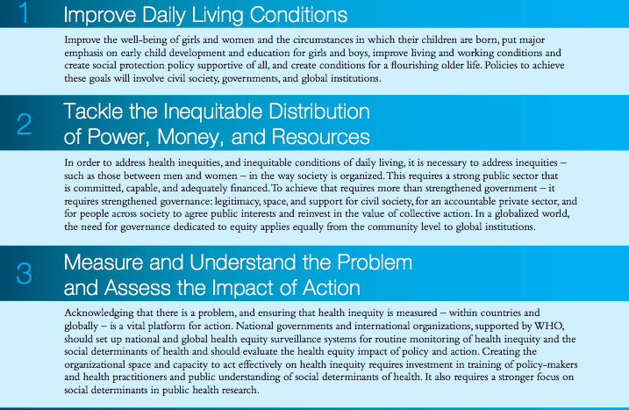
the circumstances in which people are born, grow, live, work, and age
the structural drivers of those conditions of
daily life – globally, nationally, and locally
expand the knowledge base,
develop a workforce that is trained in the social determinants of health,
and raise public awareness about the social determinants of health

Slide 3
Group work
20 minutes
1. Identify health challenges in urban setting from the video
2. Identify 2-3 solutions from the Commission on Social Determinants of Health recommendations
3. Share arguments for chosen solutions

