Slide 1
Key concepts (introduction to Health in All Policies)
Session 1.1 Nicole Valentine

Slide 2
Overview
1.Determinants
2. Intersectoral action
3. Sustainability
4. Governance and Health in All Policies

Slide 3

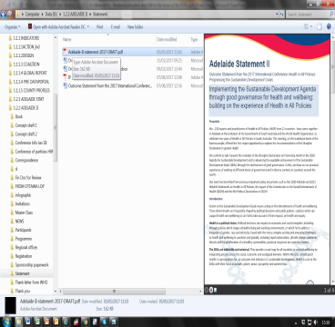

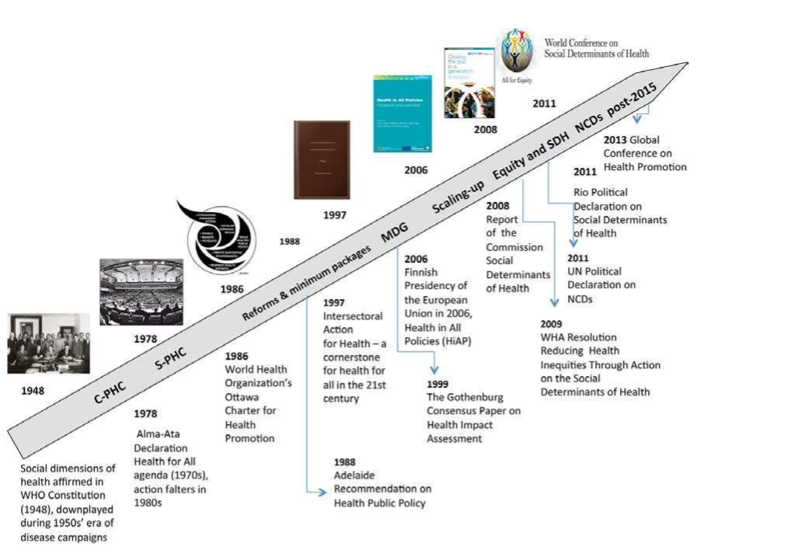
Global Agendas, SDH
2016 &
2017 Adelaide II
2017 May Launch Global Network
2016 International Health Partnership for UHC 2030
2016 Health and Climate Action Agenda Second Global Conference on Health and Climate
2010 Adelaide I and 2011 Summer school
Source: Adapted from Solar, Valentine (2013)

Slide 4
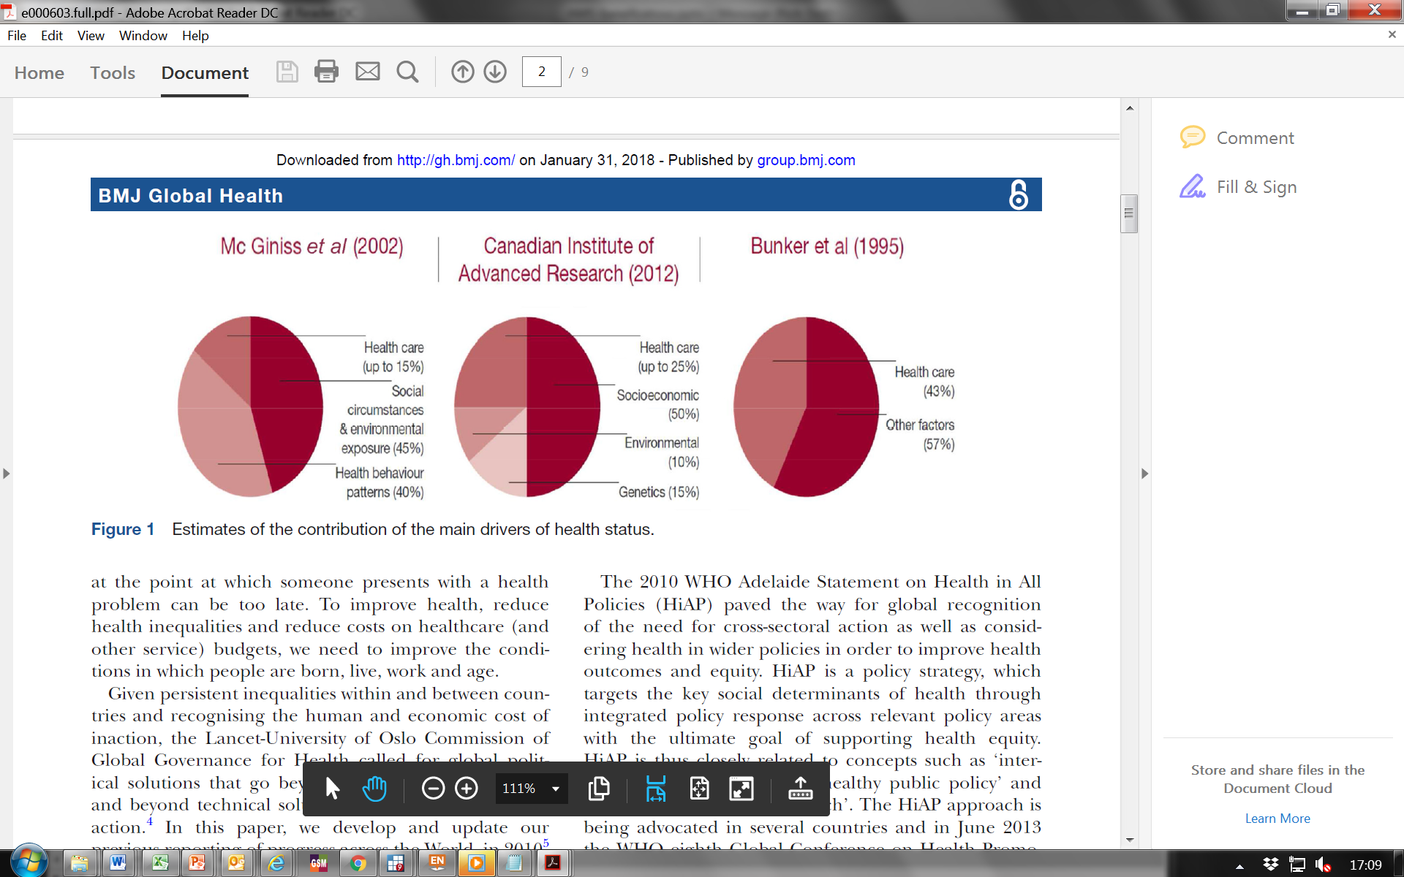
Key concept – determinant causes

Slide 5
Determinants and International Law
2000 General Comment, the right to health
Article 12.2 (a): The right to maternal, child and reproductive health
Article 12.2 (b): The right to healthy natural and workplace environments
Article 12.2 (c): The right to prevention, treatment and control of diseases
Article 12.2 (d): The right to health facilities, goods and services
Notes:
http://www.refworld.org/pdfid/4538838d0.pdf
The Committee interprets the right to health, as defined in article 12.1, as an inclusive right extending not only to timely and appropriate health care but also to the underlying determinants of health, such as access to safe and potable water and adequate sanitation, an adequate supply of safe food, nutrition and housing, healthy occupational and environmental conditions, and access to health-related education and information, including on sexual and reproductive health.
Article 12.2 (a): The right to maternal, child and reproductive health
Article 12.2 (b): The right to healthy natural and workplace environments
Article 12.2 (c): The right to prevention, treatment and control of diseases
Article 12.2 (d): The right to health facilities, goods and services

Slide 6
Complexity
Cause and effect may be identifiable in retrospect but may be unlikely to conform with prior expectations on how things work. Interventions must be flexible as outcomes may be unforeseen.
-Snowden 2005
Notes:
http://www.refworld.org/pdfid/4538838d0.pdf
The Committee interprets the right to health, as defined in article 12.1, as an inclusive right extending not only to timely and appropriate health care but also to the underlying determinants of health, such as access to safe and potable water and adequate sanitation, an adequate supply of safe food, nutrition and housing, healthy occupational and environmental conditions, and access to health-related education and information, including on sexual and reproductive health.
Article 12.2 (a): The right to maternal, child and reproductive health
Article 12.2 (b): The right to healthy natural and workplace environments
Article 12.2 (c): The right to prevention, treatment and control of diseases
Article 12.2 (d): The right to health facilities, goods and services

Slide 7
Overview
1.Determinants
2. Intersectoral action
3. Sustainability
4. Governance and Health in All Policies

Slide 8
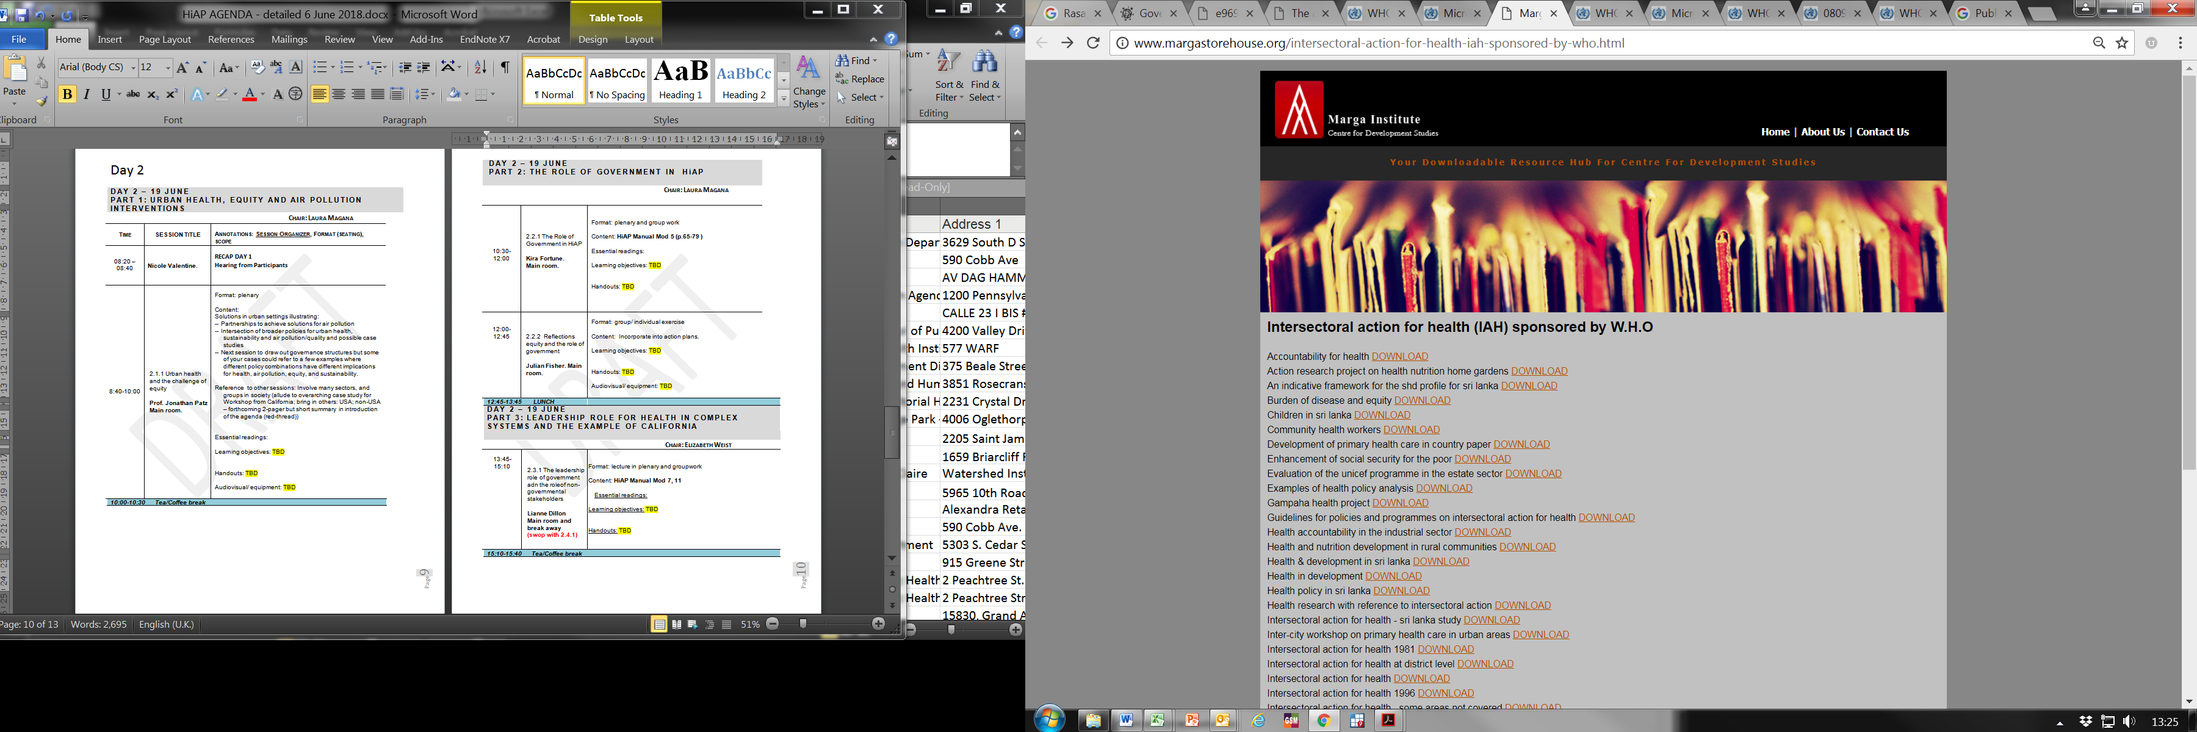
History of Intersectoral Action
Primary health care –tools 1970s-80s

Slide 9
Multisectoral / intersectoral
Multisectoral action– 2016
.."Encompasses all activities involving non health sectors that can potentially improve health." [Rasanathan et al. 2017]
Intersectoral action– 2007/earlier (WHO)
..“A recognised relationship between part or parts of different sectors to take action on issues to improve health and health equity"; [WHO International Conference on Intersectoral Action for Health 1997, p. 3]. The action cannot be undertaken without cooperation.
Action across sectors- 2015
.."Action across sectors refers to work undertaken by two or more government ministries or agencies to develop policies, programmes or projects. "
Notes:
http://journals.plos.org/plosmedicine/article?id=10.1371/journal.pmed.1002285
..“a recognised relationship between part or parts of the health sector with part or parts of another sector which has been formed to take action on an issue to achieve health outcomes (or intermediate health outcomes) in a way that is more effective, efficient or sustainable than could be achieved by the health sector acting alone.”
Health sector as a minimal actor in contexts where other individual sectors undertake their core business (such as ensuring children attend school and learn well for the education sector or access to clean power for the energy sector) and have spillover effects for health;
Health sector as a supporting actor, e.g., for cross sectoral policies to address structural forces and social norms that affect all of society, including those that drive disparities;
Health sector as a bilateral or trilateral partner, for example, in contexts where collaboration is required between two or more sectors to produce joint or “co-benefits” and to maximise health benefits (such as the use of cleaner stoves to reduce indoor air pollution, sexuality education in schools, or tobacco taxation to improve both health and revenues);
Health sector as a lead actor, e.g., in contexts where collaboration with other sectors is essential for the health sector to deliver its core mandate in delivering health services (such as ensuring adequate water and energy supplies to health facilities or road infrastructure for access).

Slide 10
Multisectoral / intersectoral
Whole-of-government
..approach refers to the coordinated efforts of two or more sectors within government to improve health outcomes. This can include working across different levels of government. Joined-up government and healthy public policies are similar terms used in the HiAP literature.
Whole-of-society
..approach refers to coordinated efforts to improve health by multiple stakeholders within and outside government that may also be from several sectors.

Slide 11
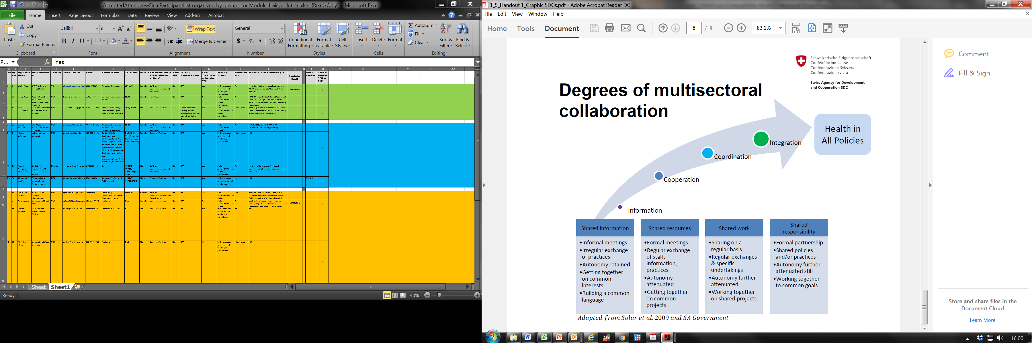
Adapted from Solar, Valentine, Rice, Albrecht 2009, and SA Government

Slide 12
Intersectoral and integrated
.. management of cross-cutting issues in public policy transcending the boundaries of established policy fields, or which often do not correspond to the institutional responsibilities of individual departments.
  Horizontal
  Vertical

Slide 13


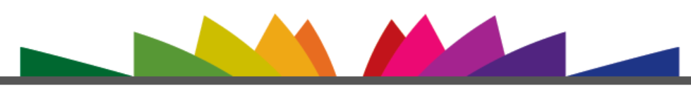
Conditions that favour effective intersectoral collaboration
Government supports and encourages intersectoral action
Sectors have shared interests or both benefit from cooperation
Issue has high political importance and requires urgent addressing
Intersectoral action is well-planned with clear objectives, roles, and responsibilities
Strong, effective leaders in the bureaucracy (policy champions/entrepreneurs)
Proposed policy has public support
Laws exists or are planned to support the proposed policy
Sufficient resources are available
There are plans to monitor and sustain outcomes

Slide 14
Overview
1.Determinants
2. Intersectoral action
3. Sustainability
4. Governance and Health in All Policies

Slide 15

Sustainability and the resource envelopes
Development is sustainable when it “meets the needs of the present without compromising the ability of future generations to meet their own needs“
[The World Commission on Environment and Development 1987; Commission on the Measurement of Economic Performance and Social Progress / Joseph Stiglitz]

Slide 16
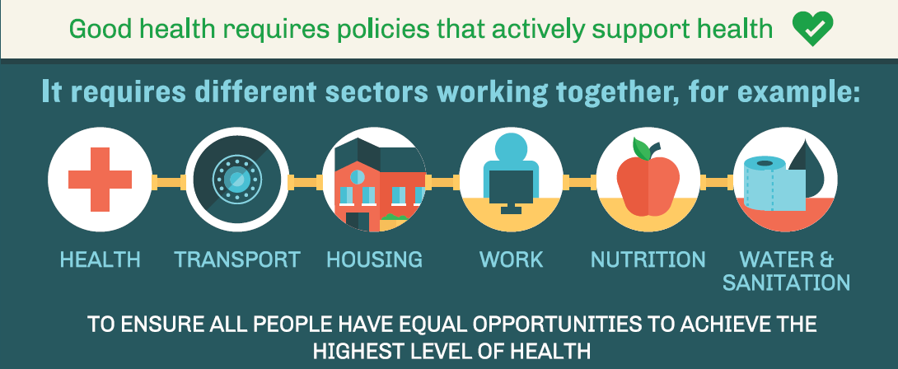
Sustainability and health
Policy coherence

Slide 17



Air pollution, cities, health, equity
Affordable and clean energy for all for healthy homes and lives
Sustainable cities and communities with healthy urban planning, clean air, adequate housing and more active living
Reduced inequalities through involvement of citizens in decisions on access to services and resources for health

Slide 18
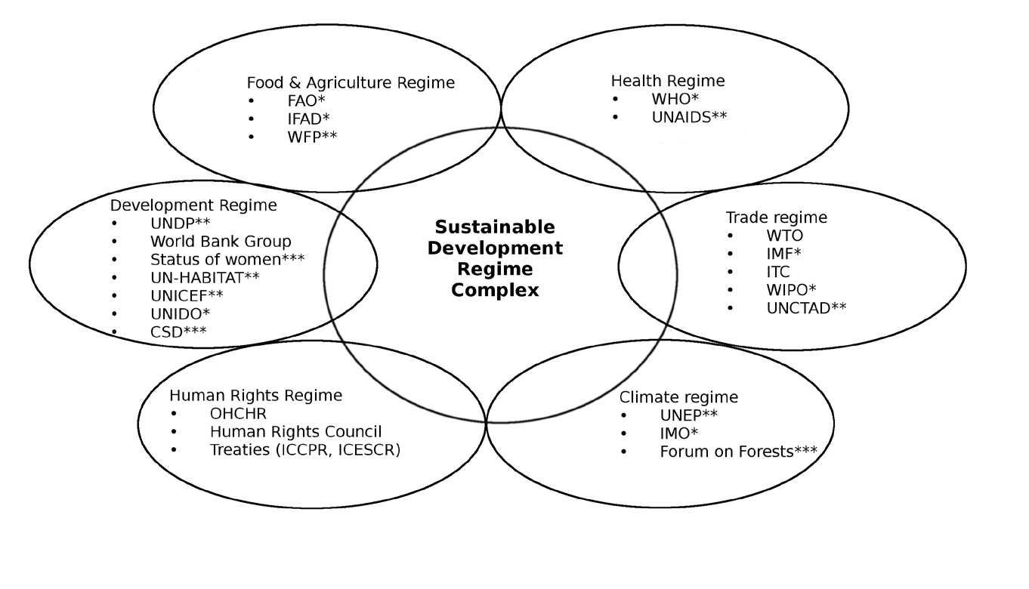
Sustainable Development International Governance

Slide 19
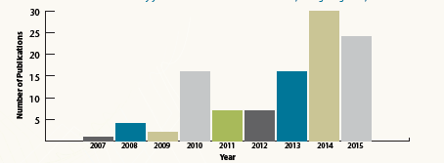
Overview
1.Determinants
2. Intersectoral action
3. Sustainability
4. Governance and Health in All Policies

Slide 20
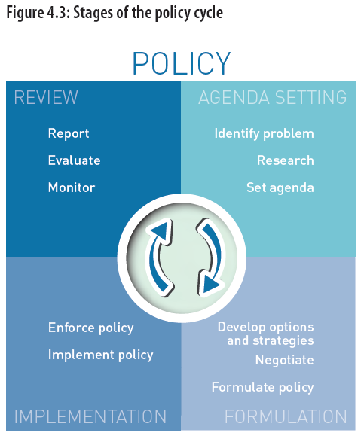
Policy
Cycle

Slide 21



Health Diplomacy
Negotiating for health in the face of other interests
Building relationships and alliances for health
outcomes and addressing health determinants
Creating opportunities for mutual gain

Slide 22
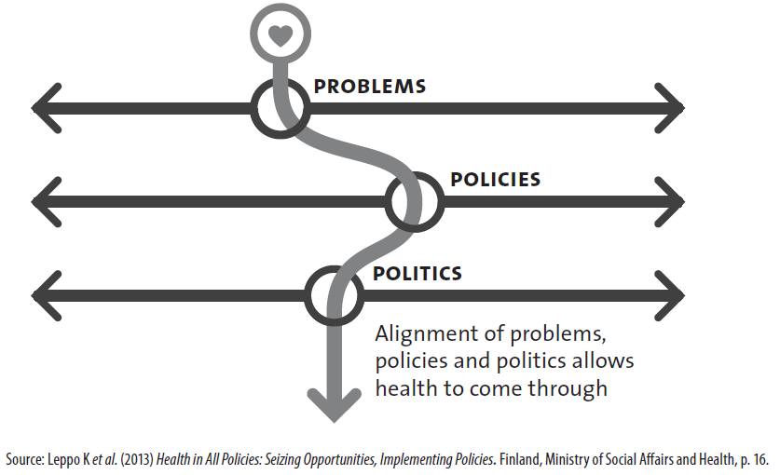
Policy window

Slide 23
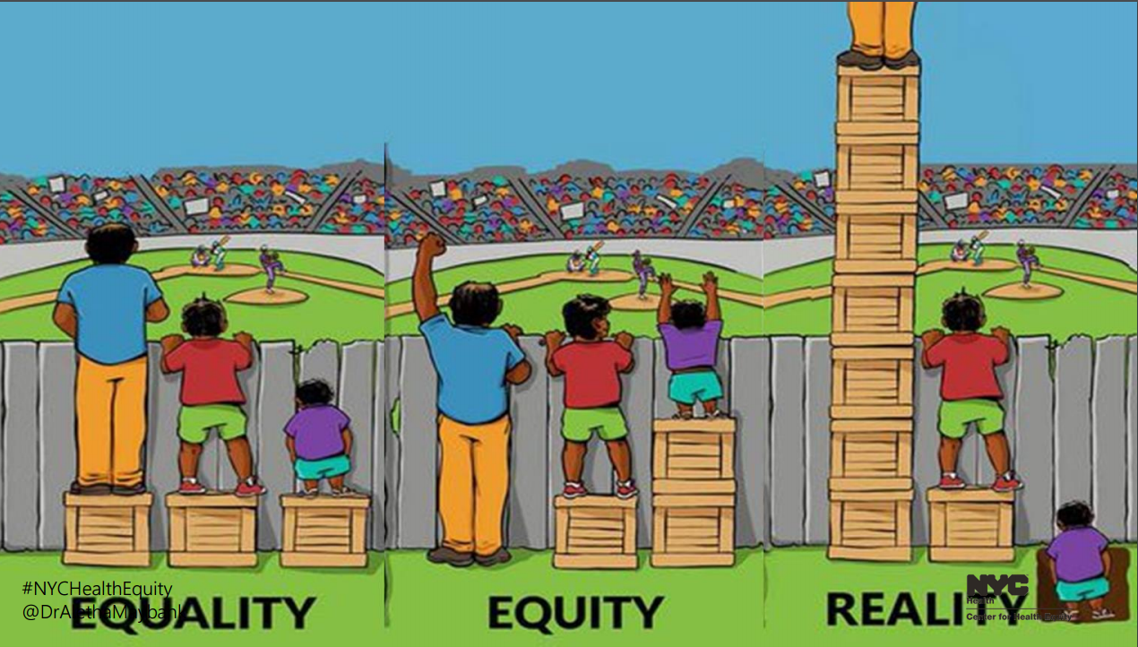
Equity
Systematic differences in health that are avoidable or remedial and unfair

Slide 24
Governance.. (and..for HiAP)
1. collaboration
2. citizen engagement
3. a mix of regulation and persuasion
4. independent agencies and expert bodies
5. adaptive policies, resilient structures and foresight
“Smart governance for health” – Kickbush,EURO 2014

Slide 25
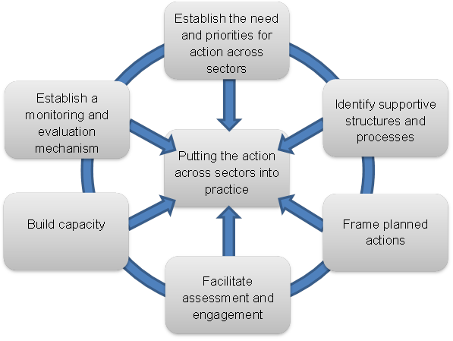
HiAP
systematically takes into account the health implications of decisions
seeks synergies
avoids harmful health impacts
Notes:
INTERSECTORAL ACTION- 2007
Intersectoral action is “a recognised relationship between part or parts of the health sector with part or parts of another sector which has been formed to take action on an issue to achieve health outcomes (or intermediate health outcomes) in a way that is more effective, efficient or sustainable than could be achieved by the health sector acting alone.” (WHO International Conference on Intersectoral Action for
Health 1997, p. 3).
http://www.who.int/social_determinants/media/iah_tor_case_studies.pdf
“intersectoral action for health” to refer to actions undertaken by sectors outside the health sector, possibly, but not necessarily, in collaboration with the health sector, on health or health equity outcomes or on the determinants of health or health equity
http://www.who.int/social_determinants/resources/health_equity_isa_2008_en.pdf?ua=1 p 3
Another earlier paper that has this type of thinking related to definitions of intersectoral action was one WHO and PHAC commissioned for the Commission on SDH – see: http://www.who.int/social_determinants/media/sdhe_csw_final_report.pdf?ua=1 and Norway intersectoral action report in this list : http://www.who.int/social_determinants/publications/isa/casestudies/en/
Norway's concept of the health sector's role in intersectoral action for health is normative - describing five responsibilities of the health sector:
• Describe social inequalities in health and make the link to their determinants
• Make visible the impact of other sector policies on health
• Support intersectoral collaboration and advocate for action in other sectors
• Strengthen preventive health service
• Ensure equity of health systems
The type of “leadership” role again is normative and based on assumed knowledge and mandate of health sector versus other sectors:
The Norwegian experience is that the extent to which the health sector itself can take the leading policy role depends on the issue at hand.
First there are issues where the health sector both have the knowledge about effective measures and control those means, like preventive services and measures to make health systems more equitable. Here the health sector has a natural leading role.
Second, there are issues where the health sector have knowledge about effective measures but do not control the arena or means for implementing the measures. Examples may be health promoting schools with physical activity, healthy school meals and, mental health programmes, smoking prevention programmes etc. In the development of policy in this field the health sector may take a lead role in promoting solutions but have to ensure close cooperation and ownership of the problem and solutions by the other sector.
Third, there are the determinants of health where the health sector have knowledge about the adverse health impacts of other sector policies, but where the health sector itself neither control the means for implementation nor has exact knowledge about how measures should be framed. Examples are inclusion to the labour market, reducing social inequalities in learning in schools etc. In the process of developing policies within these very up-stream policy areas the health sector may only play the role of a policy partner that on equal terms may inform the policy process with the health inequalities perspectives.

