Slide 1
AFRO Health in All Policies Training
Module 9 – HiAP implementation at local, regional and global levels

Slide 2
Learning objectives of the session
1. Discuss examples of HiAP implementation at the local, regional and/or global level
2. Identify some of the challenges of the implementation

Slide 3
Agenda
2. What type of ISA is required to reduce health inequities?
3. Political dimensions of ISA
4. Latin America and AFRO's key results
5. Lessons
1. Key results of HiAP research conducted globally by WHO, specially AFRO & PAHO components

Slide 4
Acknowledgements/credits
Nicole Valentine and all SDH Regional Focal Points of the WHO
Dr Orielle Solar, FLACSO (PAHO Study)
Davison Munodawafa and Peter Phori (AFRO study)
Rockefeller Foundation

Slide 5
Studies were performed by WHO in preparation of the 8th Global Conference on Health Promotion Helsinki 2013: Tcentral theme HiAP.

Slide 6
General Starting Points
“There is not just a single Intersectoral Action (ISA) type of work, but different degrees or intensities of ISA”
“The above correspond to the dominant public health approach in the respective health and other related sectors”.
“The degree of intensity of ISA needs to be aligned with the purpose of the persued public policy and its overarching societal context"
“The way ISA is organized, managed, and resourced influences its intensity and its outcomes”.
“There is synergy between social participation and ISA, especially to moving forward in achieving health equity”

Slide 7
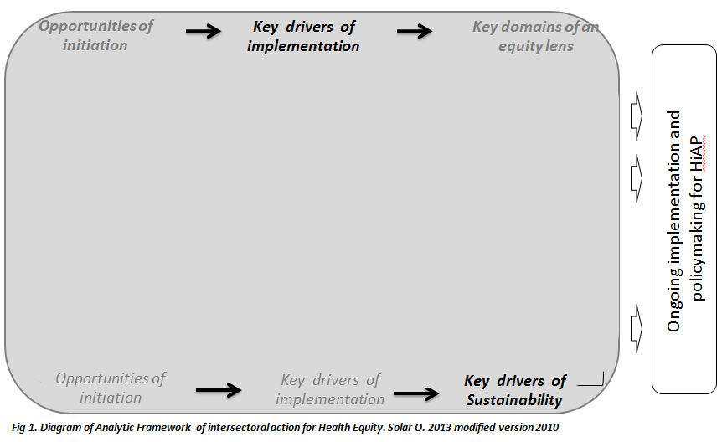
Conceptual Framework of ISA towards achieving health equity

Slide 8
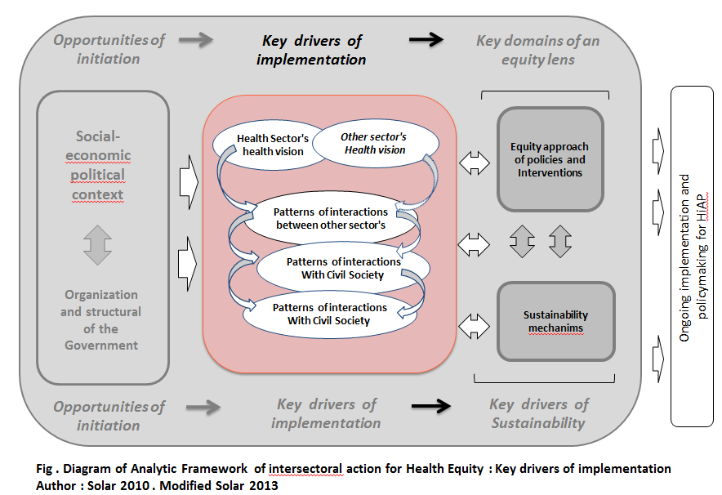
Conceptual Framework of ISA towards achieving health equity

Slide 9
HiAP action according to dominants health approaches
Health Promotion, Life Styles and Risk factors focus
SDH to reducing health inequities focus
Curative health and health service access focus

Slide 10
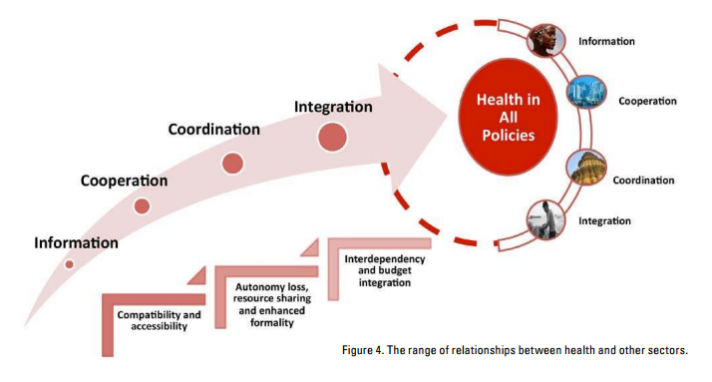
The range of relationships between health and other sectors
Source: Demonstrating a health in all policies analytic framework for learning from experiences, WHO 2013

Slide 11
Interelationship between models or types of ISA and their negotiation approaches
Models or types of ISA/HiAP
There is not an "ideal" and "unique" model it all depends on the objetive/mandate or focus of the work.
Comprehensive public policies (open to more collaboration) are usually more transformational ones vis a vis societal changes.
The same public policy could be different according to the administration level. A "coordination" policy at national level can present more "integration" fashion at the local level .
Underlying public policy mandate could explain the above.
Negotiation approaches of sectors and actors
Could evolve over time.

Slide 12
Political and technical basis of HiAP:
Political
Systematic efforts to modify public policies logic, especially the social ones. Implies POWER shifts.
Technical
Technical efforts to modify government structures for making them more flexible
From discrete, circunscribed focus to a proactive one based on citizenship and rights to improve quality of life
Aiming at transforrming public & social services through social and political action
Optimizing government structures and capacities
Searching for innovative solutions to overcome sectoral (silos) structures
Allowing sharing of different sectors experineces, practices, resouces.

Slide 13
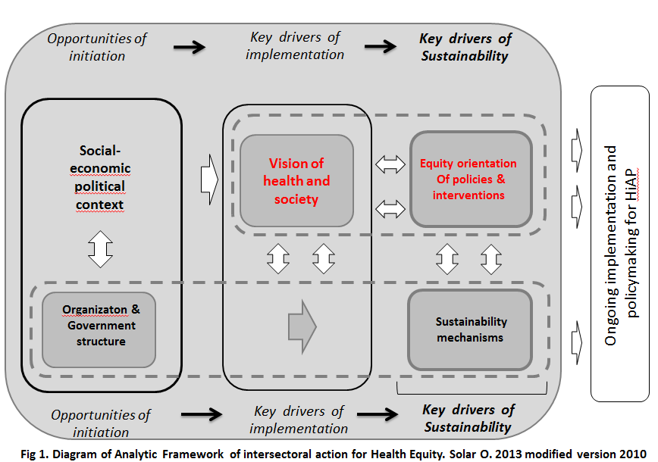

Slide 14
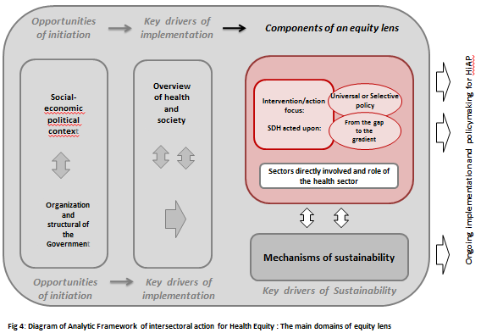
Conceptual Framework of ISA/HiAP for achieving health equity

Slide 15
Do all HiAP/ISA reduce health inequities?
Aim and design of policy intervention, based on SDH and equity analysis is, therefore, essential
The more structural the SDH are to be policy targeted, the stronger the health equity impact. The converse is also valid.
Equity lens/approach to be always used
No, only policies systematically aiming and acting upon SDH underlying health equity outcomes are to be effective in reducing health inequities. Therefore our focus should not be any ISA irrespective of originating it within our outside the health sector.
Entry points, policy objective to be clearly defined

Slide 16
“ Inequality reproduces itself because the political system reflects different access of the influences upon public decisions and because the system responds differently to groups with less resources and less influencing capacity"
"Democratization of power is an indispensable condition for human development"
"Achieving human development equality implies power redistribution as well as an improved quality of political representation”
Source: Programa de las Naciones Unidas para el Desarrollo Informe Regional sobre Desarrollo Humano para América Latina y el Caribe 2010: Actuar sobre el futuro: romper la transmisión intergeneracional de la desigualdad .

Slide 17
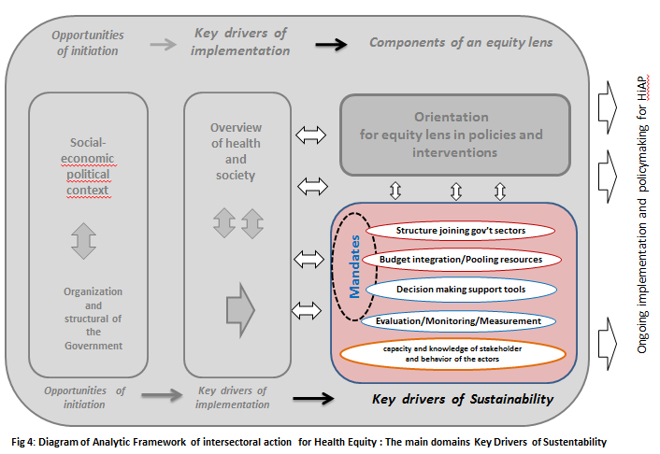
Diagram of Analytic Framework of intersectoral action for Health Equity : The main domains Key Drivers of Sustainability

Slide 18
Some lessons from the Americas HiAP experiences
1. ISA practice is quite heterogeneous regarding the role of MoH, the dominant health approach and the degree of intersectorality
2. Two ISA visions are seen vis a vis its comprehensiveness:
Coordination of services, expanding access to them from different sector/providers
Addressing actual SDH underlying health inequities as a matter of human rights (polítical, social, economic and cultural) and with social transformation/redistribution

Slide 19
Some lessons from the Americas HiAP experiences
3. Dos spaces of HiAP action coexist in the region:
3.1.- Linked to Social Security Policies and Programmes with two visions:
3.1.1.The traditional one which although respecting the Rights approach , focusses on poverty and social vulnerability.
3.1.2.An emerging and transformational one which starts from a Rights approach, social justice and equity and further develops universality and non discrimination.
3.2.- Local Government social development initiatives, many of them circunscribed and limited on servide provision and healthy life styles.
Source: Solar & Bernales 2014

Slide 20
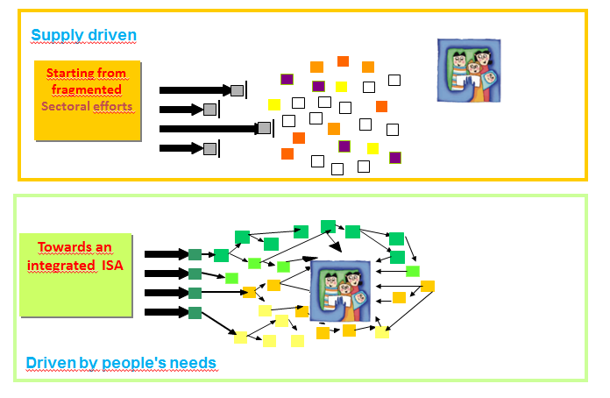
However it is not just a matter of coordinating services to reach the people Or to provide services outside traditional health spaces what really makes the difference
Source: Solar & Bernales 2014

Slide 21
Facilitating factors
FOR STARTING HIAP
POWER: Political will of Central Government
FOR SUSTAINING IT
Political will at different levels
Political will of local government including the will of transfering resources for a decentralized implementation.
A degree of autonomy in the formulation & implementation of local startegies.
KNOWLEDGE: Experience, information, research capacity and linkages with academic centers.
Government support networks.
Support from International Organizations
Institutional capacity (combination of financial resources in the short term and prioperly trained staffing resources in the long run)
Establishment of coordination structures.
Communication and sensitization of local teams.
Social Participation & interest in the community to sustain the strategy
Generating networks of technical support
Source: Solar & Bernales 2014

Slide 22
ISA/HiAP is a COMPLEX intervention
Meaning
Multiple components (interventions )
Several levels of intervention
High need of coordination between several systems
Heterogeneity in needs and mechanisms
Complex ways / complex contexts

Slide 23
Some lessons from the SS African HiAP experiences

Slide 24
Key highlights from literature review:
Few large scale HiAP documented for addressing explicitly & systematically SDH/HI
However important experiences in programmes:
HIV/AIDS (Rights approach, social participation)
Helminthic control (agriculture, water sources & urban development)
Mental health and Nutrition
Poverty reduction/SWAPS (microcredits& health)
2
3
4
5
6
1

Slide 25
Key highlights from literature review:
Social Participation seen as key success factor, including role of NGOs, FBOs with Govts.; BUT
HiAP complexity requires sustained capacities
ISA facilitated by coordination mechanisms: tobacco, road safety, environment

Slide 26
Key recommendations
Governance to be enhanced by MoH inc. creation of SDH/HiAP units and ISA coordination mechanims
Use National Dev. Plans/PRSPs to include SDH/HiAP
Use Ouagadougou's PHC & existing frameworks
HiAP& SDH training in other sectors: a must
Use HIA and develop SDH&HiAP M&E tools to measure progress
Enable CSO participation
WHO/AFRO needs to start mainstreaming its own programmes on SDH/HI and provide TC to countries

Slide 27
Thank you for your attention!
Q&A?
villare@who.int

