Slide 1
MODULE 8: NEGOTIATING FOR HEALTH
Learning Objectives:
At the end of the session the participant will be able to:
List the major stages of negotiation process
Describe several approaches to policy negotiation process
Explain the characteristics of cooperative or value added negotiation process
Apply knowledge of negotiation to a role play

Slide 2
WHY NEGOTIATION IS NECESSARY:
Intersectoral action or a whole government approach refers to directed action involving two or more sectors within government. It may also be different levels of government – central regional or local
A whole society approach in contrast refers to coordinated efforts to improve health by multiple stake holders within and outside government, these may also be from several sectors
It cannot be taken for granted that different sectors and organisations bring the same priorities, interest and attitudes to the table. This is so even for different parts of the health sector.
This means negotiations across to achieve national policy coherence through a whole government. It also means negotiating through the health sector

Slide 3
Policy Negotiation definition
Negotiation may defined as a process whereby two or more parties seek and agreement to establish what each shall give or take, or perform and receive in a transaction between them. Alternatively it is an act of discussing an issue between two or more parties with competing interests with the aim to identify acceptable trade-offs for coming to an agreement

Slide 4
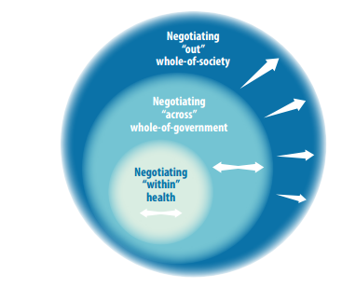
The scope of negotiating

Slide 5
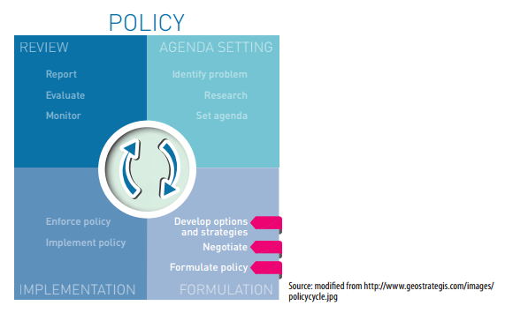
The place of negotiation in the policy cycle

Slide 6
Stages of negotiation process:
1 Understanding the problem raised in the agenda - negotiations occur after a problem has been identified, determine whether negotiations are necessary or possible, negotiations process and successful outcome are closely linked to windows of opportunity
2 Identify stake holders and their interests – once the problem is well understood, one has to identify who may lose or gain in the negotiations, are there powerful interests;
A stake holder analysis is used for this purpose.
3 Consult with stakeholders – Once the stakeholders and their interests have been identified it is important to plan and organise an effective consultation ... determine position on each of the issues to be negotiated.
Consultation with stakeholders especially those that are supportive or neural is important for building coalitions

Slide 7
4. Establish negotiation agenda – Before negotiations begin an agenda defining the issues open for discussion is usually agreed upon by the parties.
Designate representative negotiator for the participating, decide upon a format for the process including location, timing and resources for facilitation
5 Develop positions and strategies - negotiating positions and strategies may be formulated through various steps (establishing outcomes and priorities for oneself, estimating outcomes and priorities for other parties, Identifying and assessing major trade-offs and constructing and evaluating as many possible outcome and consequences
5 Negotiate with stake holders –
7 Assess proposed agreement -

Slide 8
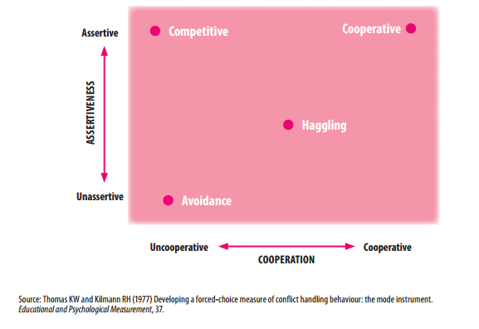
The four main approaches to policy negotiation

Slide 9
Approaches to negotiations
Competitive – maximize ones gain; zero sum game
Haggling - making trade-offs or concessions, behave in guarded and manipulative manner
Avoidance – Aim to defer or postpone decisions on difficult or unfavourable issues
Cooperative – Seeks mutual gains for all parties by joint problem solving, searches for ways to make the ‘pie bigger’ it assumes a ‘win-win’ solution

Slide 10
Negotiating technique for HiAP Approach
Negotiations for HiAP favour the cooperative approach. The tactics for cooperative approach for HiAP might also include:
study problem in detail and analyse stake holders thoroughly
- Sate objectives or interests rather than positions
- Listen carefully to what is said, what is not said and watch the body language
- Keep proposals as simple as possible
- Articulate ideas and arguments concisely
- Assume the best of other stakeholders
.
.
.

Slide 11
Cooperative and ethical negotiating
Noting that communication styles are influence by social and cultural norms it is important to note common difference which relate to the backgrounds such as class, gender religion, profession and nationality. Consider:
-Diplomacy and directness
-Literal and coded language
-Reserve and emotions

Slide 12
Group Activity (60 minutes):
Two possible scenarios which require negotiations:
Regional preparedness for Ebola Outbreak
A National Irrigation scheme that is going to involve moving and resettling 1 million people.

Slide 13
Discussion and debriefing ( 5-10 minutes)

