Slide 1
Health in All Policies
7. The Role of Non-Governmental Stakeholders
Carmel Williams, Manager
Strategic Partnerships
Public Health Services
SA Health

Slide 2
Wicked Problems
Wicked problems are socially defined
So getting the “whole system in the room” to enable people to learn from one another is both useful and necessary.
Social learning is more likely to be successful if it evolves as stakeholders meet, interact, and inform one another’s actions.

Slide 3
The 21st century approach to governance for health
Global Commitments
Overall societal goals
New strategic relationships
Interconnected forms of government
Citizens
voice and participation
SOCIAL DETERMINANTS EQUITY SUSTAINABILITY

Slide 4
Stakeholders
Regardless of reform, revitalization and a technological revolution, the reality is that in many developing countries, at least in the foreseeable future, government alone will be unable to develop sufficient capacity to offer basic services to citizens.
Yet the experience of the past decades vividly demonstrates that market forces alone will not produce enough public value either. (WEF)

Slide 5
Stakeholders: Who are they?
Any individual, group or business with a vested interest (a stake) in the success of an organization
A stakeholder is typically concerned with an organization delivering intended results and meeting its financial objectives.
A stakeholder can be one of two types
internal (from within an organization) or
external (outside of an organization).

Slide 6
A multi-stakeholder model
is an organizational framework or structure which adopts the multi-stakeholder process of governance or policy making, which aims to bring together the primary stakeholders such as businesses, civil society, governments, research institutions and non-government organizations to cooperate and participate in the dialogue, decision making and implementation of solutions to common problems or goals.

Slide 7
Stakeholder analysis
A process of systematically gathering and analysing qualitative information to determine whose interest should be taken into account when developing ………..Health in All Polices

Slide 8
Action Space
Contextual Environment
Transactional environment
Policy space
Organisationalspace

Slide 9
Identifying stakeholders
Define the range of categories you need to involve
Identify key stakeholders with in the categories

Slide 10
Balancing Pros and cons
Two central elements to consider
efficiency versus legitimacy.
A comprehensive multi-stakeholder process can give a high legitimacy to an initiative, but it also entails significant transaction costs.
The more stakeholders at the table, the more difficult and time-consuming the process can be to come to a common understanding and position.

Slide 11
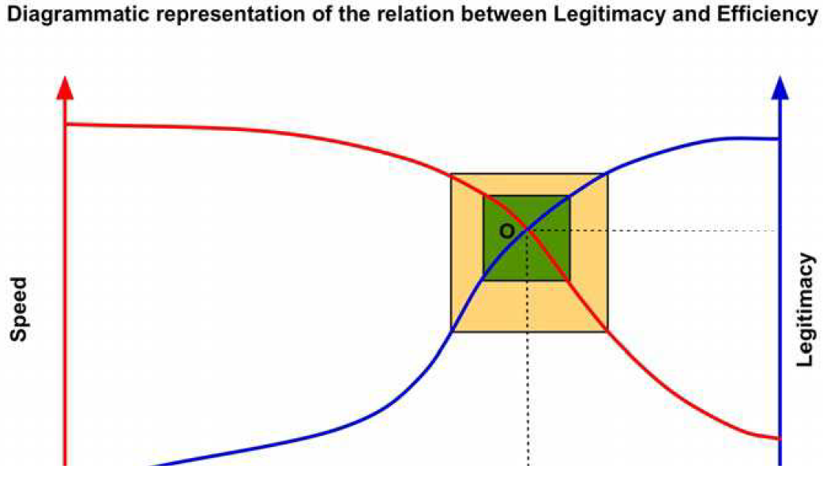
Legitimacy and Efficiency

Slide 12
Deciding on who to involve
Some points:
Knowledge of the issue/policy
Interests related to the policy
Position for or against the policy
Potential alliances with other stakeholders
Ability to affect the policy process through power or leadership (formal/informal)

Slide 13
Influence
A stakeholder refers to an individual, group or organization that has a direct or indirect interest or stake in a particular organization;
that is, a given action has the ability to influence the organization's actions, decisions and policies to achieve results

Slide 14
Points to consider
Selecting participation
Who is in and who is out
Large versus small……
Balancing membership and Leadership
Civil society? Business?
Inclusiveness x manageability
Roles and function. Eg Vice chair......

Slide 15
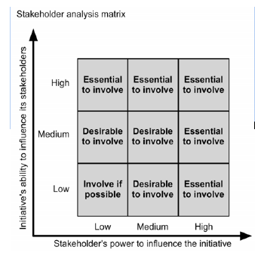
Stakeholder analysis

