Slide 1




Health in All Policies (HiAP) Workshop
Paramaribo, Suriname
5-6 May 2015
Ballroom TORARICA

Slide 2



The Role of Government in HiAP/Whole of Government Approaches
Facilitator: Dr Emily Henderson
e.j.henderson@durham.ac.uk

Slide 3
Session structure
Review of learning objectives
Part 1: Conditions that promote or hinder intersectoral collaboration
  Lecture on the role of government and the HiAP approach
  Group reflections on conditions that promote or hinder intersectoral collaboration
Part 2: Structures and mechanisms for intersectoral collaboration
  Lecture on structures and mechanisms for intersectoral collaboration
  Guest lecture from Mrs Marianne Flach, UNICEF Representative, Guyana and Suriname
  Questions and feedback
  Tea/coffee break
  Group activity on structures and mechanisms for intersectoral collaboration
Questions and feedback
Comfort break 5 mins

Slide 4
Learning objectives
• Describe the role of government in the HiAP approach
• Recognize a range of terms that refer to intersectoral action
• Explain some of the barriers to closer intersectoral collaboration
• Describe conditions conducive to the HiAP approach
• List and appraise different structures and mechanisms for intersectoral action
• Discuss examples of HiAP in practice

Slide 5
The Role of Government in HiAP/Whole of Government Approaches
Part 1: Conditions that promote or hinder intersectoral collaboration

Slide 6
Lecture:
The role of government and the HiAP approach

Slide 7
Focus of session
Focus on implementation of HiAP from perspective of government
Policy formulation and implementation cycle

Slide 8
Responsibility of government
Historically, the principle of government responsibility for the health of its population has been central to public health.
The redistributive powers of government have also been critical for redressing health inequalities.
The government’s role in health is therefore a matter of principle and pragmatism.

Slide 9
Roles of government
Roles of governments in the HiAP approach include but not limited to:
• Commissioning research;
• Engaging stakeholders within and beyond government;
• Formulating and implementing intersectoral policies; and
• Evaluating their impact.

Slide 10
Terminology
Intersectoral action: coordinated efforts of two or more sectors within government to improve health outcomes.
Intergovernmental: horizontal and vertical linkages between levels of government within a country.
whole-of-society approach: coordinated efforts to improve health by multiple stakeholders within and outside government that may also be from several sectors.

Slide 11
Group activity:
Conditions that promote or hinder intersectoral collaboration
Handout ‘Alcohol control policy and practice status in Suriname’ Ministry of Health

Slide 12
Hinder
Some notable barriers to successful intersectoral collaboration within government are likely to include:
  Distracted or unstable leadership;
  Conflicting personalities;
  Fragmented government functions;
  Sub-national geographical and government jurisdiction divisions;
  Sectors appearing to have competing interests;
  Limited or misused resources (staff, funding, etc.); and
  Restricted policy space.

Slide 13
Promote
Intersectoral collaboration is often most effective under the following conditions:
  Government supports and encourages intersectoral action;
  Sectors have shared interests or both/all benefit from cooperation;
  Issue has high political importance and requires urgent addressing;
  Proposed policy has public support;
  Strong, effective leaders in the bureaucracy (policy champions/entrepreneurs);
  Intersectoral action is well planned with clear objectives, roles and responsibilities;
  Laws exist or are planned to support the proposed policy;
  Sufficient resources are available; and
  There are plans to monitor and sustain outcomes.

Slide 14
Group activity:
Conditions that promote or hinder intersectoral collaboration
In your small groups, come up with a list of conditions or situations that promote or hinder working across sectors and levels of government as relating to alcohol policy.
Elect someone in each group to share the group’s ideas.
**Reminder of ground rules**

Slide 15
The Role of Government in HiAP/Whole of Government Approaches
Part 2: Structures and mechanisms for intersectoral collaboration

Slide 16
Lecture:
Structures and mechanisms for intersectoral collaboration

Slide 17
Policy scenarios that favour a HiAP approach
HiAP has been implemented differently in different contexts reflecting local social and political cultures as well as government structures.
Nevertheless, it is possible to make some generalizations about the structures and mechanisms commonly used for intersectoral action.

Slide 18
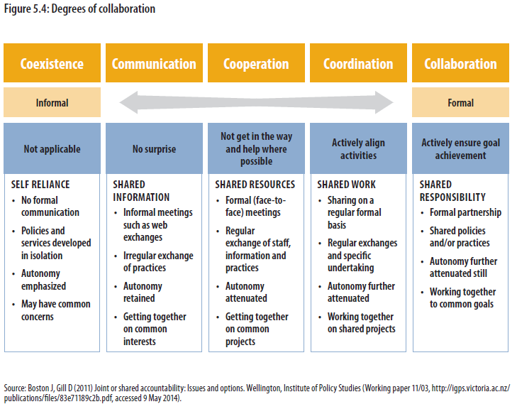

Slide 19
Overview of structures and mechanisms and HiAP
Cabinet committees and secretariats
Parliamentary committees
3. Interdepartmental committees and units
4. Mega-ministries and merges
5. Joint budgeting
6. Intersectoral policy-making procedures
7. Non-government stakeholder engagement
Notes:
We will think of these in relation to HiAP

Slide 20
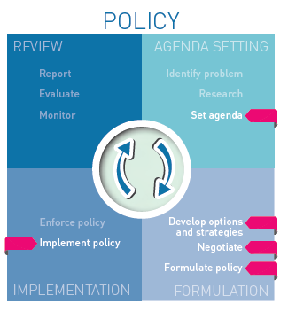
1. Cabinet committees and secretariats
Cabinet committees allow ministers to engage with policy issues of cross-departmental significance
offer a mechanism for ministers to work with outside interests.
one of the highest decision-making bodies, they do have the potential to promote and implement a HiAP approach

Slide 21
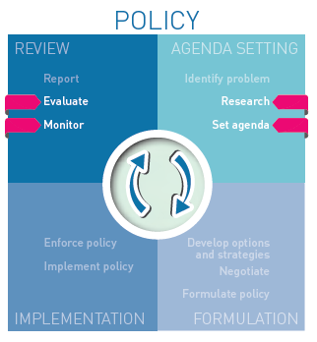
2. Parliamentary committees
can play a role in agenda setting, promoting wider political ownership of issues and reviewing policy decisions.
can enhance the potential influence
can support the longevity of an issue as a political priority despite a change of government.
likely to have the most notable influence on the agenda setting and policy review stages of the policy cycle.

Slide 22
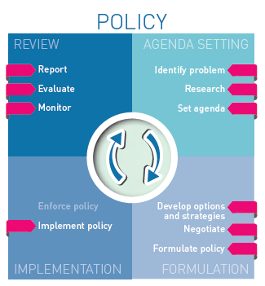
3. Interdepartmental committees and units
two of the most common mechanisms for intersectoral collaboration.
operate at the bureaucratic level and aim to re-orient ministries around a shared priority.
provide a forum for problem solving and debate.
can potentially influence the entire policy cycle.

Slide 23
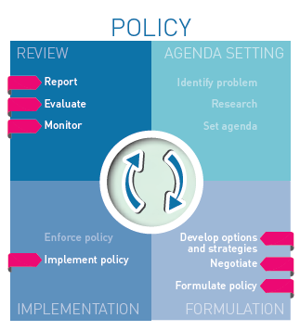
4. Mega-ministries and merges
grouping of several large government functions such as health, transport, labour, social security and education – are rare.
It is more common to merge smaller units or portfolios such as sport or culture with a larger ministry.
The costs of large reorganizations tend to be high and the benefits are contested.

Slide 24
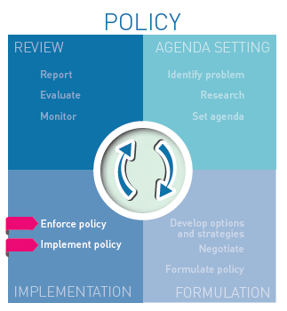
5. Joint budgeting
can range
fully integrated budgets for the provision of a service or policy objective
loose agreements between sectors to align resources for common goals, while maintaining separate accountability regarding the use of funds.
a promising way to promote and implement HiAP and has the potential to mainly influence the implementation stage of the policy cycle.

Slide 25
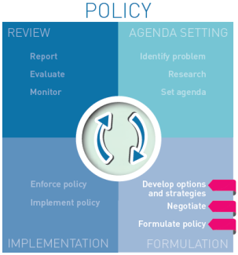
6. Intersectoral policy-making procedures
includes procedures such as impact assessments and policy proposals circulating through multiple ministries for comment prior to review by the responsible minister.
These procedures differ significantly between countries and can be mandatory or voluntary.
Such mechanisms tend to influence the policy formation stage and represent a relatively low but regular level of intersectoral action.

Slide 26
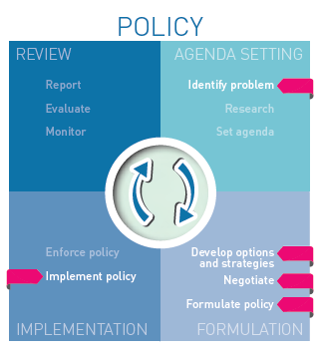
7. Non-government stakeholder engagement
Government engagement with non-government stakeholders is a crucial component of the HiAP approach
While non-government stakeholders can play a role at all stages of the policy cycle, stakeholder engagement as a government mechanism is most common during the agenda setting, policy formation and policy implementation stages.

Slide 27
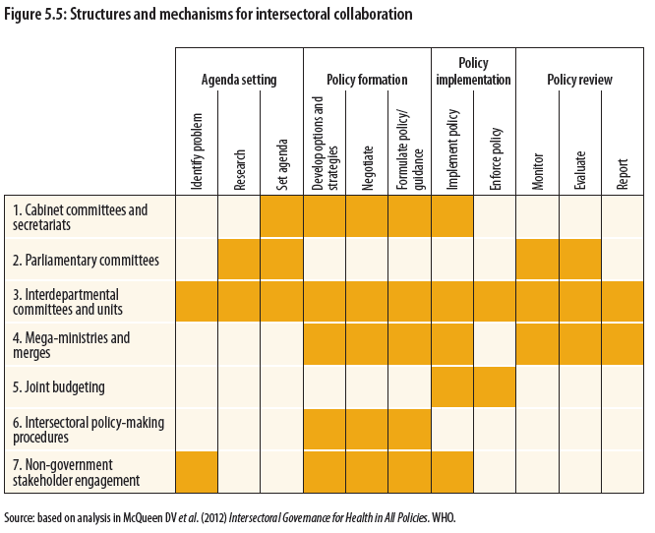

Slide 28
Guest lecture:
Mrs Marianne Flach
UNICEF Representative
Guyana and Suriname
“UNDAF/Suriname within the framework of the social determinants of health using HiAP as a tool”

Slide 29
Questions and feedback

Slide 30
Tea/coffee break

Slide 31
The Role of Government in HiAP/Whole of Government Approaches
Part 2: Structures and mechanisms for intersectoral collaboration
CONTINUED

Slide 32
Group activity: structures and mechanisms for intersectoral collaboration
Handout ‘Alcohol control policy and practice status in Suriname’ Ministry of Health
Refer to and become familiar with pages 5-7, last section ‘Roadmap for Suriname’
What are its strengths and limitations?

Slide 33
Group activity: structures and mechanisms for intersectoral collaboration
Open to the group: what structures and mechanisms or other formats can we use to carry forward this agenda?
Any other areas that need addressing to carry forward this agenda?

Slide 34
Questions and feedback

Slide 35
Comfort break
•Please feel free to stretch or use the facilities for:
5 minutes

