Slide 1
Health in All Policies
5b. Case study of HiAP intersectoral action: City of Marion, Adelaide.
Robert Quigley,
Director, Quigley & Watts Ltd

Slide 2
1. Establish the need and priorities for HiAP
The groundwork and relationships for intersectoral action had been laid for quite some time, including:
SA Strategic Plan
SA Government adopts HiAP approach after Illona Kickbusch ‘2007 Thinker in Residence’
HiAP unit at SA Health
30 Year Plan for Adelaide for ‘higher density areas of good practice’
Notes:
No work is ever in a vacuum, and neither was this. HiAP especially is not, and HiAP specifically attempts to build a strong underpinning governance and framework. Here are a few (not all) key aspects…
‘30 year plan for Adelaide’ developed by government of South Australia – with transit oriented developments a key way to move from fringe-development to infill.
“To create more walkable neighbourhoods, develop higher density areas of good practice, sustainable urban design, and create a network of open space precincts for people to use.”
What is a Development Plan?
Across South Australia, each Council is required to maintain a Development Plan - a legally binding document that sets out the guidelines for development in the Council area. This is the primary document that contains the City's planning vision and policies.
What is a Development Plan Amendments (DPA)?
A DPA enables Council to provide enough land for future use, respond to changing development and population patterns and reflect State Government objectives for future development.
It consists of an explanation of the proposed changes to the existing Development Plan as well as the research that underpins these proposed changes. The process associated with each DPA includes a number of checks and balances, including a public consultation period; an informal information session; an official, formal public hearing; and consultation with other government agencies.

Slide 3
2. Frame planned action
Collaborative development of ‘Healthy Transit Oriented Developments (TOD) Principles’ by the:
Department of Health
Department of Planning and Local Government
Department for Transport, Energy and Infrastructure
Land Management Corporation.
Notes:
Falling out of the framework was a number of planned actions, just one of which was a multi agency programme of work around TODs. TODs were highlighted as important in the 30 year plan, and of course had been highlighted by Illona Kickbusch as a key area worthy of collaboration due to the number of determinants of health affected.

Slide 4
3. Identify supportive structures and processes
An upcoming (mandatory) Development Plan Amendment for the Castle Plaza site, overseen by Marion City Council was highlighted as a space to work together to try out the Healthy Principles
Planning for this level of the collaboration included:
who was the lead agency (Marion City Council)
support from whom (four government departments and financier)
resources needed to do the work (added in a contractor).
Notes:
Coming down another level – SA Health and other partners began looking for TODs to apply the principles that’d been developed, but tying into existing structures and processes…..

Slide 5
4. Facilitate assessment and engagement
The health impacts were assessed for the Castle Plaza Development using an innovative health and wellbeing assessment.
The assessment was attached to the Development Plan Amendment process.
Key stakeholders were engaged in the development of the assessment. They scored their own plan against the assessment tool, and developed their own recommendations
Process is important – everybody bought into the results.

Slide 6
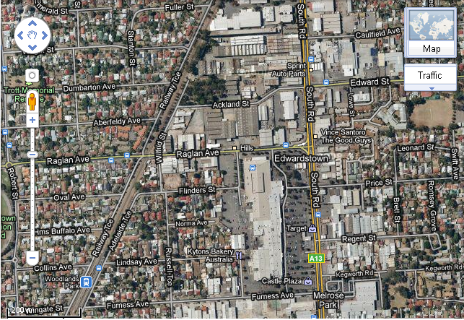

Slide 7
The determinants covered were
Employment and workplace access
Healthy environment
Accessible public transport
Climate change
Access to healthy food
Physical activity
Sustainability and vibrancy
Mental health and wellbeing
Social inclusion and cohesion
Sense of place
Biodiversity

Slide 9
Results
48 changes suggested overall
All changes have been made to the final DPA.
Notes:
e.g. quality of residential development, not just density.

Slide 10
Support factors
At the assessment-level, four supporting aspects were required:
A set of principles against which the proposal could be assessed, in this case the Principles for a Healthy Transit-Oriented Development (already available).
A thorough understanding about the proposal being assessed, in this case the Castle Plaza Development Plan Amendment (provided by the participants).
A thorough understanding of the decision-making process, to tie into, and so that recommendations for change could be useful (provided by the participants).
Excellent working relationships between the key stakeholders.

Slide 11
Questions for you:
Which determinants of health might be able to be covered in such an assessment?
Who might be involved in the assessment process – which stakeholders?

