Slide 1

Public Health Summer School
4. Understanding the Policy Process
Carmel Williams, Manager
Strategic Partnerships
Public Health Services
SA Health

Slide 2

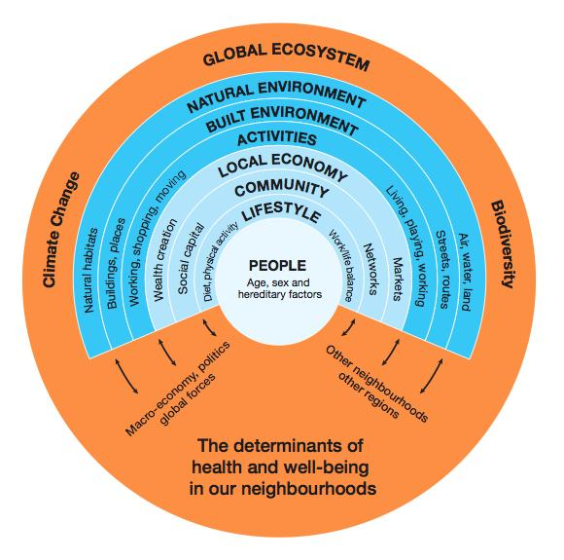
Public Policy
Public policy making
  is about problem solving
  Public policy is shaped by institutional, political, economic and other contexts
  Policy is interpreted by public and private actors who have different interpretations of the problem, solutions and their own motivations
Notes:
Public Policy is made by governments
influences how a societies resources are shared across the population.
Sets the agenda and accountability for the delivery of government services and programs
Guides decision making and budget allocations
Can take different forms
Legislation, regulation, guidelines, directives, strategic, technical and operational policy
Ultimately, public policy is what governments choose to do or not do
Deciding what gets onto political agenda or not

Slide 3
Public Policy
Is how societies figure out how to organise and regulate themselves
  Sets the agenda and accountability for the delivery of government services and programs
  Guides decision making and budget allocations
  Reflects priorities of government – ideally based on the societal views and needs
The public is source of political authority- authority for a government to act on the public’s behalf
It is inherently political

Slide 4
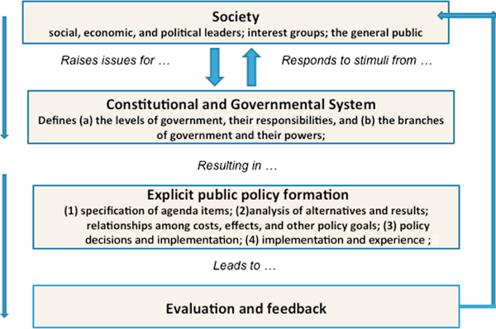
Setting the policy agenda

Slide 5
What is public policy
Public Policy is made by governments
Takes different forms
  Legislation, regulation, guidelines, directives, strategic, technical and operational policy
Ultimately, public policy is what governments choose to do or not do
  Deciding what get onto political sphere
  not placing an issue on policy agenda counts too
  How the problem/issue is framed and who frames the issue is important
  whose voice is heard

Slide 6
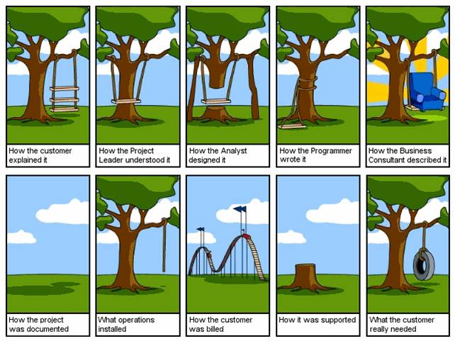
Whose voice is heard?

Slide 7
Why is policy making an important part of HiAP?
Public policy- influences how a societies resources are shared across the population.
Who gets access to what, when and how
- taxation, education, transport, healthcare, land use
These can be considered the social determinants of health and through public policy the distribution of these resources can entrench or improve inequality.
Key goal of HiAP is to improve equity through increasing ensuring the fair distribution of the Social Determinants of Health across population and within populations.

Slide 8
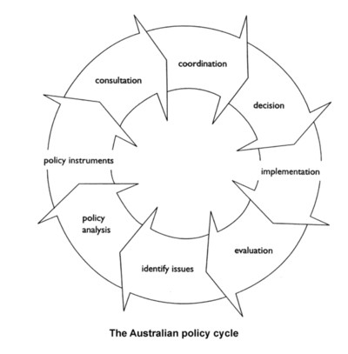

Slide 9
Policy making cycle
How evidence is used
Sometimes evidence not used at all in policy making
Mitigating, recognising, balancing
Therefore the use of evidence and the way you frame it –in defining the problem and the solution is critically important

Slide 10
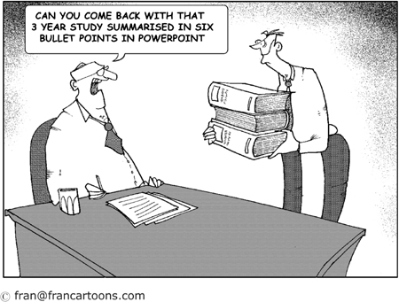

Slide 12
Joined up policy making

Slide 13
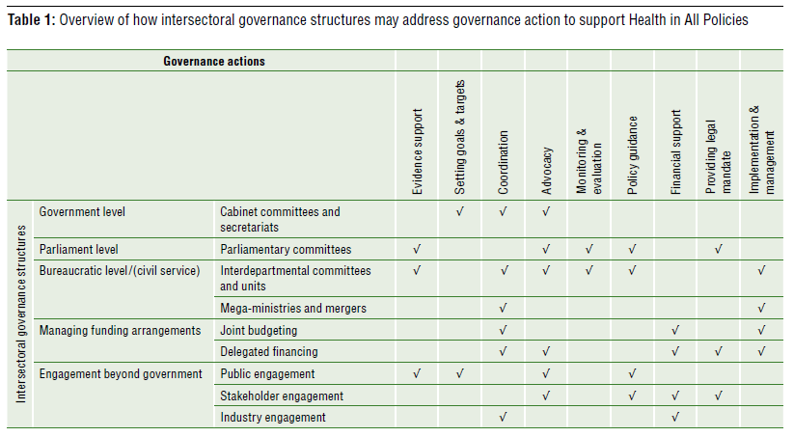
Intersectoral governance structures

Slide 14

A Health Lens Analysis across the Seven Strategic Priorities

Slide 15
Health in All Policies
PURPOSE
To provide information to the Cabinet Task Force and Senior Officers Groups about the key health and wellbeing considerations for each priority area and
identify where health and wellbeing adds value to the priority actions of the task group, recognising that maximising population health also supports the sustainability of initiatives over the longer term.
Notes:
contributed to identifying opportunities for joined up government and cross-agency initiatives within and across the SSP
­where appropriate, highlighted the alignment between existing HiAP work and the SSP, strengthening cross sector partnerships and connections
­where possible, considerations to where health and wellbeing adds value to the short and medium term priority actions of the task group were also identified
­identified several interlinked cross cutting themes which emerged across the strategic priority areas, highlighting the need for a continued focus on our social and cultural infrastructure. The HLA also enabled more considered attention on those most vulnerable in our communities and assisted in realising strategies to address health inequities in all seven priority areas.
­identified small number of new policy priorities for HiAP action during 2013-2014

Slide 16
An Affordable Place to Live
Engage: Met with Senior Officers Group, later nominated as SA Health representative on the SOG
Gather Evidence: 2 papers developed
  An Affordable Place To Live And Improving Our Health And Wellbeing
  The Cost of Ill Health
Increasing our social and community finance infrastructure
Connected and resilient communities
Improved Health and Wellbeing
An affordable place to live
An affordable place to live, work, play and for caring about our communities and each other
Ensuring social infrastructure wrapped around income and employment opportunities
Increased community social capital and self esteem
Providing financial security to be able to enjoy, connect and participate

Slide 17
An Affordable Place to Live
Generate:
Support and advice on activities
Contribution to SA Affordable Living Strategy (under development)
Navigate: Strategy and other work through SA Health Ex.
Evaluate: In the context of the broader project – HLA over Seven Cabinet Priorities

