Slide 1
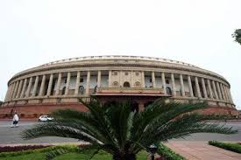
Policy making Process: Module 4
Dr Sanjiv KumaR, Executive Director, National Health Systems Resource Centre (NHSRC), National Health Mission, Ministry of Health & Family Welfare, Government of India, New Delhi
WHO AFRO Regional Workshop on Implementation of Health in All Policies,
01-04 Dec 2015, WITS University, Johannesberg, South Africa.

Slide 2
Learning Objectives
Define Policy and describe the stages of policy making
Recognize the complex and political nature of policy making
Identify the “windows of opportunity” for policy change
Define & Identify the policy champions
Frame a complex health issue and identify its policy changes and opportunities
Introduction to National Health Systems Resource Centre, Min of Health & FW, Govt of India

Slide 3
NHSRC Presentation
NHSRC Objectives & Structure
Health Systems Framework: WHO
Health Systems Framework: NHSRC
Linkages with Community
NHSRC main activities

Slide 4
NHSRC Broad Objectives
1
Respond to technical assistance needs of MOHFW and States
2
Inputs to Policy, Strategy & Plan Development
3
Coordinate technical assistance to MoHFW and States
NHSRC works closely with MOHFW

Slide 5
NHSRC: A SYSTEMS APPROACH TEN DIVISIONS
Admin, HR & Accounts
Public Health Planning
Community Processes
Human Resources for Health
PH Administration
Healthcare Financing
Healthcare Technologies
Quality Improvement
Health Informatics
Regional Resource Centre-North East (8 states)

Slide 6
NHSRC Health System Framework
Community
Leadership & Governance
Healthcare Financing
Essential medical products and
technologies
Human Resources for Health
Health Information Systems
Service Delivery

Slide 7
Why understand Policy Making Process?
An approach to public policies across sectors that systematically takes into account the health implications of decisions, seeks synergies, and avoids harmful health impacts in order to improve population health and health equity.
Helsinki Statement on Health in All Policies 2013

Slide 8
What is policy?
A principle or a plan to guide decisions, actions & outcome, Laws, documents, procedures, guiding principles, statements of intent or working framework
A way of working, a vision, a programme of action, duties responsibility, accountability or an unwritten cultural or ethical code
Public policy refers to policy of government
Developed through negotiation, repeated practice, decree/order or convention
Often a discrepancy between policy intent and policy practice

Slide 9
Four Stages of Policy Cycle

Slide 10
Types of Health Problems
Type of Problem | Cause and effect | Response
Simple | predictable | appropriate response to definable situations can be codified in standard Operating Procedures which then drive interventions Example Acute Gastroenteritis in an individual
Complicated | unclear at the time, but can be inferred using data, analysis and expert knowledge | Once understood, rules for intervention can be defined and followed. Example: Salmonella Outbreak in an institution
Complex | may be identifiable in retrospect. Interventions go beyond one sector | unlikely to conform with prior expectations how things work. Interventions must be flexible as outcomes may be unforeseen. Example Arsenic poisoning varied symptoms
Chaotic | may be speculated in retrospect, but cannot be validated | Interventions must be approached as a learning exercise: act, sense, then revise if necessary Example: Nodding Syndrome (Since 1990 in Uganda, Sudan & Tanzania) https://www.youtube.com/watch?v=fsrV395S-2I

Slide 11
Need for HiAP
Fact:
Sectors outside health account for 80-90% of health.
An example: 1 in 8 deaths due to air pollution
Action in following sectors
Household Energy
Energy
Transport
Urban Planning
Housing
Waste Management
Industry
International agencies
Local Self Government NGOs, Civil Society
Min of Health

Slide 12
What is “Window of Opportunity”

Slide 13
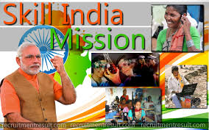
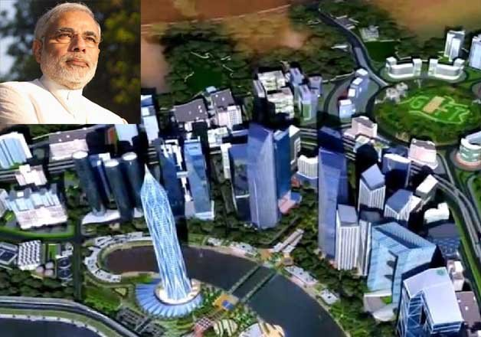
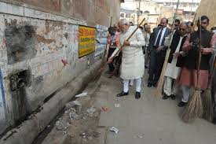
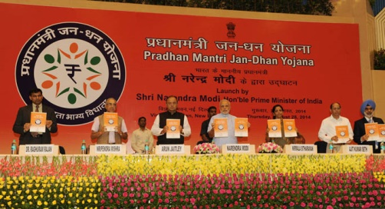
Windows of Opportunity: Examples from India
National Health Policy 2015 Draft
Public Health Act
Four Task Forces on National Health Assurance Mission

Slide 14
Policy Champions
Person or team willing and able to lead and manage the policy process.
Proactively promote policy reforms, publicly support the policies and foster the support of others.
Frame discussion of the issue, build consensus, attract resources, and seize and create opportunities to move the reform forward.

Slide 15
Policy development in related sectors
All sectors that impact health, health systems, health determinants, health equity, cost of health care
Recognize, own the problems, define and frame the issues
Identify the role of each sector- clearly identified as causes of causes and what action can be taken
If not done ownership of health problems falls by default on health actors (ministry and health institutions)
Inform the stake holders (public institutions, academic institutions, think tanks, private sector, CSOs) through policy briefs giving policy options
Technically sound, culturally and ethnically acceptable and financially reasonable
Negotiations between various stakeholders

Slide 16
Health Policy 2015 - Goal
The attainment of the highest possible level of health and well-being for all at all ages, through a preventive and promotive health care orientation in all developmental policies, and universal access to good quality health care services without anyone having to face financial hardship as a consequence.
Health in All Policies articulated in goal itself.

Slide 17
Cross Sectoral Goals
Prevalence of tobacco use - reduce by 15% by 2020 & 30% by 2025. Prevalence of stunting of under-5children - Reduction of 40% by 2025. Access to safe water and sanitation to all by 2020 Reduce occupational injury by half from current levels of 334 per lakh agricultural workers by 2020 National/ State level tracking of selected health behaviours e.g. 150 minutes exercise per week amongst adults below 60 years

Slide 18
Seven Priority Areas in NHP
1. Clean India Campaign
2. Balanced and Healthy Diet
3. Addressing Tobacco, Alcohol and Substance Abuse
4. Travellers Safety (Yatri Suraksha)
5. Women Safety (Nirbhaya Nari)
6. Occupational Diseases
7. Air Pollution

Slide 19
Proposed Role of Health Sector
1. A strengthened Comprehensive Primary Care approach.
2. Recognizing two way continuity of Preventive and Promotive Care with Curative care.
3. Extending the coverage and quality of existing package of services and focus on School Health interventions.
4. Developing capacities and processes for ‘Health Impact Assessment’ of existing and emerging policies of key non-health departments.

Slide 20
Contd.
5. Setting up of seven Task Forces for formulation of a detailed ‘Preventive and Promotive Care Strategy’ in each of the seven priority areas.
6. Promoting prevention strategies from AYUSH systems, Yoga at workplaces.
7. Wider involvement of stakeholders including elected local governments, local communities and community based organizations to create a Social Movement for Health.

Slide 21
Sum up
Defined Policy and the stages of policy making
Looked at the complex and political nature of policy making
How to look for and identify the “windows of opportunity” for policy change
Identify & work with the policy champions
Frame a complex health issue and identify its policy changes and opportunities

Slide 22
Thank You & Best wishes for your leadership role
Blog: drsanjivkumar.wordpress.com/

