Slide 1
Health in All Policies (HiAP) Workshop
Paramaribo, Suriname
5-6 May 2015
Ballroom TORARICA

Slide 2
Policy making processes
Part 1: Complex social issues
Part 2: Policy making and HiAP/Framing and windows of opportunity
Facilitator: Dr Emily Henderson
e.j.henderson@durham.ac.uk

Slide 3
Session structure
Review of learning objectives
Part 1: Complex social issues
Lecture on policy and complex social issues
Part 2: Policy making and HiAP/Framing and windows of opportunity
Lecture on policy making and HiAP
Group activity on framing and windows of opportunity using tobacco control in Suriname as a case study
Questions and feedback

Slide 4
Learning objectives
• Define policy and describe the stages of the policy-making cycle
• Recognize the complex and political nature of the policy-making process
• Identify the characteristics of a “window of opportunity” for policy change
• Define a policy champion/policy entrepreneur
• Frame a complex health issue and identify its policy challenges and opportunities

Slide 5
Policy making processes
Part 1: Complex social issues

Slide 6
Lecture: Policy and complex social issues

Slide 7
What is policy?
wide range of different meanings
a principle or a plan to guide decisions, actions and outcomes.
laws, documents, procedures, guiding principles, statements of intent or working frameworks.
developed and implemented through negotiation, repeated practice, decree/order or convention.
• discrepancy between policy as intent and policy as practice

Slide 8
Definitions of complex social issues
The causes are not always clear, the solutions are not straightforward and there are many actors involved.
In the scholarly literature they are even described as “messy”, “fuzzy” or “wicked”(Ritchey 2011).
Different environments have different contexts and thus different policies
Obesity is a well worked up example (Foresight Report, Butland et al 2007)

Slide 9
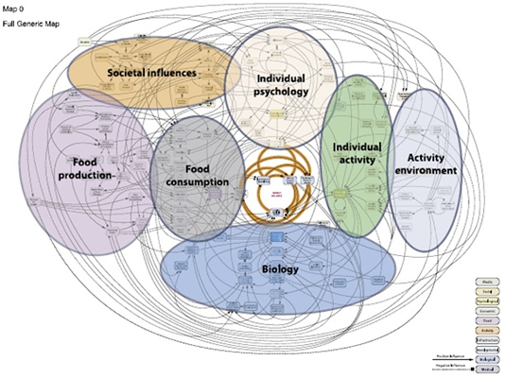
Foresight Obesity System Map

Slide 10
Complexity and solutions
Complex problems require complex solutions.
A single government sector, specializing in the management of care delivery, will not have all the tools, knowledge, capacity, let alone budget, to address this complexity.
Ministries of health are not equipped to deal with the “causes of the causes” such as the social determinants of health (Evelyne de Leeuw 2013)
Therefore, HiAP is premised on a strategic, collaborative approach to policy-making.

Slide 11
Complexity and solutions
Need a mindset that accepts that increasingly public health problems are not suited to easy solutions.
Solutions require:
A range of trade-offs;
A tolerance for ambiguity and for uncertainty;
An opportunities driven approach;
A good contextual analysis
Different contextual environments at play:
The contextual environment: factors in the external world which impact the issue but cannot be influenced by the organization;
The transactional environment: factors that are external to the organization but can be influenced by that organization; and
The policy or strategy space: the internal world of an organization or system which can be controlled.

Slide 12
Policy making processes
Part 2: Policy making and HiAP/Framing and windows of opportunity

Slide 13
Lecture: Policy making and HiAP

Slide 14
The policy-making cycle
HiAP an inherently political process
involves the reallocation of resources including power and responsibilities. It can stretch over long periods of time and usually involves many actors and interests
may vary over the course of time.
is not necessarily linear. The completion of one stage does not guarantee movement to the next. Nor is progress in one stage dependent on completion of all the tasks in the previous stage.

Slide 15
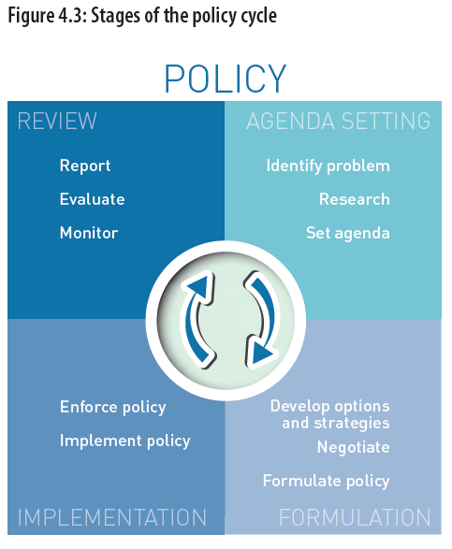

Slide 16
Windows of opportunity and framing
It is essential to seize “windows of opportunity” that arise from changing economic, social and political realities (Kingdon 1995).
Three interplaying, non-linear streams in policy-making – problems, policies and politics
Opening up windows of opportunity for policy decisions - short periods of time
Simultaneously, a problem is recognized, a solution is available and the political climate is positive for policy change.

Slide 17
Framing
Firstly, an issue needs to be recognized as a “problem” by politicians, policy-makers and the overall community before it can be raised in the policy-making agenda
E.g key information on the magnitude of the problem; worrying changes in the situation; failures to meet previous goals; or rising costs
opportunities may also arise from policy development within other sectors
framing refers to how an issue is defined
can influence how the issue is viewed (non-issue, problem, crisis, etc.), who is considered responsible and the cause and possible solutions.
Policy stakeholders can own or disown a public problem through the way they define it.
Redefining or reframing the problem allows for new ways of understanding, which can encourage new stakeholders to engage in the policy process.

Slide 18
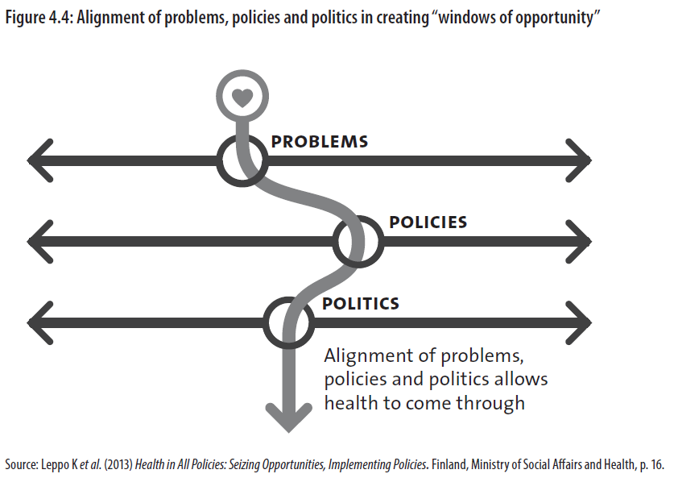

Slide 19
Policy formulation and implementation
The negotiation of politics is part of both the policy formulation and policy implementation stages of the policy cycle.
Long-term vision is essential to guide the policy process
Progress is made by taking opportunities
But, at a given political time, some windows might be closed or missed because of lack of awareness of policy processes in other sectors (see Figure 4.5). There can also be drawbacks that worsen the situation.

Slide 20
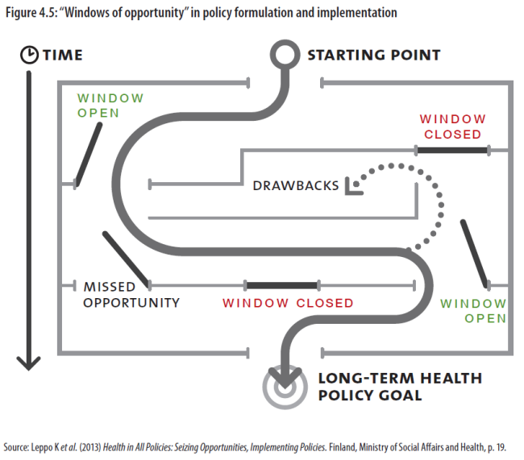

Slide 21
Example of seizing a window of opportunity
High binge-drinking rates in Latin America.
In Ecuador, nothing was done until 50 people died and 14 were left blind due to bootleg liquor in June 2011.
Three-day ban on alcohol sales and bought back any contaminated alcohol still in circulation.
An intersectoral alcohol policy in April 2012
tax reform increased excise tax for imported alcohol significantly;
several local districts banned alcohol sales and consumption on the streets during public festivities.

Slide 22
Policy champions/ Policy entrepreneurs
Considering windows of opportunity and the complex, political nature of policy-making, Kingdon emphasizes the importance of policy champions.
A policy champion is a person or team
willing and able to lead and manage the policy process.
proactively promoting policy reforms, publicly support the policies and foster the support of others.
frame discussion of the issue, build consensus, attract resources, and seize and create opportunities to move the reform forward.
Change agents and policy entrepreneurs are similar – there is a creative dimension of breaking with existing ideas and initiating new policies.

Slide 23
Group activity: Framing and windows of opportunity
Case study on tobacco control in Suriname
Handout 4.1 ‘SurinameTobaccoBrochureFINALmay15’
How was tobacco control “framed” as a problem that requires urgent action?
2. How was you the problem defined to encourage other sectors to take ownership?
3. What existing opportunities were used to put the issue on the agenda?

Slide 24
Questions and feedback

