Slide 1
HiAP TOT Meeting, Johannesburg 30 Nov – 4 Dec 2015
Health in All Policies
In the WHO African Region

Slide 2
Learning objectives
Define public health and HiAP
Explain the origins and development of HiAP
Recognize when to use a HiAP approach
Distinguish the HiAP from other public policies

Slide 3
Outline
Context
Historical experiences
Tools
Commitments for actions

Slide 4
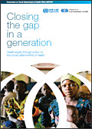

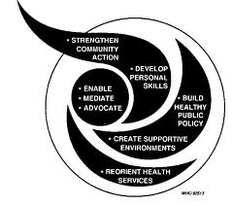
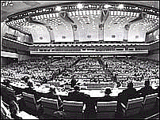

History: opportunities in action on Social Determinants of Health through Health in all Policies approach
2011
2008
Sustainable Development Goals
2011
WHO Rio Political Declaration on Social Determinants of Health
1997
2008 Report Commission social Determinants of Health
1988
2006
Finnish Presidency of the European Union in 2006, Health in All Policies (HiAP).
C-PHC S-PHC Reforms & Minimum Packages MDG Scaling-up Equity and SDH SDGs
2009
WHA Resolution Reducing Health Inequities Through Action on the Social Determinants of Health
1986
1997
Intersectoral Action
for Health- A
cornerstone for health
for all in the Twenty
First Century.
1978
1986
World Health Organisation’s Ottawa Charter for Health Promotion
1948
1999 The Gothenburg consensus Paper on Health Impact Assesment
1978
Alma -Ata Declaration Health for All agenda (1970s), action falters in 1980s.
Social dimensions of health affirmed in WHO Constitution (1948), downplayed during 1950s era of disease campaigns.
1988
Adelaida Recommendation on Health Public Policy.
Notes:
Ideological shifts:
70s – Decade of development: consensus on health and development
80s – “Lost Decade”, proliferation of strategies: selective PHC vs. integrated health care, district health systems and Healthy Cities
90s – Decade of Reform & Globalization: efficiency of bureaucracy and introduction of market economies in health sector; also the Water Decade and the "Washington Consensus” – IMF-WB-WTO
New influence of stakeholders:
UNICEF – selective application of PHC, 1979, then moved to children's rights, 1995
WB – redefines measurements of health: WDR 93 Investing in Health
UNDP – introduces country strategy note & includes PHC. Effort for better UN coordination, MDGs
USAID – emphasizes civil society and quality
New health discipline:
Health economics introduces new ways of measuring resources and health achievements, influencing design of health systems financing and efficiency measures
National budgets for health:
Increase as % of GDP
Decrease in equitable distribution

Slide 5
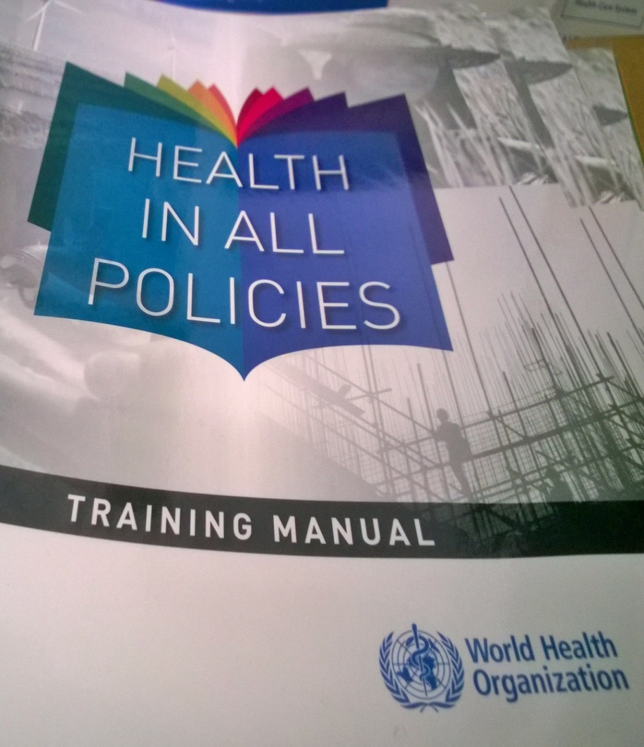
What is Health in All Policies (HiAP)
  An approach to public policies across sectors that takes into account the health implications of decisions, seek synergies, and avoids harmful health impacts, in order to improve population health and health equity

Slide 6
Why focus on HiAP approach and mind-set
Shift in perspective
Shared mental map of participants
All actors consider improved health and wellbeing as an overarching social goal requiring shared action
Create a mental map of participants in relation to HiAP and equip them to be policy champions/ entrepreneurs for HiAP

Slide 7
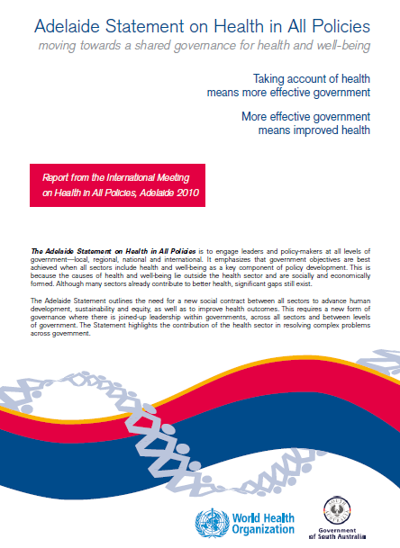
Implementing a Health in All Policies approach
Q: How can intersectoral practice be part of the role of health and
how can policies for equity be fostered?

Slide 9
The New role for the Health Sector
(including Ministry of Health)
Leader
- Work with other arms of government to achieve their goals
- Understand other sectors' political and administrative imperatives
Partner
- Sectors other than health
- Evaluate the effectiveness of intersectoral work
- Integrated policy-making
- Build capacity for ISA and HiAP,
- Resource mobilization
Partner
Leader
Negotiator
- Provide technical knowledge but no control
- Intersectoral platforms for dialogue
- Evidence base
- Policy and legislative coherence
Negotiator

Slide 10
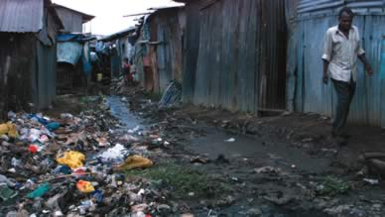
Why treat people and send them back to the same conditions that made them sick in the first place?

Slide 11
Health in All Policies: Tools and required actions

Slide 12
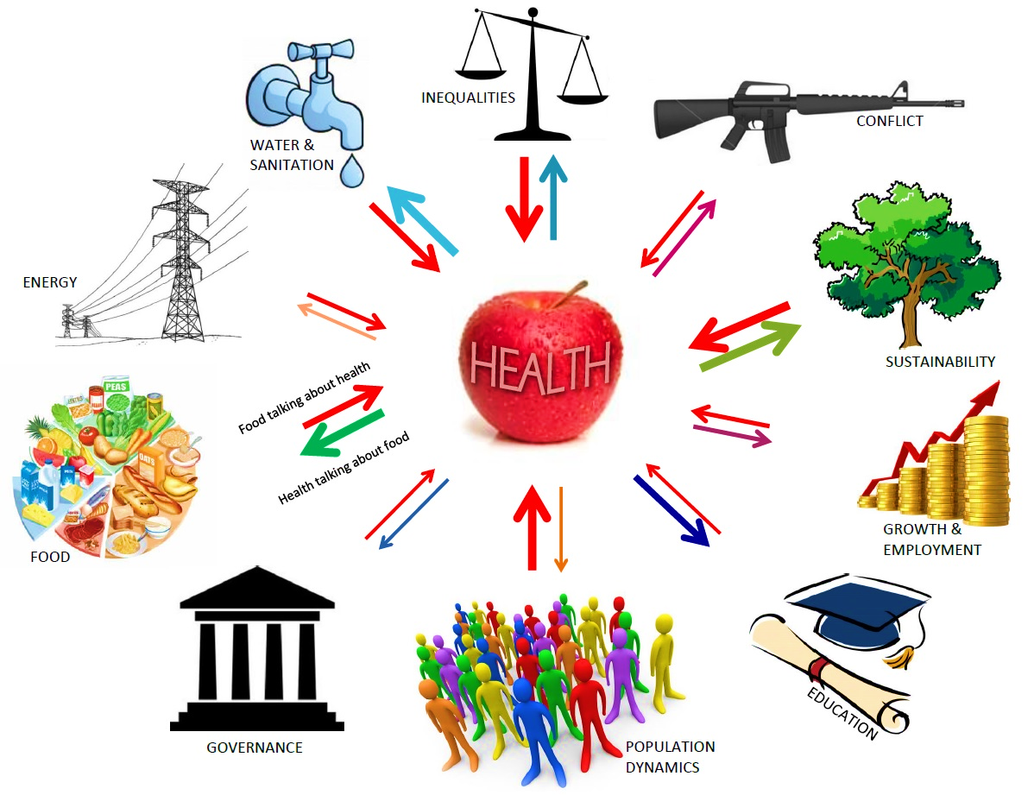
Health in All Policies - Means Health Talking with Everyone

Slide 13
Health in All Policies Training Manual
Training Manual Content Outline
The policy-making process
The role of Government in HiAP (whole-of Government approach)
Preparing Policy briefs
The role of non-government stakeholders;
Negotiating for health
Implementation at local, regional and global levels
Measuring progress in health
Leadership role of the sector in HiAP

Slide 14
Documentation of intersectoral action case studies
http://www.afro.who.int/en/clusters-a-programmes/hpr/social-a-economic-determinants-of-health/case-studies/country-experiences-rio.html

Slide 15
Health Promotion and Social determinants of health strategies
http://www.afro.who.int/en/clusters-a-programmes/hpr/social-a-economic-determinants

Slide 16

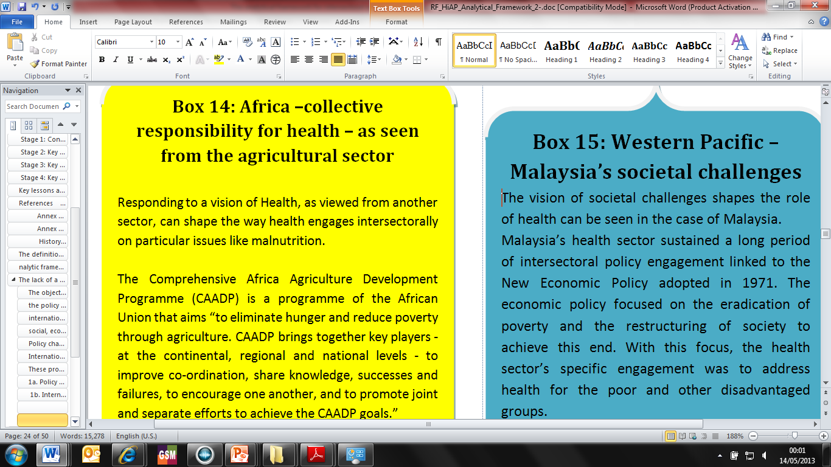
Drivers of implementation: health vision
Vision of health among policy-makers from other sectors

Slide 17
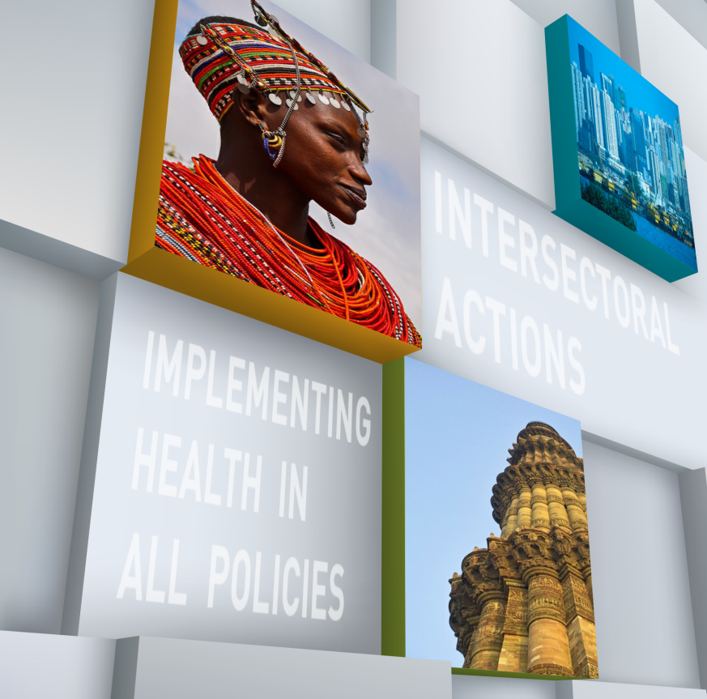
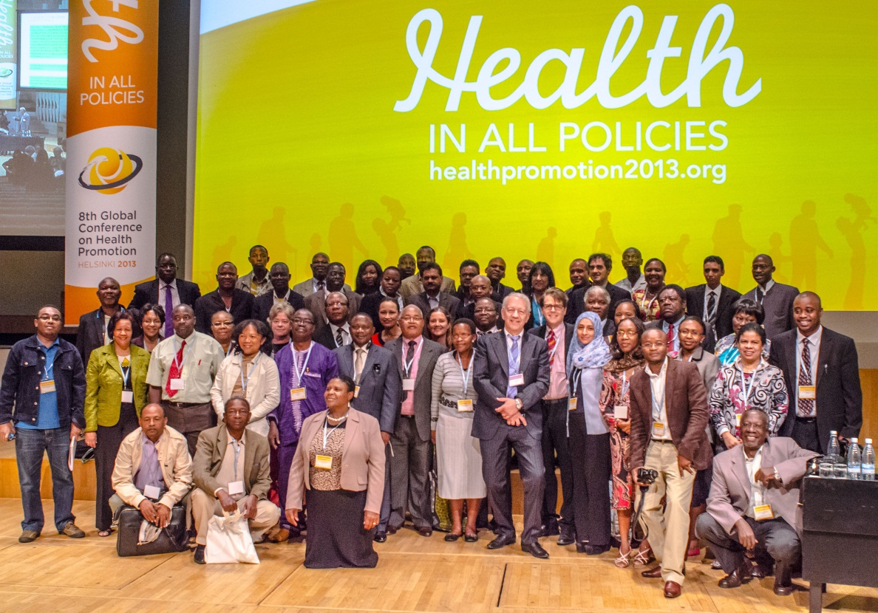

Supporting regional positions on moving toward Health in All Policies (with Rockefeller Foundation) and training

Slide 18
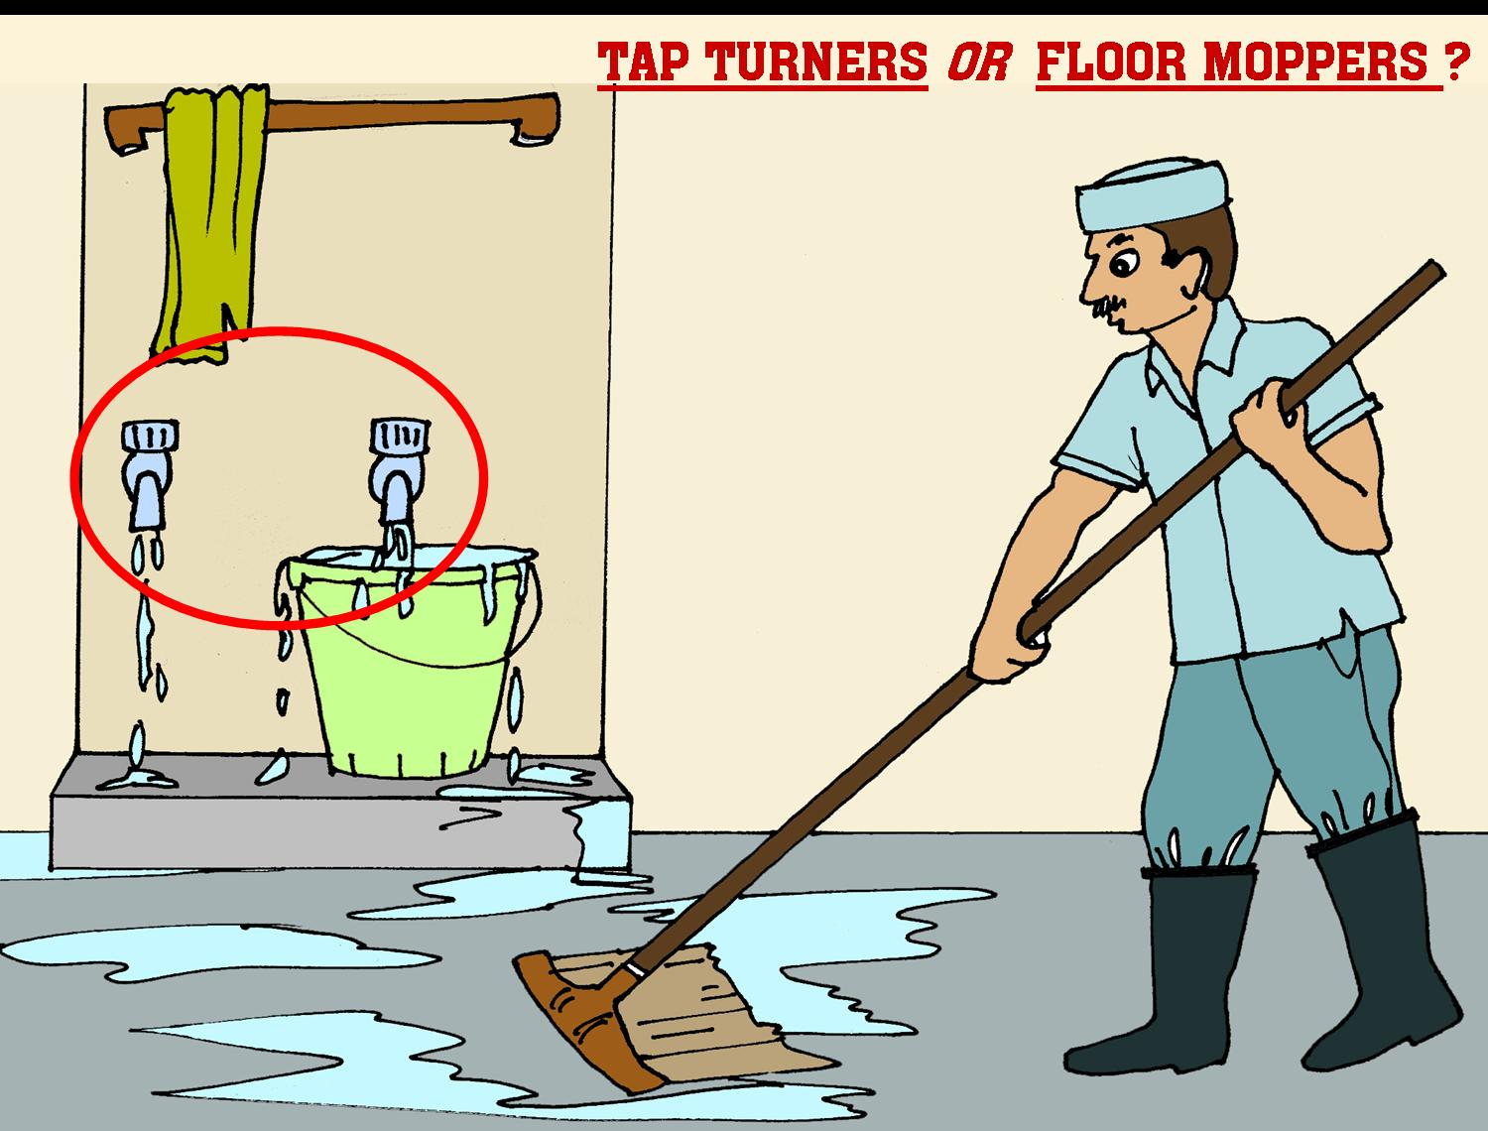
Outline of the presentation
Background
What is a health system?
Structure and programme areas of work of the Health System Strengthening (HSS) Cluster
Major challenges/constraints
Strategies/approaches to address challenges and constraints
Conclusion
Notes:
18
The presentation will cover the topics as highlighted. We will however spend more time,
BACKGROUND
reminding ourselves about what the health system and its characteristics are;
Having a closer look at the HSS structure and program areas of work of HSS,
major challenges and constraints
Outlining the critical roles to be played by government and WHO
Then we will conclude.

Slide 19
Conclusion
You cannot do it alone - various players at multiple levels are critical for success in HiAP!

Slide 20


