Slide 1
Health in All Policies
3b. The Foundations of HiAP
Louise Signal

Slide 2
Health in All Policies Defined
An approach to public policies across sectors that systematically takes into account the health implications of decisions, seeks synergies, & avoids harmful health impacts in order to improve population health & health equity.

Slide 3
The Foundations of Health in All Policies
19th Century Public Health
Housing
Water and Sanitation
Mandatory schooling
Nutrition
Workers rights
Economic development
Improved living conditions
Social security

Slide 4
World Health Organization Constitution 1948
Health is a state of complete physical, mental and social wellbeing, and not merely the absence of disease or infirmity.
Governments have a responsibility for the health of their peoples which can be fulfilled only by the provision of adequate health and social measures.

Slide 5
Alma Ata Declaration 1978
Health is a fundamental human right and the attainment of the highest possible level of health is a most important world-wide social goal whose realization requires the action of many other social and economic sectors in addition to the health sector. .. and demands the coordinated efforts of all those sectors

Slide 6
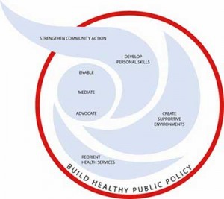
Ottawa Charter for Health Promotion 1986
Prerequisites for Health
The fundamental conditions and resources for health are: peace, shelter, education, food, income, a stable eco-system, sustainable resources, social justice, and equity.

Slide 7
Healthy Public Policy
Health promotion…puts health on the agenda of policy makers in all sectors and at all levels, directing them to be aware of the health consequences of their decisions and to accept their responsibilities for health.

Slide 8
Towards Health in All Policies
A call for health in all policies - Finnish
presidency of European Union 2006

Slide 9
Highlighting Evidence and Equity – 2005-2008/9
Commission on the Social Determinants of Health, World Health Organization
Final Report 2008 - 2009 World Health Assembly
The social determinants of health are the conditions in which people are born, grow, live, work and age, including the health system. These circumstances are shaped by the distribution of money, power and resources at global, national and local levels, which are themselves influenced by policy choices. The social determinants of health are mostly responsible for health inequities - the unfair and avoidable differences in health status seen within and between countries.

Slide 10
Towards Health in All Policies 2007-2010
South Australia adopts Health in All Policies approach 2007/8
International Meeting on Health in All Policies: Adelaide Statement on Health in All Policies 2010

Slide 11
International Momentum
Moscow Declaration on Healthy Lifestyles and Non Communicable Diseases 2011
United Nations Summit on the Prevention and Control of Non-Communicable Diseases 2011
Rio Political Declaration on the Social Determinants of Health 2011
The Helsinki Statement on Health in All Policies

Slide 12
Call for Government Action
Commit to health and health equity as a political priority by adopting the principles of HiAP and taking action on the social determinants of health.
Ensure effective structures, processes and resources that enable implementation of the HiAP across governments at all levels
Strengthen the capacity of Ministries of Health to engage other sectors of government

Slide 13
Call for Government Action
Build institutional capacity and skills that enable the implementation of HiAP
Adopt transparent audit and accountability mechanisms for health and equity impacts
Establish conflict of interest measures that include effective safeguards to protect policies from distortion by commercial and vested interests and influence.
Include communities, social movements and civil society in the development, implementation and monitoring of HiAP

Slide 14
The Challenge
The globalization of unhealthy lifestyles is by no means just a technical issue for public health. It is a political issue. It is a trade issue. And it is an issue for foreign affairs… Efforts to prevent NCDs go against the business interests of powerful economic operators. In my view, this is one of the biggest challenges facing health promotion… it is not just Big Tobacco anymore. Public health must also contend with Big Food, Big Soda, and Big Alcohol. All of these industries fear regulation, and protect themselves by using the same tactics.

Slide 15
The Challenge
This is formidable opposition. Market power readily translates into political power. Few governments prioritize health over big business. … Let me remind you. Not one single country has managed to turn around its obesity epidemic in all age groups. This is not a failure of individual will-power. This is a failure of political will to take on big business.…In the view of WHO, the formulation of health policies must be protected from distortion by commercial or vested interests.

Slide 16
The Opposition
Policies designed to enable people to lead healthy lives face opposition from many sides. Often they are challenged by the interests of powerful economic forces that resist regulation. Business interests and market power can affect the ability of governments and health systems to promote and protect health and respond to health needs.
Margaret Chan – Director-General WHO

Slide 17
UN Resolution on HiAP

Slide 18
Implications
HiAP higher up the international agenda
Gives us permission, helps build capacity, provides a body of evidence, strong equity focus, strong focus on powerful economic interests opposing health
Strengthed by support from WHO Director-General Margaret Chan
Strengthened by guidance for Country Plans of Action
Means to address the Sustainable Development Goals.

Slide 19
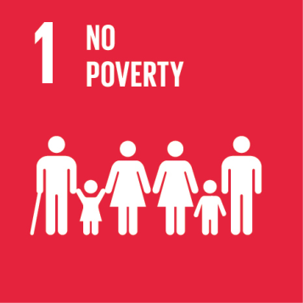
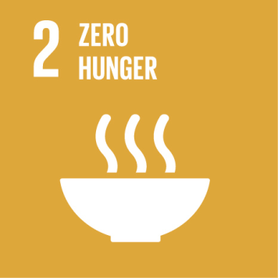
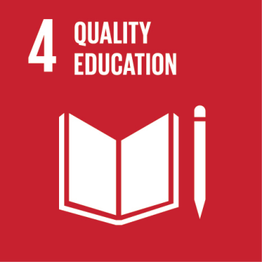
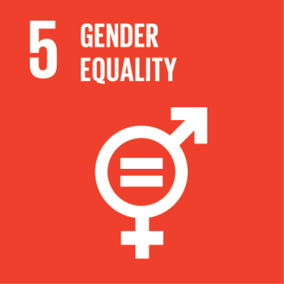
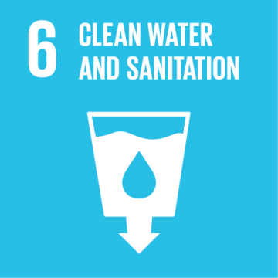
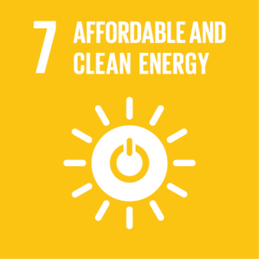
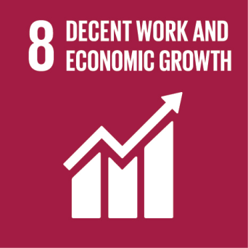
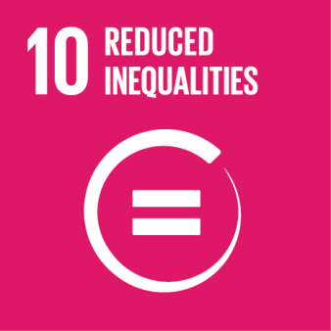
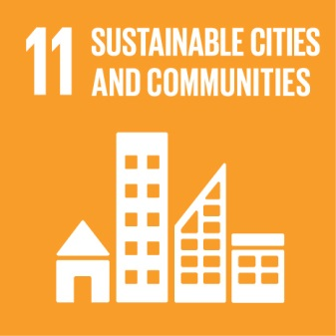
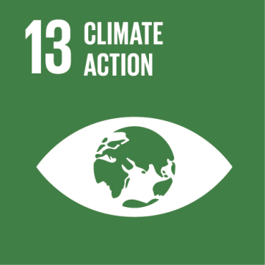
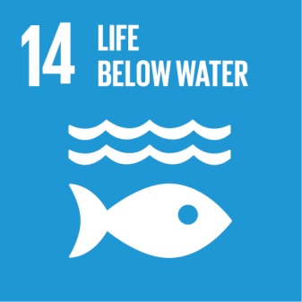
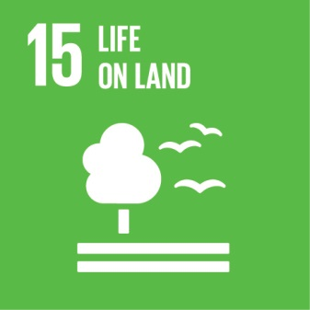
Means to address the SDGs
Notes:
On September 25th 2015, countries adopted a set of goals to end poverty, protect the planet, and ensure prosperity for all as part of a new sustainable development agenda. Each goal has specific targets to be achieved over the next 15 years.
For the goals to be reached, everyone needs to do their part: governments, the private sector, civil society and people like you.

