Slide 1

Health in All Policies
3e. Health in All Policies - Key Concepts and Approaches
Carmel Williams, Manager
Strategic Partnerships
Public Health Services
SA Health

Slide 2
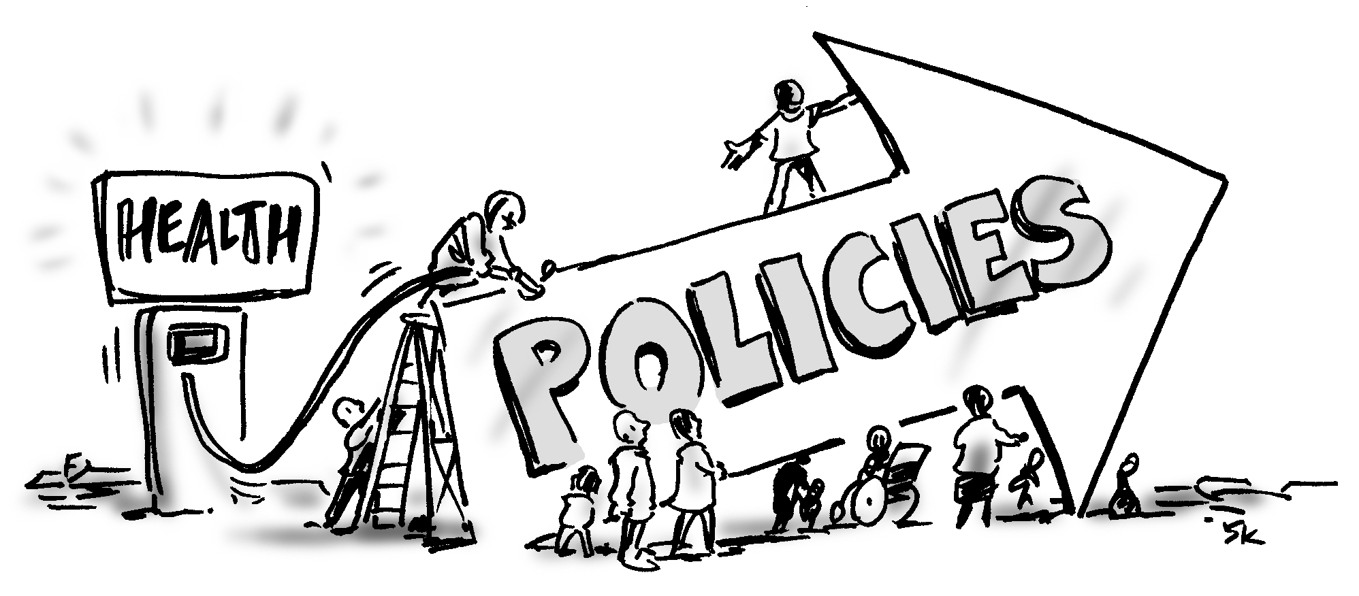
‘Health in All Policies’?
What’s it about?
It’s about working together to achieve the goals and policies of other sectors in ways that protect or promote health
Notes:
2

Slide 3
What is Health in All Policies
Health in All Policies (HiAP) is about promoting healthy public policy. It is a way of working across government to encourage all sectors to consider the health impacts of their policies and practices.
HiAP is based on understanding that population health is largely influenced by social, economic, environmental, political and cultural determinants.
At the same time, HiAP examines the contribution that a healthier population can make to other sectors’ goals.
Good population health has positive impacts on productivity, sustainability and the economy—it benefits all sectors and society as a whole.

Slide 4
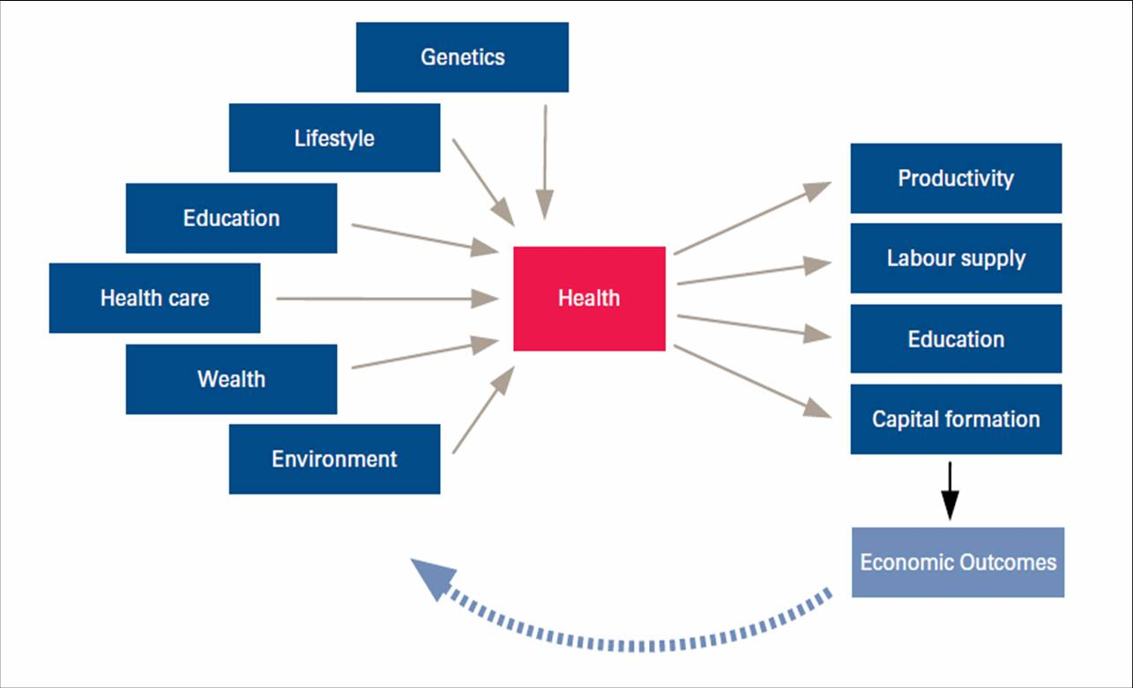
Health and the Economy

Slide 5
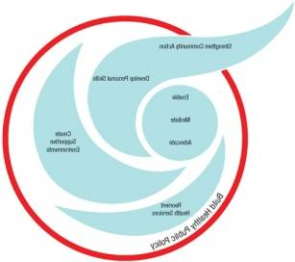

From Alma Ata to Health in All Policies
Alma Ata Declaration 1978
Ottawa Charter for Health Promotion 1986
Second International Conference on Health Promotion, Adelaide 1988
Finnish Presidency of the European Union 2006
Adelaide Statement on Health in All Policies 2010
Rio Declaration on Social Determinants of Health 2011
Helsinki Statement on Health in all Policies 2013
Notes:
5
Alma Ata Declaration of 1978, where the importance of intersectoral action for health was first acknowledged.
…health and wellbeing is influenced by the decisions and policies of other sectors
…to achieve significant health gains the health sector would need to work in partnership with other sectors.
Alma Ata set the scene for the future development of key global policy statements from WHO including the now classic Ottawa Charter for Health Promotion.
Efforts to redress this problem re-emerged in 2006 during the Finnish Presidency of the European Union (EU).
Formally introduced Health in All Policies to elevate health concerns into the policy considerations of other EU sectors. Since 2006, the HiAP approach has been endorsed as a lead theme and incorporated into the EU health strategy.8
WHO convened the second International Conference on Health Promotion
in Adelaide in 1988 which focussed on building healthy public policy. The conference produced important
recommendations highlighting the important influence that other sectors’ policy impacts have on health.
While this work was extremely valuable, it has proven difficult to move this action beyond the theory and, in
particular, beyond the health sector and into the policy domains of other sectors.

Slide 6


.
Government objectives are best achieved when all sectors include health and wellbeing as a key component of policy development
Requires new form of governance.
Different role for the health sector, one of facilitator and enabler
Notes:
??

Slide 7

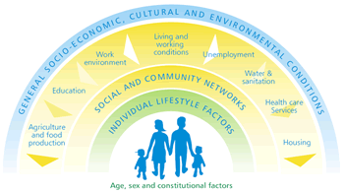
Determinants of Health
Social
Economic
Behavioural
Environmental
Notes:
7
All of you here will be familiar with this image – and know a great deal about it. As you are all aware the determinants of health - which are, if you like, the policy levers to improving the social, economic and environmental conditions that impact on health - largely lie outside the responsibility of the health sector.
The understanding of these social, economic and environmental determinants of health has been greatly boosted by the recent World Health Organization’s Commission on the Social Determinants of Health led by Sir Michael Marmot. The Report challenged all of us to do things differently if we were going to be serious about eliminating health inequities and improving health in our communities.
In Australia, we have had further evidence of the importance of addressing the determinants- The report released yesterday from Catholic health Australia national centre for Social and economic modelling NATSEM confirmed the importance of the determinants on health and wellbeing outcomes. You may have heard in media releases yesterday that they found educational outcomes were a more powerful predictor of cardiovascular disease that many of the traditional risk factors such as cholesterol, smoking and obesity combined.
Clearly, to work on the determinants of health in any meaningful way the government needed to find effective ways of joining-up with other parts of government.
But this joining-up has to be done in a way that is acceptable to other sectors and acknowledge and respect their imperatives and policy priorities.
It is with this understanding that we embarked on the development of South Australia’s approach to Health in All Policies.

Slide 8
Health in All Policies
South Australia’s Approach

Slide 9

            The Challenges
The agencies who are able to take action on the determinants of health don’t (always) know how to and don’t (always) see it as their business
In the Health sector we know we need to work intersectorally, but we are not always that good at it . . .
Notes:
9

Slide 10
The Response: Reframing the agenda
We don’t try to pull other agencies onto health’s agenda or priorities.
We don’t try to turn other sectors of government into health agencies.
We work with them on their issues and their priorities and help them achieve their policy goals in ways that protect and promote health.
Notes:
10

Slide 11
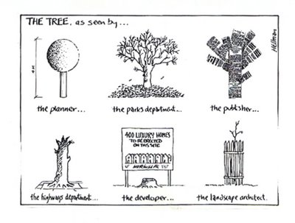
HiAP - a different approach
When health needs a tree...
HiAP sees the tree from a partner’s perspective and then works together to create their tree for their benefit
Notes:
Health in all policies looks at how we can assist other agencies to meet their goals, in a way that supports health and wellbeing
As a Unit we are really facilitators … and as the approach in SA matures … the “co-facilitators” in the public policy development cycle
So how did it all start?

Slide 12

Foundations of HiAP in South Australia
Thinker in Residence, Professor Ilona Kickbusch
South Australia’s Strategic Plan (SASP)
A receptive and proactive Cabinet Office
A willing and supportive Chief Executive

Slide 13

HiAP and SASP
HiAP is applied to South Australia’s Strategic
Plan (SASP) and 7 Cabinet Strategic Priorities
(7 CSP)
SASP and 7 CSP:
  are of strategic importance to all government agencies
  requires all government agencies to achieve their SASP targets
HiAP provides the framework to:
  explore some of the interconnections between the SASP targets/7 CPS
  to identify joint areas of work to achieve a ‘win-win’ solution
  progress agencies’ SASP/CPS targets and support the health and wellbeing of the population
Notes:
2007

Slide 14
Health in All Policies
Putting a “health lens” over 7 Strategic
Cabinet Priorities….
Creating a vibrant city
Safe communities, healthy neighbourhoods
An affordable place to live
Every chance for every child
Growing advanced manufacturing
Realising the benefits of the mining boom
for all South Australians
Premium food and wine from our clean environment
Notes:
14

Slide 15

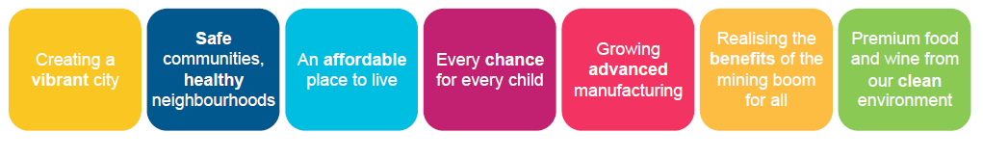
Government Priorities
HiAP is applied to South Australia’s Strategic
Plan (SASP) and 7 Cabinet Strategic Priorities (CSP)
HiAP provides the framework to:
  explore some of the interconnections between the SASP targets/CSP
  to identify joint areas of work to achieve a ‘win-win’ solution
  progress agencies’ SASP targets/CSP and support the health and wellbeing of the population
Notes:
Applied, what does that mean?

Slide 16
Governance
Central leadership
  Centralised government agency commitment
  Linked to centralised mandate
  Clear policy advisory role—priority setting
  Active participation
  Partnership with health agency
Health Commitment
  Internal mandate
  Policy development space
  Link to health reform agenda
  Resource allocation
Notes:
2007

Slide 17
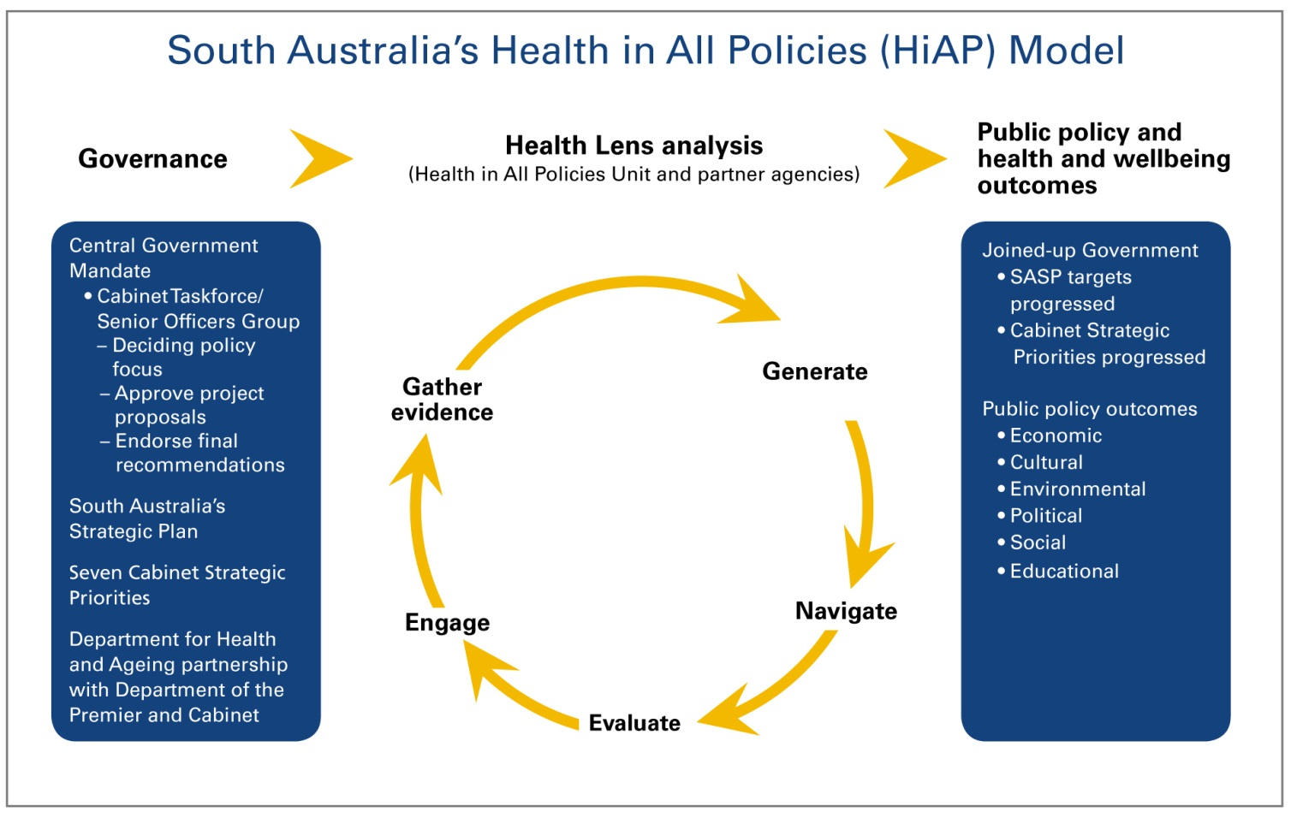
South Australian HiAP Model
Notes:
Settling on project proposal can take time_ to date best results have arisen when this part of the process is given the time it needs.

Slide 18
The Health Lens Process

Slide 19
Key Strategies
Partnering with government agencies on the policy imperatives underlying their core business
Operating under the directive of central government
Leveraging from existing government decision making structures
Jointly generating evidence-based solutions with project partners
Integrating qualitative and quantitative methodologies into solutions.
Notes:
19

Slide 20
Partnership Principles
Flexibility and Responsiveness
Recognition and Mutual Respect
Support and Resources
Outcome-Focused
Clarity and Collaboration
Notes:
20

Slide 21
Health Lens Analysis Projects
-completed
Regional Migrant Settlement
Water Sustainability: Alternative water sources
Digital Technology: Access and Use
Transit-oriented Developments
Local Government: Castle Plaza Rapid Wellbeing Assessment
Healthy Weight Desktop Analysis
Overseas Students Health and Welfare
Active Transport: Economic contribution of cycling
HLA across the 7 Cabinet Priorities
Notes:
21

Slide 22
Health Lens Analysis Projects - current
Improving Parental Engagement in Children’s Literacy
Aboriginal Road Safety
Healthy Sustainable Regional Communities (mining)
Active Ageing through Employment
Learning or Earning
Cycling Strategy for SA
An Affordable Place to Live – Affordable Living Strategy
Every Chance for Every Child – Parental Engagement Project
Notes:
22

Slide 23
Improving Parental Engagement in Children’s Literacy to Create Literacy Rich Home Environments
Health Lens - example
Project partners:
SA Department of Education and Child Development
SA Health
Notes:
Key Drivers of the Project:
In 2009, under the previous governance arrangements, education and early life was endorsed as one of the priority areas for HiAP.
Strong established links between Health and Education.
Strategic Links:
SASP Target: by 2010, 93% of students in Year 3 achieve the national benchmarks in reading, writing and numeracy.
Links to COAG National Education Agreement.
Socio-Economic School Communities National Partnership.

Slide 24
Opportunities/Challenges
History of poor ‘partnership’ – usually Health directing DECD.
Schools, including Principals and Project Manager used to thinking at program/project level, not policy level.
Schools don’t generally think ‘outside’ the school gates – ie engaging with parents where they are at.

Slide 25
HLA: 1. The Engagement phase
Aim:
To raise parental engagement with literacy to improve literacy outcomes for children in the early years of schooling, and ultimately improve their health.
  Focus on parental engagement at home and school
  Focus on learners from low SES backgrounds
Objective:
In partnership with participating schools:
  Investigate how to better engage families in co-creating a literacy rich environment for children at home and school.
Notes:
Developed after a number of months of discussion with DECD officers, and a preliminary literature scan.

Slide 26
          HLA: 2. Gather Evidence
Methodology
Literature Review
Parental involvement has bigger impact on attainment at seven and eleven years of age than school factors even controlling for social class.
Variations in the level of parental involvement in children’s learning at home and at school is strongly influenced by family socio-economic status.
Parental engagement in the school, such as school governance, has no demonstrated impact on learning outcomes per se.
Four Schools in Western Adelaide region
Multi Governance
  Steering group
  Regional working group
  4-schools group
Parent/Care-giver Focus Groups
Notes:
Highly diverse multicultural & socio-economic community of learners
School profiles – demographic data.
Parent/care-giver focus groups.
10 held between July-September 2011 with 66 participants
Barriers and facilitators to engagement with literacy
4-school meetings.
Explore teachers role in supporting parents
Best practice approaches to support parental engagement

Slide 27
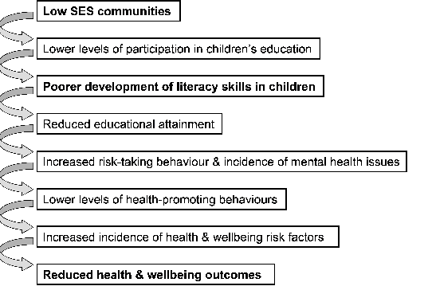
2. Gather Evidence

Slide 28
HLA. 3.Generate
Homework Club – parental support
School newsletters and articles
Linking with other agencies to build
trust
The Domains of Family Engagement with Literacy
Communication & Confidence
Increasing and strengthening parent’s/families’ confidence to support their children’s’ learning at home, school & the community, as well as be involved at school
Knowledge &
Strategies
Developing parents’ knowledge of literacy learning and strategies to support their children
Resources
Resources that support families to improve their children’s literacy learning
Improved literacy outcomes & wellbeing for students. Positive long-term health outcomes
Parents participating in classrooms
“Cameo Lessons” during school days
“Partners In Print” evening
workshops
Literacy Showbags
DVD – phonological
awareness
“Reading Strategies” Booklets

Slide 29


Project Outcomes
Recommendations being finalised – framed at school,
region and systems level.
New South Australian Numeracy & Literacy Strategy (2013) incorporates:
  Stronger recognition of parents role as their children's teacher
  Parent/School partnership approach.
ClassMovies commissioned to develop film around the project at the school level – to be showcased as example of good practice.

Slide 30
HLA:4. Navigate
Project recommendations to be endorsed by Chief Executives of DECD and Health.
Recommendations to go to Every Chance for Every Child SOG and CTF for endorsement.
  Influenced policy setting and 90 Day projects of Govt
5. Evaluate
Focus groups undertaken with parents and teachers from the four schools.
To be completed following finalization of recommendations.

Slide 31
Future Challenges
Language—that speaks to other sectors as well as to Health
Clearly linking determinants to other sectors’ policy agendas
Tackling health policy issues using HiAP framework
Medium- and long-term impacts for health and other policy goals
Capacity Building—adapting the approach to enable others to apply a health lens methodology
The determinants of health and the national health agenda
Sustainability through the SA Public Health Act and SA Public Health Plan
Notes:
31

Slide 32
Acknowledgements
HiAP Health Lens Partner Agencies
Health in All Policies Unit members
For further information please visit the website:
http://www.sahealth.sa.gov.au/healthinallpolicies
hiap@health.sa.gov.au
Notes:
32

Slide 33

Notes:
33

