Slide 1
Public Health Summer School
3c. Foundations of Health in All Policies
Carmel Williams, Manager
Strategic Partnerships
Public Health Services
SA Health

Slide 2


Why Health in All Policies?
Wicked Problems
Most 21st century health and social problems (in particular in dealing with the causes of the causes) are wicked problems or social messes
Ageing of the population
  Escalating prevalence of chronic conditions
    Obesity
Health budget and economic crises
Workforce: labour shortfalls
Creates a window of opportunity for innovative approaches such as Health in All Policies
Based on South Australian Health in All Policies Summer School 2011
Notes:
2
Australia and in particular South Australia is facing a number of significant challenges, partly arising out of changing demographic patterns and societal expectations. To successfully tackle the implications of these changes we need new approaches to Health and wellbeing, new approaches to cross sector collaboration and policy making and importantly new approaches to acting on the social determinants of Health and increase equity.
South Australia has a rapidly ageing population – in fact our population is ageing more rapidly than the rest of Australia. Increased ageing brings with it increased incidence of chronic disease and other health challenges which will in turn have significant impact on our health systems, contributing to the escalating health care budget. Therefore we expect to experience the full impact of an older population on our health system earlier than the rest of Australia.
Our workforce is ageing as well. In SA those in the workforce are older, and average age of workforce will continue to climb until at least 2030.
Participation and productivity are impacted on by the health of the workforce as well as the age of the population

Slide 3


Wicked Problems
The growing interest in HIAP approaches reflects the recognition that public health policy needs new approaches in order to be able to address very complex policy problems. Some of these policy issues are so complex they have been called ‘wicked’ problems – one example is the challenge of obesity which has been described as a wicked problem by the United Nations.
Kickbusch 2013
Based on South Australian Health in All Policies Summer School 2011

Slide 4
What are Wicked Problems
Wicked Problems
Complex, continually developing and mutating social, organisational and policy planning problems
(Rittel and Webber 1973)
Social messes
A social or organisational planning problem (usually long-term) that is vaguely defined, ambiguous and reactive „they fight back“ (Ackoff 1974)
Kickbusch 2013
Based on South Australian Health in All Policies Summer School 2011

Slide 5
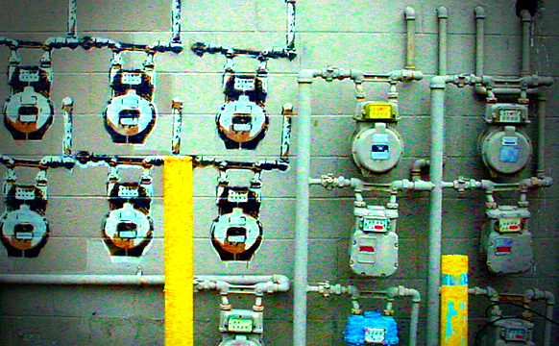
Wicked Problems
Reference: Tom Ritchey 2011
There is a whole realm of social planning problems that cannot be successfully treated with traditional linear, analytical approaches.
Wicked Problems are ill defined, ambiguous and associated with strong moral, political and professional issues.
Wicked Problems are about people, stakeholders, vested interests and politics - they are highly sensitive
(Horst Rittel 1972)
Kickbusch 2013
Based on South Australian Health in All Policies Summer School 2011

Slide 6
Criteria for wicked problems
There is no definite formula
Solutions are not true or false but better or worse
There is no immediate or ultimate test of a solution to a WP – there are waves of consequences
You cannot learn by trial and error – each leaves „traces“ that cannot be undone
One will never know all the solutions
Every Wicked Problem is essentially unique
The causes of a Wicked Problem can be explained in numerous ways
(Rittel and Webber 1973)
Kickbusch 2013
Based on South Australian Health in All Policies Summer School 2011

Slide 7
Wicked Problems-Health Care Budget
In 2012-13, $4.927 billion will be spent on health services and functions in South Australia
A 5.6% increase compared with 2011-12
A 129% increase ($2.8 billion more) than 2001-02
1.8% of health care budget spent on prevention 
Department of Treasury and Finance SA - 2012
Based on South Australian Health in All Policies Summer School 2011
Notes:
But first ... Why?
When we look at what the 31% is comprised of it is not surprising that over 90% goes into hospital services and its related functions
Currently in Australia, approximately 70% of the Federal Health budget is spent on diagnosing and managing chronic conditions in this hospital and related functions budget.
Of these conditions, approximately 70% are caused by lifestyle/behaviour and are therefore amenable to preventative strategies.
1.8% of health care budget spent on prevention 

Slide 8
Financial crisis
SA Health spending grown by an average of 8.3% per year 2004/05 – 2010/11
If SA Health spending continues on current growth path then by 2034 the entire state budget will be consumed by health
As early as 2015 all new revenue would need to be spent on health
From 2016 all non-health areas will have to cut their budgets to feed the growth in health
Based on South Australian Health in All Policies Summer School 2011
Notes:
Like the rest of Australia, and the developed world, South Australia is facing a number of significant challenges
Ageing of the population * Population growth
Escalating prevalence of chronic conditions * Ageing infrastructure, information technology
Ageing of workforce - labour shortfalls
So, we know that health spending on acute care is and will continue to increase and we know that spending on traditional prevention is low and likely to be cut, we have see that in Qld. And we also know that as Health, we have little control over influencing the determinants. So we need to work with other sectors so they can influence the health of the population.
However, many of the agencies we work with are creating health everyday, but don’t necessary see it that way
Many of the agencies who are able to take action on the determinants of health and wellbeing don’t (always) know how to and don’t (always) see it as their business.

Slide 9
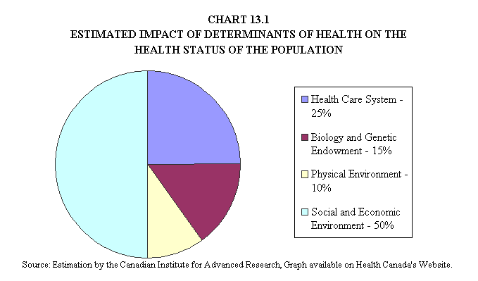
Health is largely created, developed, maintained (and destroyed) by activities outside of the health care sector
Figure 1: Estimated impact of determinants of health on the health status of the population
Based on South Australian Health in All Policies Summer School 2011
Source: Estimation by the Canadian Institute for Advanced Research – available at Health Canada’s website
Notes:
9
And if you all stop and think about the things that contribute to your health and wellbeing – make you feel healthy, I bet having a hospital down the road isn’t top of your list! Which isn’t to say its not important, but we need to recognize and understand the other elements too.

Slide 10
Wicked Problems - Obesity
Both the problem and the solution are systemic.
is a complex system of determinants and involves a plethora of actors who fulfil many different functions in society.
Risk patterns are local (e.g. the absence of playgrounds or lack of bicycle lanes) as well as national (e.g. the lack of food labelling requirements) and global. (Foresight Report)
Equity is cross cutting
Based on South Australian Health in All Policies Summer School 2011
Notes:
Reason 1: You know what the problem is, when you have the solution. Since it is hard to define what exactly the problem is, it is difficult to find a solution. This definitely applies to overweight. For example, experts often disagree what the major causes are of overweight: lack of physical activity or overeating? Bad genes or bad eating habits?
Reason 2: The solution process does not have a clear end-point. As Seidell wonders; it is not exactly clear what the purpose is of preventing overweight: halting the rising trends or reducing the number of people with overweight to zero?
Reason 3: Solutions are not right or wrong. All involved stakeholders (such as food companies, authorities, consumers, health professionals) have an opinion about the problem and often disagree. For example, last week we had the No Diet Day (or 'Anti-Diet-day' in the Netherlands). Although the day aims at body weight acceptance, it led to debates about the usefulness of particular diets and the risks of overweight.

Slide 11
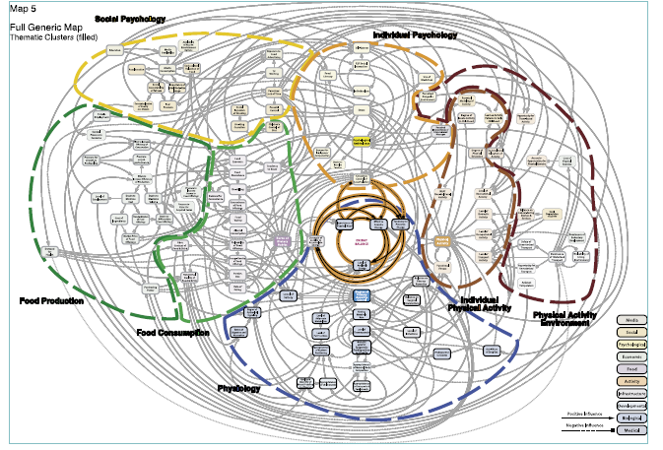
Obesity system
Foresight report –Tackling obesity future choices 2007
Based on South Australian Health in All Policies Summer School 2011

Slide 12
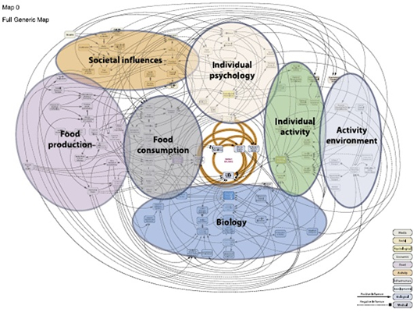
Obesity Model 2
Based South Australian Health in All Policies Summer School 2011
Foresight report –Tackling obesity future choices 2007
Based on South Australian Health in All Policies Summer School 2011

Slide 13
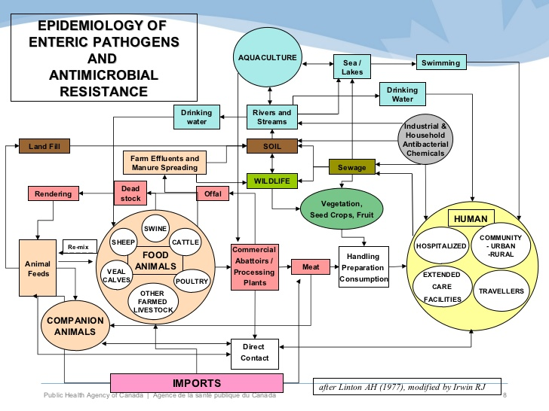
Anti Microbial Resistance

Slide 14
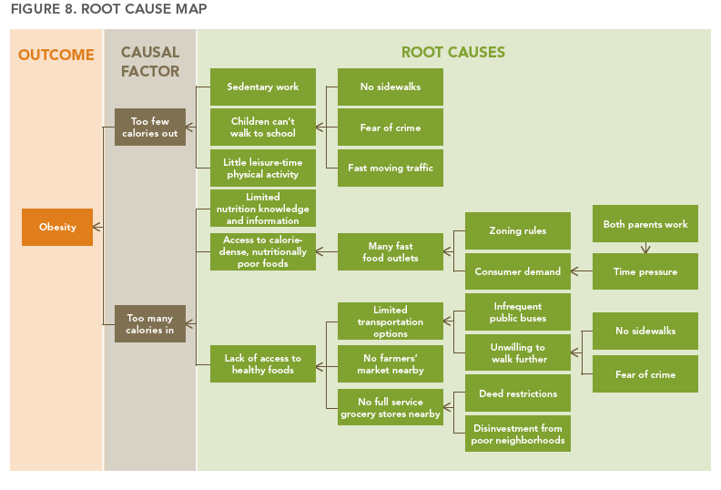
Root causes: policies that address systemic risks
HiAP: a guide for State and local governments California 2013
Based on South Australian Health in All Policies Summer School 2011

Slide 15

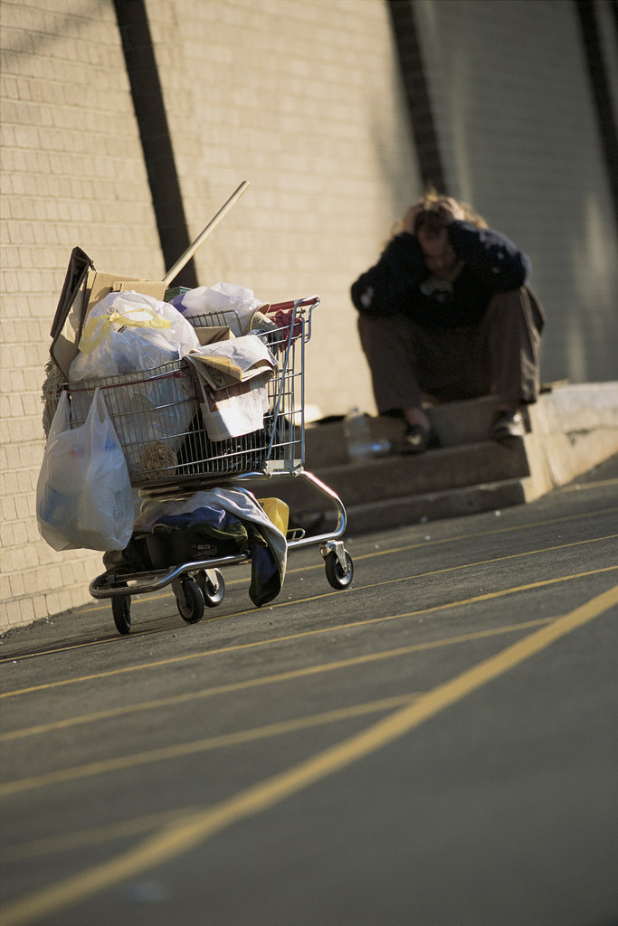
Addressing Wicked Problems
The require systems approaches and networked responses at all levels and force policy makers to move beyond silos.
Working across organisational is fundamental-within and outside the organisation
Effectively engaging stakeholders and citizens
    So they understand the complexity of the issues and
    Involved in identifying potential solutions
Urbanisation
Poverty
Kickbusch 2013
Based on South Australian Health in All Policies Summer School 2011

Slide 16
HOW to tackle Wicked Problems
Accomodate multiple/alternative perspectives rather than prescribe single solutions
Function through group interactions and iteration rather than back office calculations
generate OWNERSHIP OF THE PROBLEM FORMULATION through transparency
Facilitate a graphical visual representation for the systematic, group exploration of a solution
Focus on relationships between discrete alternatives
Concentrate on possibility rather than probability
Rosenhead 1996
Based on South Australian Health in All Policies Summer School 2011

Slide 17

Whole of government
The Whole of Government approach emphasizes not only the need for better coordination and integration of government activities, but aims for this coordination and integration to be centered on overarching societal goals that the government stands for.
Health in All Policies is one type of Whole of Government approach to prioritize governance for health and well being involving more than the health sector and working in all directions: the impact of other sectors on health and the impact of health on other sectors and synergistic policies for greater wellbeing.
Kickbusch 2013
Based on South Australian Health in All Policies Summer School 2011

Slide 18

Example: A determinants based
21st century public health
Principles:
Health equity
Health in all policies
Sustainable development
Precautionary principle
Participation
Norwegian Public Health Act 2011
Entry into force 1. January 2012
Public Health in the 21st century places responsibility for public health as a whole of government, whole of society and whole of municipality responsibility rather than of the health sector alone
Examples: public health acts Norway and South Australia
Kickbusch 2013
Based on South Australian Health in All Policies Summer School 2011

Slide 19
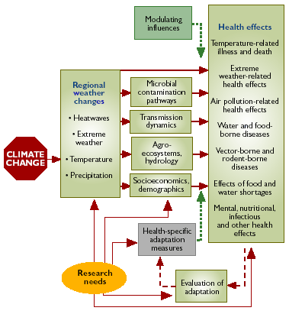
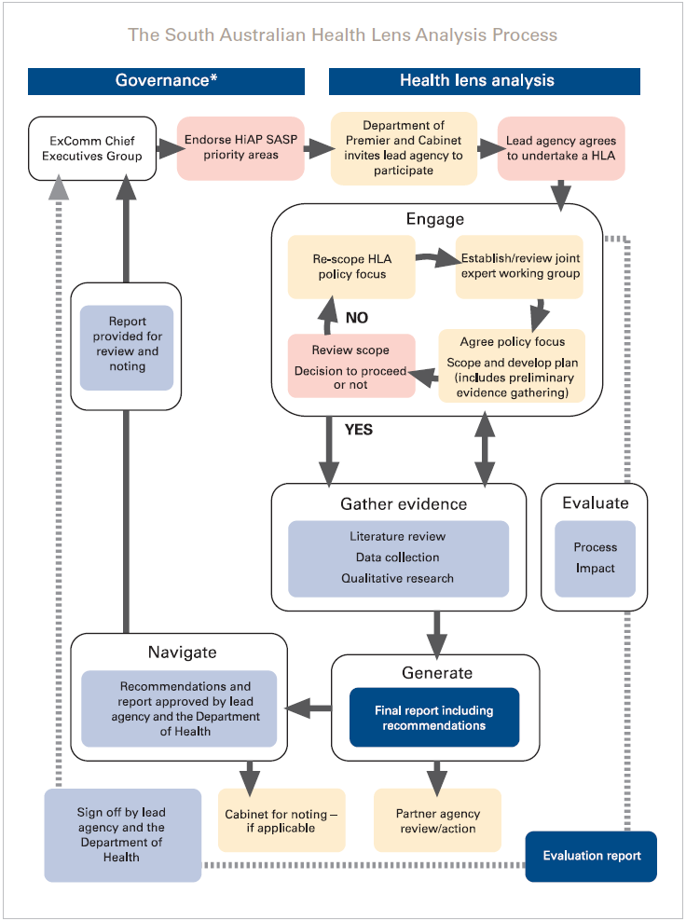
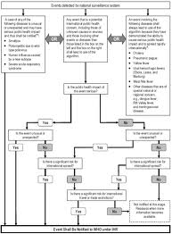
Systemic risks – systemic failures – systemic solutions
Environment and health
SA health lens
IHR
Based on South Australian Health in All Policies Summer School 2011
Notes:
Settling on project proposal can take time_ to date best results have arisen when this part of the process is given the time it needs.

Slide 20
Reorienting Health
PUT HEALTH FIRST
HEALTH AS THE GOAL
HEALTH IN THE LEAD
HEALTH IMPACT ASSESSMENT
HIERARCHICAL STATE FOCUSED
TECHNICAL POLICY FOCUS
Make health part of the synergy – social protection
Health, well-being and fairness
Health as an integral dimension of other policies
Joint strategic assessments
Smart governance
Politically astute
Based on South Australian Health in All Policies Summer School 2011
Kickbusch 2013

Slide 21
Four key questions
Depth: What is the intensity of joined working needed?
It is critical to understand that different levels of depth are needed for different problems or that the move towards a deep relationship will require a significant period of time, commitment of resources or specific windows of opportunity.
• Co-ordination: How many organizations and goals exist?
One should not aim for more shared work than can be managed by the resources at
hand.
• Complexity: To what extent are the required actions known in advance?
Do all partners share the same understanding of the complexities (e.g. in relation to
the social determinants of health)?
• Responsibility: Can the performance of each actor involved be adequately specified and measured separately?
This is frequently required and can present major difficulties.
Kickbusch 2013
Based on South Australian Health in All Policies Summer School 2011

Slide 22
Key issues
Each governance structure has its own profile in terms of intersectoral actions, therefore the choice of intersectoral governance structures must follow the desired intersectoral action
The evidence collected shows that intersectoral governance rarely work in isolation since there are other intersectoral governance structures working in parallel
There is a need for action at various levels and strong leadership is needed, especially in the broader policy environment where the concept of HiAP is less familiar.
HiAP needs to be firmly embedded within general policy imperatives that feed into overarching societal goals
Kickbusch 2013
Based on South Australian Health in All Policies Summer School 2011

Slide 23
The HiAP Approach
The HiAP mindset consists of an understanding of:
•the interaction between health and society and health and wellbeing
•the major health challenges related to dynamic social and economic change
•the wide range of determinants of health, in particular the social, political and commercial determinants of health
•the equity challenges in relation to health
The HiAP approach consists in:
•the management of complexity
•targeting inequalities
•a new approach to policy making
•applying collaborative and participatory approaches to governance and policy making including the involvement of many stakeholders
•developing new formal and sustained mechanisms for intergovernmental integration
•ensuring a commitment to and mechanisms for accountability.
Kickbusch 2013
Based on South Australian Health in All Policies Summer School 2011

