Slide 1
Course name
2. 21st century health dynamics and inequalities
Louise Signal &
Anjana Bhushan

Slide 2
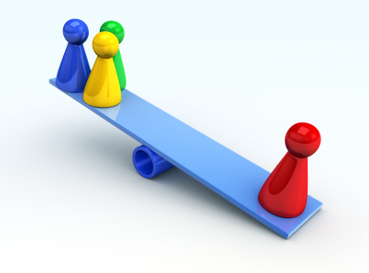
Health inequality defined
Health disparities that are judged to be unfair, unjust, avoidable, and unnecessary (meaning: are neither inevitable nor unremediable)
Kreiger
Notes:
Use Reducing Inequalities

Slide 3

Health Inequality Exist
Health inequalities exist internationally & occurs between
  Socioeconomic groups
  Ethnic groups
  People in different geographical areas
  Males and females
In colonial countries indigenous people
have poorer health
Even when socioeconomic
position is taken into account

Slide 4
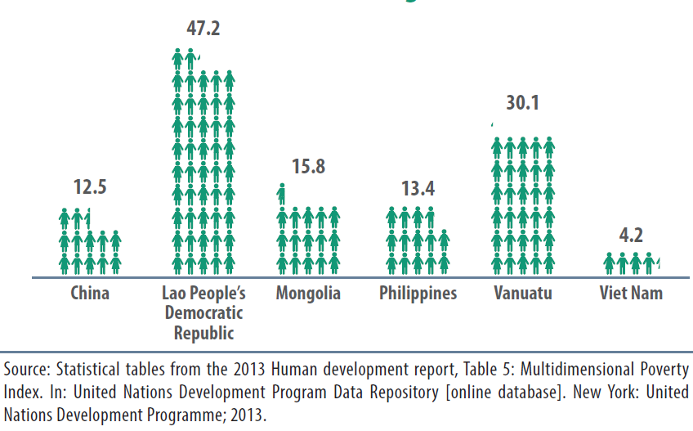
Equity, Poverty & Health
Percentage of population living in multi-dimensional poverty,
selected countries, Western Pacific Region, 2013

Slide 5
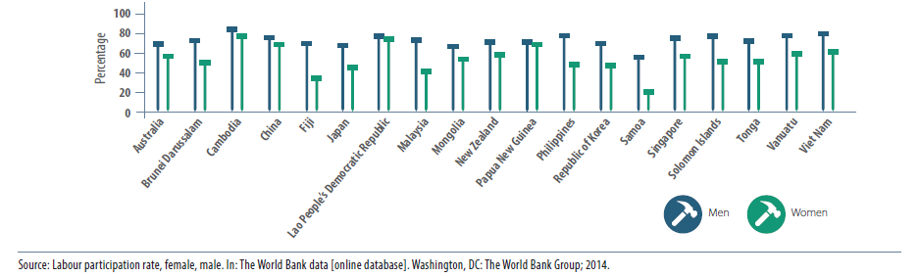
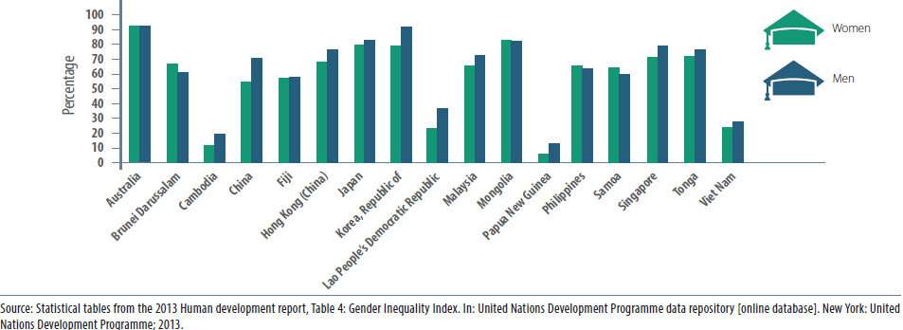
Inequalities: underlying determinants

Slide 6
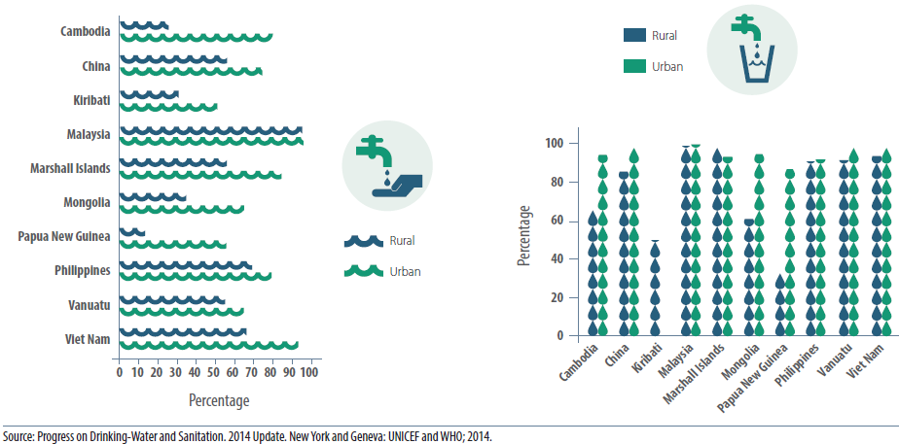
Inequalities: underlying determinants
% population with improved sanitation facility by place of residence, selected countries, Western Pacific Region, 2012
% population with improved drinking water source by place of residence, selected countries, Western Pacific Region, 2012

Slide 7
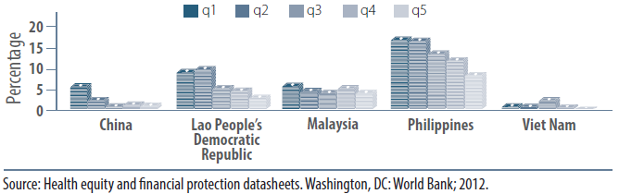
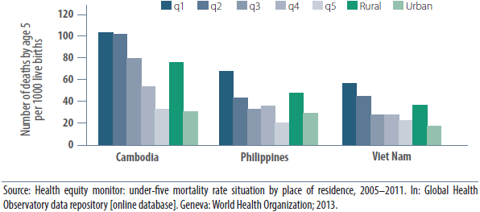
Inequalities: morbidity & mortality
Adult tuberculosis prevalence by wealth, selected countries, Western Pacific, 2012
Under-5 mortality by household wealth and place of residence,
selected countries, Western Pacific Region, 2005-11

Slide 8
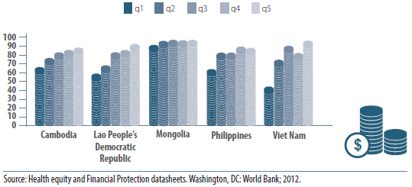
Inequalities: use of services
Percentage of children with full immunization coverage, by household wealth quintile, selected countries, Western Pacific Region, 2005-10

Slide 9
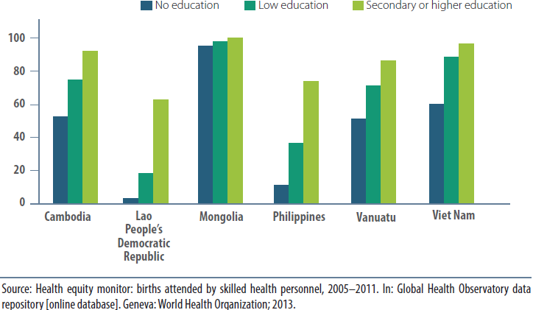
Inequalities: use of services
Skilled attendance at birth by mother’s education,
selected countries, Western Pacific Region, 2005-11

Slide 10
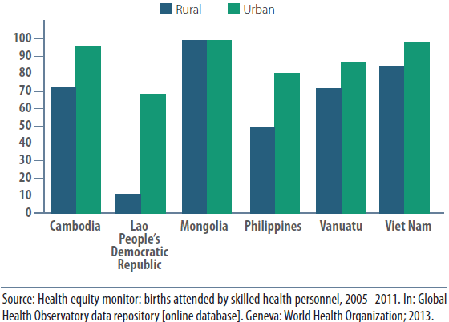
Inequalities: use of services
Skilled attendance at birth by mother’s place of residence,
selected countries, Western Pacific Region, 2005-11

Slide 11
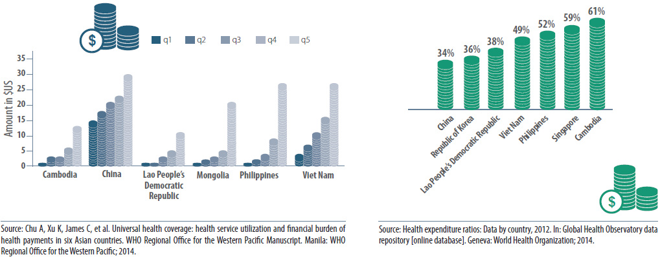
Inequalities: barriers to access
Monthly household out-of-pocket expenditure by income quintile, selected countries, Western Pacific Region, 2007-10
Out-of-pocket expenditures as a % of total health expenditure, selected countries, Western Pacific Region, 2011

Slide 12
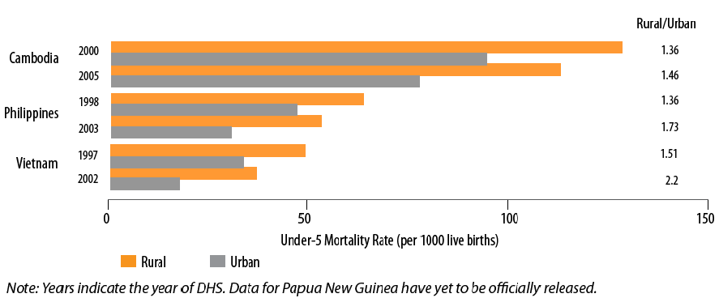
Health inequalities are widening
Under-five mortality – rural-urban rates and ratios, selected countries
Source: UNESCAP, UNDP and ADB, 2010. Achieving the Millennium Development Goals in an Era of Global Uncertainty: Asia-Pacific Regional Report 2009/10.

Slide 13
Life expectancy Māori & Non-Māori
Courtesy of Tony Blakely HIRP & Martin Tobias PHI

Slide 14
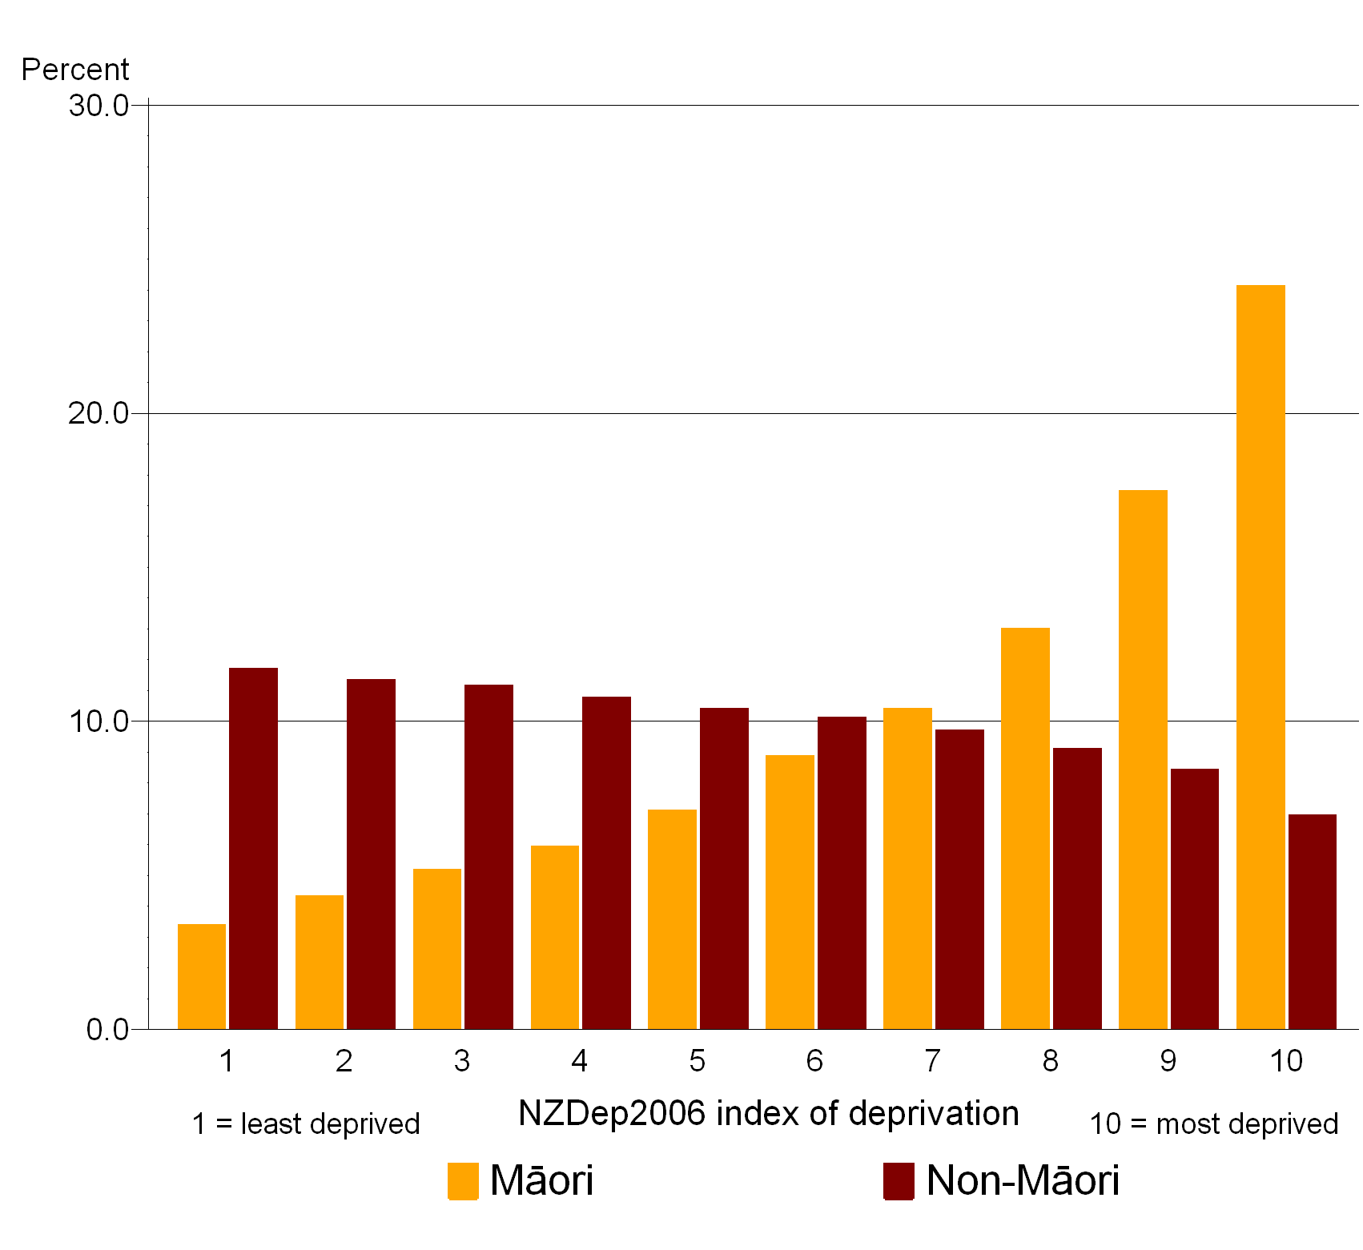
Deprivation distribution, Māori &
Non-Māori, 2006

Slide 15

What Causes Inequality Between Groups?
There are multiple causes of, and a range of theoretical explanations for, inequality in health.
Notes:
What explanations can you think of? Talk to your neighbour for a few mintues

Slide 16
How Do Health Inequalities Arise?
Differences in the quality of care received within the health care system
Differences in access to health care, including preventive and curative services
Differences in life opportunities, exposures, and stresses that result in differences in underlying health status
Dr Camara Jones
Centres for Disease Control
Atlanta, Georgia, USA

Slide 17
Critical Causes
Socioeconomic circumstances
Social exclusion "the process by which individuals are denied the opportunities to participate in the activities normally expected of members of that society”
  For example: sexism, racism, class.
Notes:
While there are many explanations for this unequal distribution, critical factors appear to be socioeconomic circumstances and social exclusion. Points that Tania Riddell makes in her paper on socioeconomic and ethinc inequalities in cardiovascular disease.
Social exclusion is defined as "the process by which individuals are denied the opportunities to participate in the activities normally expected of members of that society" , p29. Examples of social exclusion - stimatising mentally ill, sexism, racism, social class structure.

Slide 18
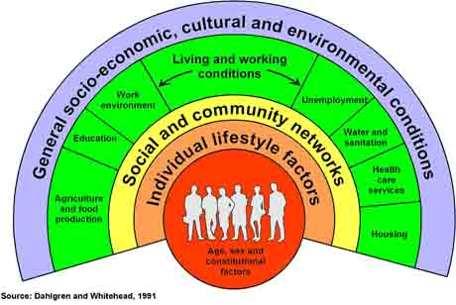
Determinants of Health
Notes:
Evidence suggests that it is the unequal distribution of the determinants of health that causes and maintains inequalities in health.

Slide 19
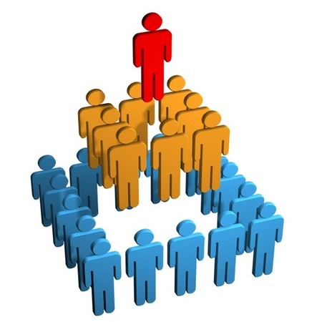
“How long and how well one lives is largely determined by ones place in [social] hierarchies”
Hilary Graham
Notes:
Hilary Graham - how long and how well one lives is largely determined by ones place in [social] hierarchies - class, income, racial, gender hierarchies
END Here

Slide 20

Who is Responsible for
Reducing Inequalities in Health
Action must be taken by everyone
  At all levels
  By all parts of the health sector
  At national, regional and local levels
  With and by other sectors
  Through policymaking, funding, provision of
  services and community action
Notes:
HP has a key role to play

Slide 21
Why should we be concerned?
Why address health equality?
  inequality can be reduced
  International recognition that equity a key health goal
  There is much to gain
Notes:
THERE is cause of optimism
Graham argues that "inequalities in health are not immutable" . They are the result of historical and contemporary policies and programmes in health and other sectors of society. Just as they have developed, they can be reduced.
The challenge of tackling inequalities in health is one being picked up by health agencies internationally.
Health sectors have focused on improving health as their key goal. It has only been in recent years that a clear understanding has emerged that health sectors need another goal, that is to "tackle inequalities in health".
Government's stated key goals - to reduce inequalities in education, employment, housing and health for all disadvantaged groups, and particularly for Māori and Pacific peoples and between men and women p. 24).
The recent New Zealand Health Strategy, for example, acknowledges the need to address health inequalities as "a major priority requiring ongoing commitment across the sector" .
Action - in Ottawa Charter equity fundamental for health
recog…

Slide 22
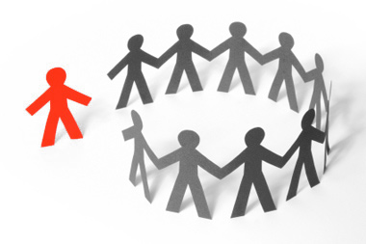
What do we have to gain?
Fairer societies, where everyone has the opportunity for good health
Inclusive societies, where everyone has a sense of belonging and feels that their contribution is valued
Better health and wellbeing for the population as a whole, not just for those groups who are currently experiencing relatively poor health
A stronger economy
Notes:
Reducing inequalities p. 7
Economy - because a healthier population can contribute to a richer social and economic life (Treasury)
income inequalities less, economy stronger, bounce back from recessions

Slide 23
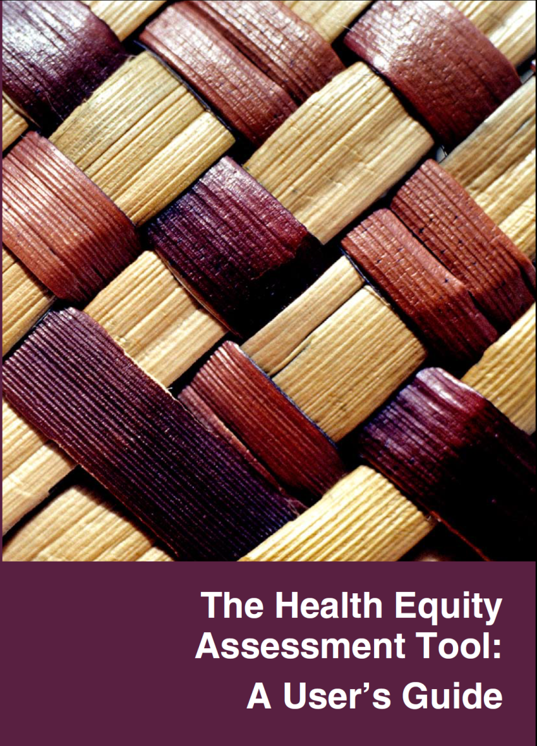
The Health Equity Assessment Tool (HEAT)
Signal, L., Martin, J., Cram, F., and Robson, B.
The Health Equity Assessment Tool: A user’s guide.
2008. Wellington: Ministry of Health
http://www.pha.org.nz/documents/health-equity-assessment-tool-guide1.pdf

Slide 24
What is the HEAT tool?
10-question rapid assessment tool
Assists user to consider equity when planning, implementing and evaluating health interventions
Best used by a group of people who reflect the range of views of the community
Based on health inequalities impact assessment tool developed in Wales
Simple checklist will all the limitations that simplicity brings
Been very effective in helping health sector to consider equity
Notes:
Training team have developed a tool - an equity lens for you to use in your work.
Set of 12 questions that assists the user to consider equity when planning, implementing and evaluating health interventions. Best used by a group of people who reflect the range of views of the community being worked with.
Based on a health inequalities impact assessment tool developed in Wales
Simple checklist will all the limitations that simplicity brings
However, we have found it has been very effective in helping health workers to consider equity.
Going to work through the questions in the tool over the day. This morning we will focus on questions 1-6. In the afternoon you will work through questions 7-12.

Slide 25

Equity Lens In HiAP
Build equity lens into HiAP work
Assess needs of the less advantaged
Intervene with the less advantaged
Intervene in all sectors & at all levels – comprehensive action
Evaluate interventions for progress in tackling inequalities
Amend policies accordingly
Notes:
First, they can build this approach into needs assessments by identifying and addressing the needs of priority groups who are least advantaged. As discussed above, health promoters have strategies for intervening at a number of levels to address inequalities in health.
At the structural level, healthy public policy can be used to address the root causes of inequalities such as racism, poverty and unemployment. At an intermediary level, community action and the development of personal skills can be used to address factors such as the environment, behaviour and access to resources that determine inequalities. At the level of the health system, the health sector can be reoriented to focus on prevention, thereby avoiding the development of illness and disability. At the impact level, a number of different strategies can be used to reduce the impact of illness and disability, e.g. the development of personal skills and advocacy for appropriate policies.
The sector in New Zealand has the TUHA-NZ tool that assists practitioners to prioritise health promotion action that improves Māori health outcomes . Health promotion's apparent commitment to evaluation provides the opportunity to assess progress in tackling inequalities. Finally, health promoters work "upstream" - in prevention rather than cure. It is clear that the earlier in the cycle of inequality that intervention occurs, the less impact the inequality has on health.
Barriers to successful action include: inadequate resources, lack of support to the workforce, and the challenges of the structures that continue to support inequalities. Supports workforce development, equity tools to help understand the issues and how to address them, and support from colleagues .

Slide 26
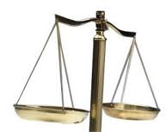
Conclusion
Inequality is cased by the unequal distribution of the determinants of health
Comprehensive action required
HEAT one way to highlight issues
Always use an equity lens in HiAP
Critical component of HiAP

