Slide 1
Module 2: 21st CENTUTY HEALTH DYNAMICS AND INEQUALITIES
Learning objectives
Explain the measurement of burden of disease (DALY)
Summarise commonly used contemporary fact about the burden of disease
Describe major global challenges impacting health
Distinguish health inequities and inequalities
Explain how inequalities influences health out comes

Slide 2
CONVENTIONAL HEALTH AGREEABLES
Health is state of complete physical, mental and social wellbeing and not merely the absence of disease or infirmity
Health is an individual right and a social justice issue. It is also a public good.
Many determinants of health inequities in populations have social, environmental and economic origins that extend beyond the direct influences of health sector and health policies.

Slide 3
200 Years, 200 Countries

Slide 4
Commonly used measure of disease experience in society is DALY:
The burden of disease is a measure of the gap between a population current health and the optimal state where all people attain full life expectancy without suffering ill health. Disability Adjusted Life Years (DALY) measures overall disease burden in number of years lost due to ill-health, disability or early death.
e.g. DALY= Deaths x Discounted Average Number of Life years lost to one death, + (case morbidity rate x probability of contracting the disease x length weighting x disability weighting)
64 x 40 + (0.2 x 0.8 x 10,000 x 0.083 x 0.8)
2,560 +16 = 2,666 DALYS

Slide 5
Non-communicable diseases (NCDs) were responsible for two thirds of all deaths globally in 2011 up from 60% in 2000. (Main NCDs are cardiovascular diseases, cancers, diabetes and chronic lung diseases.
Over the next decades 2011-2030 the leading NDCs are predicted to cost LMIC close to US$ 21.1 trillion which is equivalent to 5% of their annual GDP

Slide 6
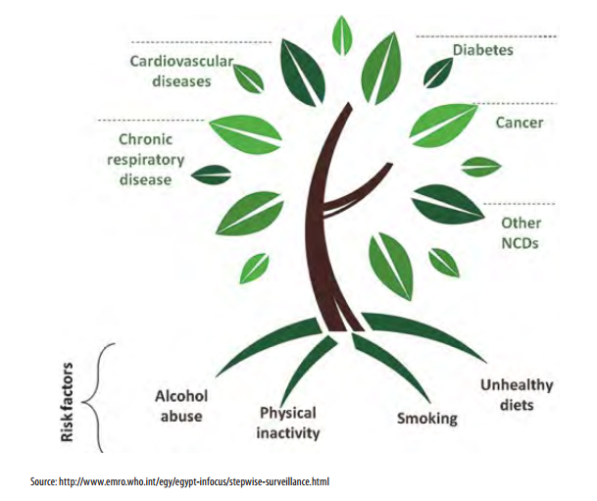
Most NCDs are strongly associated and causally linked with four particular risk factors

Slide 7
Roughly general panorama of health inequities in the world and in the region is as depicted below:
FACTS ON HEALTH INEQUITIES AND THEIR CAUSES
Health inequities are systematic differences in health outcomes
Health inequities are differences in health status or in the distribution of health resources between different population groups, arising from the social conditions in which people are born, grow, live, work and age. Health inequities are unfair and could be reduced by the right mix of government policies.
Every day 21 000 children die before their fifth birthday
They die of pneumonia, malaria, diarrhoea and other diseases. Children from rural and poorer households remain disproportionately affected. Children from the poorest 20% of households are nearly twice as likely to die before their fifth birthday as children in the richest 20%.
Maternal mortality is a key indicator of health inequity
Maternal mortality is a health indicator that shows the wide gaps between rich and poor, both between and within countries. Developing countries account for 99% of annual maternal deaths in the world. Women in Afghanistan have a lifetime risk of maternal death of 1 in 11, while a woman in Ireland has a risk of 1 in 17 800.

Slide 8
Tuberculosis is a disease of poverty
Around 95% of TB deaths are in the developing world. These deaths affect mainly young adults in their most productive years. Contracting the disease makes it even harder for these adults to improve their personal economic condition and that of their families.
About 80% of non-communicable diseases are in low- and middle-income countries
In low-resource settings, health-care costs for non-communicable diseases (NCDs) can quickly drain household resources, driving families into poverty. The exorbitant costs of NCDs are forcing 100 million people into poverty annually, stifling development.
Life expectancy varies by 36 years between countries
In low-income countries, the average life expectancy is 57, while in high-income countries, it is 80. A child born in Malawi can expect to live for 47 years while a child born in Japan can expect to live 83 years.
There are alarming health inequities within countries, too
For example, in the United States of America, African Americans represent only 12% of the population but account for almost half of all new HIV infections. There is no biological or genetic reason for these alarming differences in health.

Slide 9
Health disparities are huge in cities
In London, men's life expectancy ranges from 71 years in Tottenham Green ward (Haringey) to 88 years in Queen’s Gate (Kensington and Chelsea) – a difference of 17 years. According to the findings of the London Health Observatory, when travelling east from Westminster, each tube stop represents nearly one year of life expectancy lost.
Health inequities have a significant financial cost to societies
The European Parliament has estimated that losses linked to health inequities cost around 1.4% of gross domestic product (GDP) within the European Union – a figure almost as high as the EU's defense spending (1.6% of GDP). This arises from loses in productivity and tax payments, and from higher welfare payments and health care costs.
Persistent inequities slow development
Over 800 million people in the world live in slum conditions, representing about one third of the world's urban population. The likelihood of meeting the health-related Millennium Development Goals is lowered by poor health service delivery to hard-to-reach populations such as these.

Slide 10
Group Activity on contemporary Burden of disease. Agree on the order of disease as per DALYs contribution (30 minutes)

Slide 11
Global Challenges
The 21st Century brings many complex and interactions challenges:
Globalization- trade, migration and industrialization – the world has become more economically connected, the number of people travelling is rising at very high rate, many low and middle income countries have achieved a big measure of industrialization
Globalization has impacted on health in many ways: trade and travel increase the risk of global epidemics e.g. SARS, Ebola, spread of hazards including contaminated foods and other products, industrialization puts pressure on environment, risk of poor standards, pollution and contamination

Slide 12
Urbanization – The world is becoming rapidly urban, it is estimated that between 2010 and 2050 the world will move 50% to 70% urban. The point is slum expansion- strain on infrastructure and access to amenities.
Rapid urbanization is accompanied by poor sanitation, lack of access to electricity, use of bio-fuels in crowded places etc. All these affect health negatively by contributing to infectious disease and the NCDs

Slide 13
Environmental Degradation – Growing evidence shows that humanity is undermining the stability of earth’s ecosystem. The earths bio-physical systems are being undermine by human activity
The anticipated global warming of 2-4 degree centigrade by 2100 will cause higher decrease in crop productivity in the warm zones of Africa, Asia and Latin America
Endemic morbidity and mortality due to communicable diseases associated with floods and droughts is expected to rise throughout Asia and Africa

Slide 14
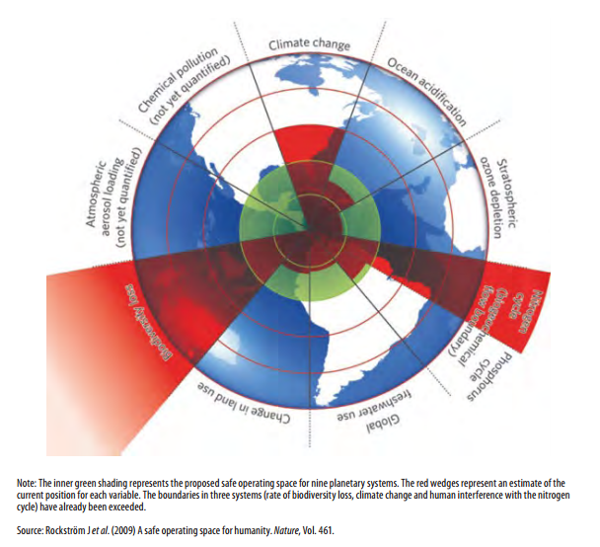
Beyond the boundary

Slide 15
Economic growth, poverty and governance – economic growth that is generating socio inequalities.
It is estimated that almost half of the world wealth is owned by just 1% of the population and that 85 richest individuals own the equivalent of the wealth owned by 3,5 billion of the world population.
In many African countries 50% of the population live on less than 2 dollars a day. – Socioeconomic inequality is a key social determinant of health because it shapes the conditions in which we grow, live, work and age.

Slide 16
Demographic transition – The population of the world will be 9.1 billion by 2050, median age in the developed countries will be 46 and 37 in the developing countries.
The important point is that health systems will be strained because more people will be needing services especially for the costly chronic NCDs. There will be a relatively smaller work force.

Slide 17
Example- Effect of rural urban divide on quality, quantity and type of care people can access
Each group will identify an inequality and discuss how it impacts on health.
Group Activity: Health inequalities

Slide 18
Notes:
Health in equities are the unjust differences in health between persons of different social groups and can be linked to forms of disadvantage such as poverty discrimination and lack of access to services
Equity stratifiers include socioeconomic status, education, place of residence (urban, rural etc), race or ethnicity, occupation gender and religion

Slide 19
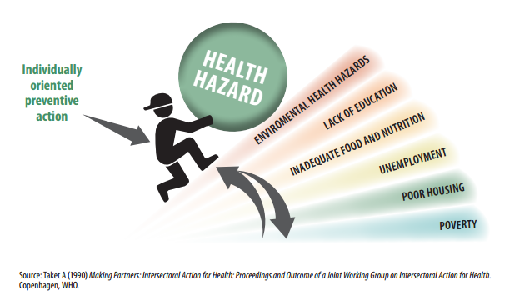
The health gradient

Slide 20
Questions and feedback 5-10 minutes

