Slide 1
Health in All Policies (HiAP) Workshop
Paramaribo, Suriname
5-6 May 2015
Ballroom TORARICA

Slide 2
21st Century Health Dynamics and Inequality
Facilitator: Dr Emily Henderson
e.j.henderson@durham.ac.uk

Slide 3
Session structure
Review of learning objectives
Recap of session 1.4
Video on life expectancy
Group activity on the contemporary burden of disease in the Caribbean context
Lecture: Global challenges and health dynamics
Group activity: Health inequalities in the Caribbean context
Questions and feedback

Slide 4
Learning objectives
• Explain the measurement unit “DALY” (disability-adjusted life year)
• Summarize stylized facts about the contemporary burden of disease
• Describe some of the major global challenges impacting health
• Distinguish health inequality and health inequity
• Explain how inequality influences health outcomes

Slide 5
Recap of session 1.4
Health is a state of complete physical, mental and social well-being, and not merely the absence of disease or infirmity.
Health is an individual right and a social justice issue. It is also a public good.
Many determinants of health and health inequities have social, environmental and economic origins that extend beyond the direct influence of the health sector and health policies.
Thus, public policies and decisions made in all sectors and at different levels of governance can have a significant impact on population health and health equity.

Slide 6
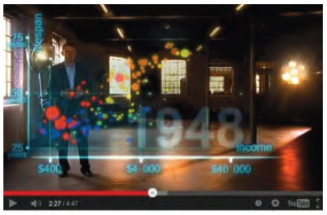
Video
LIFE EXPECTANCY “200 YEARS, 200 COUNTRIES, 4 MINS”
https://www.youtube.com/watch?v=jbkSRLYSojo

Slide 7
Group activity: Contemporary burden of disease in the Caribbean context
Handout 2.1 The changing burden of disease in the Caribbean context

Slide 8
Burden of disease
A measurement of the gap between a population’s current health and the optimal state where all people attain full life expectancy without suffering major ill-health.
Disability-adjusted life year (DALY) is one measure of overall disease burden, expressed as the number of years lost due to ill-health, disability or early death

Slide 9
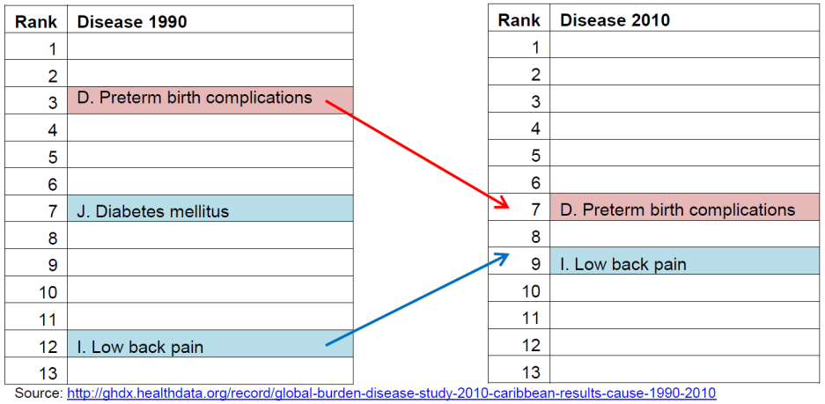

Slide 10
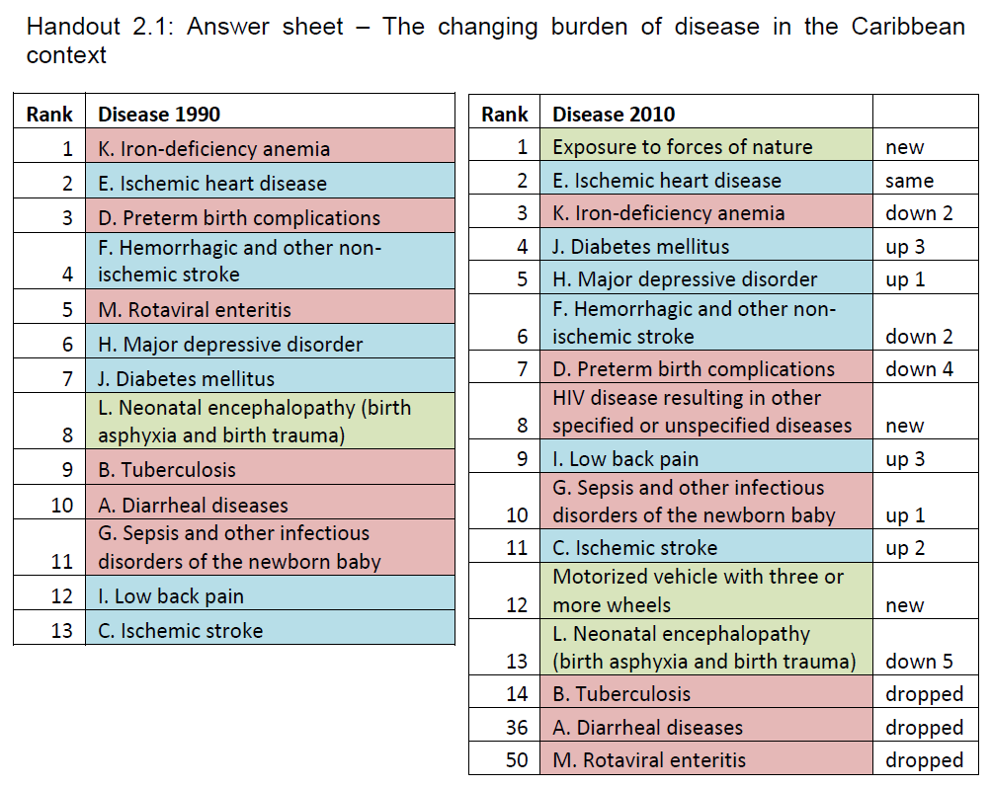
-All non-communicable diseases up except non-ischemic strokes (down 2)
-Some communicable diseases up some down
-Two new trauma related diseases and one new communicable disease

Slide 11
Points to consider
Globally, communicable diseases and injuries declining
Excepting HIV and disasters in low- and middle-income countries
Non-communicable diseases are growing
The indirect cause is associated with global trends (industrialization, increasing trade and economic integration, and urbanization)
The combined burden of NCDs is rising fastest among low- and middle-income countries where NCDs are often detected later
Demographic transition from a relatively younger to older population

Slide 12
Lecture: Global challenges and health dynamics

Slide 13
Globalization: trade, migration and industrialization
Economic interconnectedness
Between 1950 and 2000, the global volume of trade increased by a factor of nearly 200.
Travel and migrating increasing
Between 1995 and 2012, the number of international tourist arrivals annually doubled from 530 million to 1.1 billion. In 2010, the number of international migrants was 214 million, and based on current trends could reach 405 million by 2050.
Many low- and middle-income economies industrialized and grown
rural to urban migration, urbanization and socioeconomic change.
Impact on health
global epidemics; occupational accidents; poor construction and planning; more pollution and over-exploitation of natural resources.

Slide 14
Economic growth, poverty and governance
A large percentage of the world’s population still lives in poverty.
In 2005, around 2.6 billion people survived on less than USD 2 per day
Increasingly more poverty in middle-income countries
challenges North-South models of development assistance and encourages more public investment in social protection.
The concept of universal health coverage (UHC) is critical
Shift in the discourse of public policy and governance towards neoliberalism.
strict fiscal discipline, tax reform to benefit corporations and higher income individuals, market-determined exchange rates and interest rates; free trade and free capital flows, as well as state privatization and deregulation.
In the health sector, this has led to less public health spending, fewer health care services and higher out-of-pocket expenses

Slide 15
Socioeconomic inequality
Parallel to poverty, there is also socioeconomic inequality
In 2000, 85% of the world’s population were living in countries where inequality was increasing.
The difference between the top and bottom 20% of the world’s population has widened from 30:1 in 1945 to 60:1 in 1970 to 82:1 in 2000.
Today, almost half of the world’s wealth is owned by just 1% of the population and the richest 85 individuals own the same amount of wealth as the bottom half of the world’s population or approximately 3.5 billion people.
Socioeconomic inequality is a key social determinant of health because it shapes the conditions in which we grow, live, work and age.

Slide 16
Environmental degradation
Conserving the earth’s ecosystem is a precondition for economic and social development, including good health.
Global warming of 2°C to 4°C by 2100 expected to be greater in the more populous and poorer regions of Africa, Latin America and Asia.
In seasonally dry and tropical regions, crop productivity to decrease for even small temperature increases
intensifying food insecurity
Endemic morbidity and mortality due to communicable diseases associated with floods and droughts is expected to rise throughout Asia.

Slide 17
Group activity: Health inequalities in the Caribbean context
In your small groups, brainstorm how inequality might impact on health and why it matters.
List some different types of inequality and give an example to share with the overall group
Health inequities are the unjust differences in health between persons of different social groups, and can be linked to forms of disadvantage such as poverty, discrimination and lack of access to services or goods.

Slide 18
Points to consider
Equity vs Inequality
Health inequity is a normative concept
Health inequality – observable differences between subgroups within a population – can be measured and monitored, and serves as an indirect means of evaluating health inequity. E.g life expectancy
Equity stratifiers (groups and individuals):
Socioeconomic status; Education; Place of residence (rural, urban etc.); Race or ethnicity; Occupation; Gender; and Religion.
Socioeconomic status can partly account for differences in life expectancy.
Poor living conditions, inadequate nutrition and poor antenatal care explain child mortality
Education increases health literacy
gender can make a significant difference due to social attitudes about the value of men and women. For example, parents might be more likely to take a son to get immunized than a daughter because of social customs that value men over women.

Slide 19
Points to consider
Equity stratifiers can ovelap
it is not always possible to say, for example, whether relatively high child mortality in a poor rural area is due primarily to place of residence, socioeconomic status or education since they are related.
Key to our understanding is the social gradient in health.
income and education differ by degrees. In general, the more severe the inequality, the steeper the health gradient.
A HiAP approach directly addresses inequalities by looking to improve the social determinants of health that the different and unequal conditions in which people grow, learn, live, work and age produce.

Slide 20
Suriname equity profiles
Suriname’s life expectancy at birth increased from 67.4 years to 68.7 years for men and from 72.8 years to 73.7 years for women (2004-2009)
Inequalities between ethnic groups, rural/urban areas and genders
59% of households in Paramaribo and Wanica were living below the poverty line in 2003
the most severely disadvantaged groups are children of Maroon descent who have migrated from the interior to urban districts
unemployment rates decreased from 12% in 2006 to 9% in 2009 but disproportionately higher (16.7%) exists in rural interior
49% enrollment in secondary school (2008–2009) but as low as 3% in Sipaliwini in the rural interior
data are not consistently disaggregated by sex to allow for gender analysis, the nation’s policies and programs do not systematically include a gender equality perspective

Slide 21
Questions and feedback

