Slide 1
Module 11: The Leadership Role of Health Sector in Health in All Policies

Slide 2
Learning Objectives
Explain the leadership role of Health Sector in HiAP
Describe role of WHO and other partners
Apply the knowledge & Skills by outlining a contemporary Health ministry
Identify key skills for Health professionals for promoting HiAP

Slide 3
Major roles of health authorities in HiAP
Government has ultimate responsibility for health of the people
Health authorities (professionals) are key actors
Evidence based identification, definition & prioritization of health issues
Use/Establish mechanisms of dialogue across government & whole of society
Implement, monitor & evaluate policies & their implementation

Slide 4
Role of Health Authorities
Collaborate & Partner with other ministries, stake holders & CSOs
Strengthen capacity to use & generate evidence
Promote understanding of social determinants of health and health inequity
Manage, negotiate competing interests
Support development, implementation, monitoring & evaluation of HiAP

Slide 5
Challenges
Access to & ability to influence politicians
Political commitment and discontinuity
Politicization of bureaucracy & corruption
Difficulty in gathering and disseminating evidence
Limited resources including leadership skills among public health professionals

Slide 6
Role of WHO
Brings Health consideration into global, regional & national policy making
Support policies for health promotion & protection
Share good practices and lessons learned
Technical assistance to countries for HiAP
Capacity building of health professionals & civil servants

Slide 7
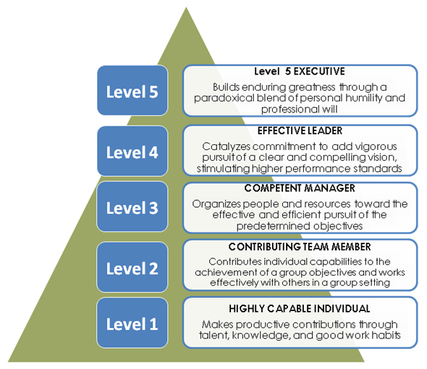
Leadership among Health Professionals
Jim Collins 5 levels of Leadership
Notes:
Level 1 – Highly Capable Individual: Makes productive contributions through talent, knowledge, skills, and good work habits
Level 2 – Contributing Team Member: Contributes to the achievement of group objectives; works effectively with others in a group setting.
Level 3 – Competent Manager: Organizes people and resources toward effective and efficient pursuit of predetermined objectives.
Level 4 – Effective Leader: Catalyzes commitment to and vigorous pursuit of a clear and compelling vision; stimulates the group to high performance and standards.
Level 5 – Level 5 Executive: Builds enduring greatness through a paradoxical combination of personal humility plus professional will.

Slide 8
Keeps an eye on external world and benefiting the society: Keeps in touch with what is happening in the external environment. Ensures that the organization contributes to the good of the society through its products and social welfare activities
The Three Circles Leadership Model (Ref Kumar S, Adhish VS, Deoki N. Making sense of theories of leadership for capacity building. Indian J Community Med 2014;39:82-6.)
Enables the organization by developing individuals
Execution of the vision by coaching, Motivation, Delegation, right person in right job, see their role in the vision
The Leader has vision, charisma, integrity, self awareness, strong commitment and change, social, emotional and intellectual intelligence

Slide 9
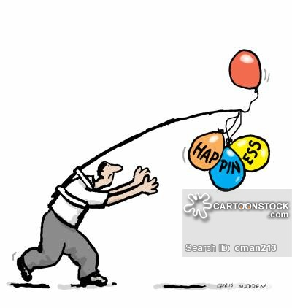
The Skills required for Pursuit of Health in All policies or Happiness

Slide 10
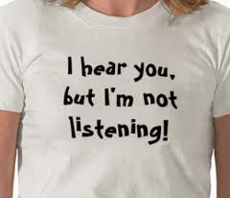
1. Listening Skills
“Most people do not listen with the intent to understand; they listen with the intent to reply.” Stephen R. Covey, The 7 Habits of Highly Effective People: Powerful Lessons in Personal Change

Slide 11
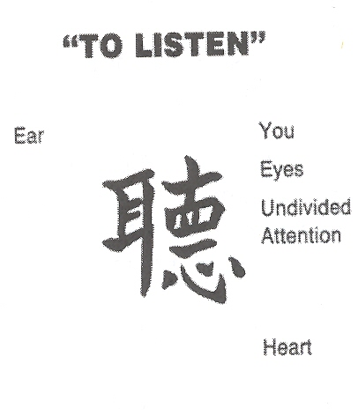

Slide 12
Seven simple ways to enhance listening
Face the speaker
Maintain eye contact
Focus solely on what the speaker is saying
Keep an open mind
Avoid tell the speaker how you handled similar situation
Even if speaker is complaining, wait until he finishes
Engage yourself

Slide 13
2. Advocacy Skills
The act of pleading or arguing in favour of something
Highlights to change the “what is” into a “what should be”
A process by an individual or group which aims to influence policy and resource allocation decisions within political, economic, and social systems and institutions
Advocacy can include many activities that a person or organization undertakes including media campaigns, public speaking, publishing research etc

Slide 14
Documents for advocacy
Research Update
Abstract
Policy Brief
Talking Points
Research Summary
Report
Publication in Journal
Press Release
Fact Sheet
Power Point
Website/Internet
Television/ Radio spots
Article in newspapers
Article in magazines
and many others...

Slide 15
KEY ACTORS
Think Tanks
Policy Champions
Peers
Bureaucracy
Media
Civil Society
Political Class
Judiciary

Slide 16
Techniques and Tactics
Advocacy techniques and tactics | Audience/Stakeholder Category
 | Beneficiaries | Partners | Adversaries | Decisionmakers
Sensitization
Mobilization
Dialoguing
Debating
Negotiating
Lobbying
Petitioning
Pressuring

Slide 17
When Opportunity Knocks
A one-minute message includes:
The statement of the issue
Evidence to support the issue
An example of the problem
The desired policy action
Ideally, only one main point should be communicated (or, if that is not possible, two or three points at the most)

Slide 18
3. Networking Skills
What is networking
Cultivation of productive relationships for employment or business
A force multiplier in advocacy efforts to achieve professional and personal goals
In today’s world
Virtual Networking: Various professional and social networking sites need to be used effectively to reach out those in your contact easily and fast to communicate and mobilize like-minded persons and groups
Face to face networking: strong way of making new contacts and effectively maintaining old contacts

Slide 19
Forms of Networking
Form Characteristics | Operational | Personal | Strategic
Purpose | Work done effectively | personal & professional development | Future priorities and challenges
Temporality | Mainly internal Current demand | Mostly external | Internal & external, future oriented
Context | Prescribed by task | Prescribed by task | Strategic context and environment
Network Attributes | Depth | Breadth | Leverage
Key Behavior | Building strong relationship | Contacts & referrals | Inside & outside linkages
Source: Three Forms of Networking, Ibarra H and Hunter M Hon, Leaders Create and Use Networks, HBR Jan 2007.
Notes:
As a manager moves into leadership role his network must move itself externally and towards future.

Slide 20
4. Emotional Competencies
Emotional Intelligence (Salovey & Meyers) “a type of social intelligence that involves the ability to monitor one’s own and others’ emotions, to discriminate among them, and to use this information to guide one’s thinking and actions”
4 X more important than IQ in determining professional success
High emotional intelligence has a relationship to strong job performance

Slide 21
Four areas of Emotional Competencies
Competencies/ Skills | Self | Others
Awareness | Perceive one’s emotions Early. identify triggers which generate them | Reading emotions of others around us
Managing | Not behaving under the influence of emotions i.e. not letting emotions hijack one’s behavior | Managing emotions of others around us to achieve results

Slide 22
5. Working with Difficult Persons/Behaviors
A difficult person is anyone who causes irritation, upset, stress or anxiety
It is difficult ‘behavior’ rather than ‘person’
There are three levels of difficult persons:
Difficult some of the times. includes almost everyone
When a person’s behavior affects more than one person on a regular basis
Include persons who purposely hurt or harm others through their behavior

Slide 23
Three skills to deal with difficult Persons
Keep your focus on the problem and not on the person, otherwise, even non issues will become issues
Agree with the person what are the issues that need to be addressed. Focus your conversation on logic and issues
Look for option agreeable to both of you

Slide 24
Sum up
Health Sector professionals have to take a leadership role for leading HiAP
Challenges in leading HiAP
WHO is committed to support country efforts to promote HiAP
Five main skills for Health professionals for promoting HiAP

Slide 25
Thank You

