Slide 1
Public Health Summer School
10. Evaluating Health in All Policies: South Australia’s Experience
Carmel Williams, Manager
Strategic Partnerships
Public Health Services
SA Health

Slide 2
Health in All Policies Evaluation
Evaluation methodology includes the following components:
process evaluation (i.e. did it meet the needs of all agencies involved; did it help to develop a collaborative climate?)
impact evaluation (i.e. is there documentary or other evidence that health issues have been incorporated)
outcome evaluation (i.e. what measures or proxy measures can be used to indicate medium to long term change i.e. have partner agencies’ policy priorities and health impacts been positively progressed?)
Evaluation of Health Lens projects
National Health & Medical Research Council
5 year Project Grant
Notes:
2

Slide 3
Health Lens Evaluation
Health lens project evaluation
Each Health Lens is evaluated to determine its success.
Has a collaborative relationship developed?
What has been the impact of the policy decisions of partner agencies – where have the recommendations been adopted?
Did their goals benefit from the process?
What determinants were influenced through this work?

Slide 4
Health Lens Analysis
- evaluation outcome
General Observations
Development of a shared understanding and integrated strategy between partner agencies
Effective integration of health considerations into other policies and sectors beyond the health sector.
The HiAP process was valued by partner agencies
Improved recognition by other agencies about their contribution to health determinants
Collaborative and synergistic relationships developed between partner agencies
HiAP project recommendations are being adopted and incorporated into core work of partner agencies.

Slide 5
Health Lens Analysis
- Specific Outcomes
Process and early impact evaluation – four projects completed.
Findings to date suggest the HLAs have resulted in:
Increased understanding of policy makers regarding the impact of their work on health outcomes
Changes in policy direction
Development and dissemination of policy relevant research
Greater understanding and stronger partnerships between health and other government departments
A positive disposition toward employing health lens analyses in future work.

Slide 6
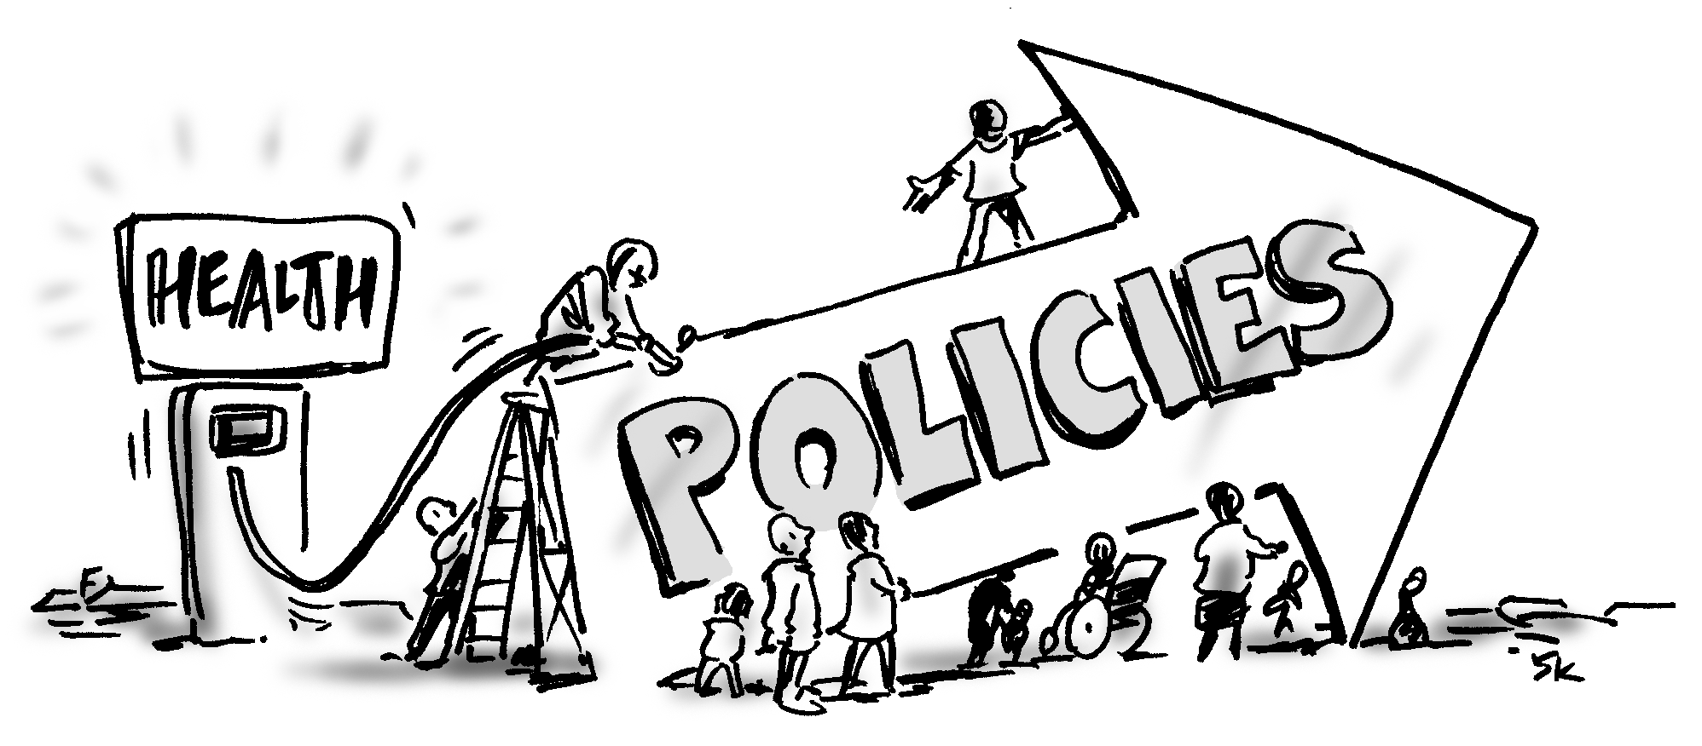
NHMRC Evaluation
National Health and Medical Research Project Grant
Does a Health in All Policies approach improve health, well-being and equity?
Notes:
6
Key questions
Challenges of working in the SDH policy space – complicated
More information about the grant can be found on the flinders university website.

Slide 7
Research partnership: Chief Investigators
Fran Baum
Liz Harris
Ilona Kickbusch
Colin MacDougall
Dennis McDermott
Angela Lawless
Associate Investigators
Danny Broderick
Kevin Buckett
Michael Marmot
Sandy Pitcher
NH&MRC- Baum et al 2013

Slide 8
Associate Investigators (Cont.)
Deb Wildgoose
Jennie Popay
Andrew Stanley
Carmel Williams
Research staff
Toni Delany-Project manager
Laura Jones- Research assistant
PhD candidate- TBA
NH&MRC- Baum et al 2013

Slide 9
NHMRC evaluation
The evaluation will examine:
To what extent is SA HiAP approach an effective method of building healthy public policy to modify the SDH across sectors of government.
To what extent does the application of policy agenda setting and implementation theory explain the strengths and weakness of the HiAP model as a means of bringing about action on the SDH, well-being and health equity across sectors of government?
How effective is the combination of a program logic and action research as a framework for determining the impact of a complex multi-sectoral policy initiative on population health?
NH&MRC- Baum et al 2013
Notes:
9
Key questions
Challenges of working in the SDH policy space – complicated
More information about the grant can be found on the flinders university website.

Slide 10
Concurrent stages of the research
Building theories and mapping context
- Program Logic
- Interviews
Testing the
theories and examining
practice
Assessments
and case studies
Annual surveys
- Observations
Synthesis and triangulation of data
Collaborative
examination of
emerging
findings
Dissemination of findings
NH&MRC- Baum et al 2013

Slide 11
Overview of work completed so far
Interviews
CEs and Senior policy staff (27)
Political and other non-bureaucratic actors (4)
Other key informants (15)
Observations
Context mapping
Documenting changes
5
1
Data analysis
4
2
Program Logic
2 workshops
Assessment of
HiAP work
4 HLA projects
Document analysis
Participant interviews (23)
3
Online survey
168 responses
NH&MRC- Baum et al 2013

Slide 12
Public Servants Reactions to Health in All Policies
Results from Survey
NH&MRC- Baum et al 2013

Slide 13
What impact do you consider that policies in your department have on health and wellbeing?
Strong impact
Moderate impact
No impact
64% Health
(n=39)
35% Other
departments
(n=30)
21% Health
(n=13)
42% Other
departments
(n=36)
0% Health
(n=0)
6% Other
departments
(n=5)

Slide 14
I feel that I understand what the social determinants of health are
Strongly agree or Agree
98% Health
(n=60)
75% Other
departments
(n=64)
NH&MRC- Baum et al 2013

Slide 15
What impact do you consider the policies in your department have on health equity?
Strong or moderate impact
73% Health
(n=44)
50% Other
departments
(n=43)
I am unfamiliar with the term health equity
1.7% Health (n=1) 21% Other departments (n=18)
NH&MRC- Baum et al 2013

Slide 16
How would you rate your understanding of Health in All Policies in South Australia?
Excellent and
Very good
Good
Average and
Poor
53% Health
(n=35)
36% Other
departments
(n=31)
33% Health
(n=21)
31% Other
departments
(n=26)
13% Health
(n=8)
32% Other
departments
(n=26)

Slide 17
Collaboration with HiAP is more complex than other areas of my work
Strongly agree or Agree
Neither agree or disagree
25% Health
(n=13)
14% Other
departments
(n=10)
57% Health
(n=29)
58% Other
departments
(n=42)
NH&MRC- Baum et al 2013

Slide 18
What are the strategies and activities we call HiAP?
SA Health in All Policies ‘approach’
What’s happening between doing HIAP…
…and reaching these big picture outcomes?
Avoids harmful health impacts
Improve population health
Improve health equity
Improve accountability of policy-makers
Sample text
Sample text 2
Sample text
Sample text 2
Sample text
Sample text 2
Sample text
Sample text 2
Causal inference is a crucial part of linking inputs and activities to outcomes
NH&MRC- Baum et al 2013

Slide 19
Capturing context
Programs operate according to the conditions into which they are placed
Local context: organisational culture, staffing, history, beliefs …
Wider political and policy context
NH&MRC- Baum et al 2013
Notes:
Can be smooth sailing

Slide 20
Capturing context
Programs operate according to the conditions into which they are placed
Local context: organisational culture, staffing, history, beliefs …
Wider political and policy context
NH&MRC- Baum et al 2013
Notes:
Or meet more challenging conditions

Slide 21
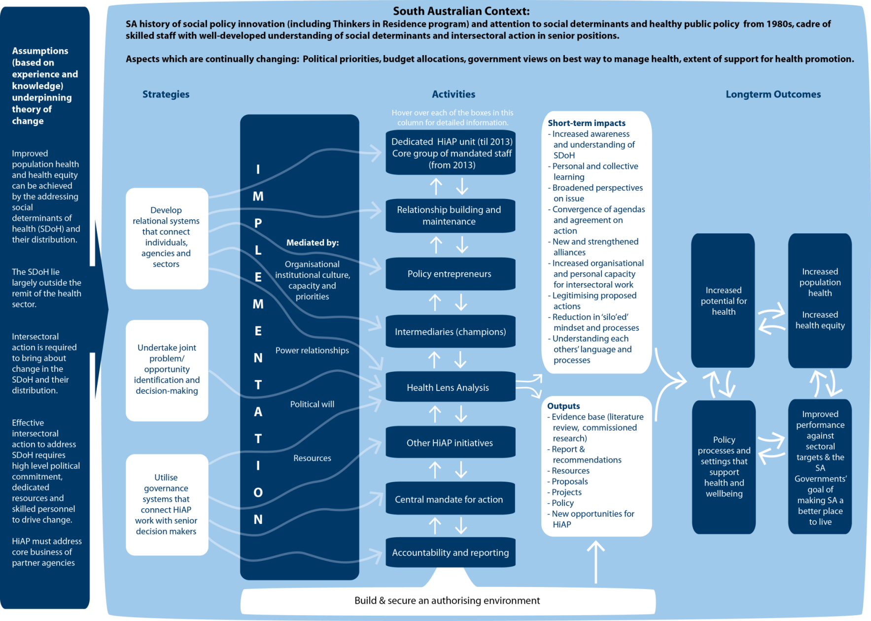
Preliminary Program Logic Model
NH&MRC- Baum et al 2013
Notes:
Participants to have A3 handout

Slide 22
Health in All Policies
What works…
for whom…
in what circumstances?
NH&MRC- Baum et al 2013

Slide 23
Acknowledgements
HiAP Health Lens Partner Agencies
Health in All Policies Unit members
NH&MRC Investigators and research team
For further information please visit the website:
http://www.sahealth.sa.gov.au/healthinallpolicies
hiap@health.sa.gov.au
Notes:
23

Slide 24
Notes:
24

