Slide 1




Health in All Policies (HiAP) Workshop
Paramaribo, Suriname
5-6 May 2015
Ballroom TORARICA

Slide 2



The Determinants of Health
Facilitator: Dr Emily Henderson
e.j.henderson@durham.ac.uk

Slide 3
Session structure
Review of learning objectives
Group discussion on what is health and well-being
Group discussion on factors determining health
Video on social determinants of health
Questions and feedback
Comfort break 5 mins

Slide 4
Learning objectives
• Explain the concepts of health and well-being
• Recognize the responsibility of states to uphold the health of their population
• Identify socioeconomic, biological and behavioural factors that influence health
• Explain the social determinants of health

Slide 5
Group discussion:
What is health and well-being?
“What kind of places do you think of when we talk about health?”
“What kind of people do you imagine?”
“What keeps us healthy and well?”
“What place does health have in society?”

Slide 6

Definitions of health
•Handout 1.1 ‘Definitions of health’

Slide 7
Summary of definitions of health
• Health is a state of complete physical, mental and social well-being, and not merely the absence of disease or infirmity;
• Health is an individual right and a social justice issue;
• Health is a public good; and
• Governments have a responsibility for the health of their peoples.

Slide 8
Group discussion:
Factors determining health
•Handout 1.1Definitions of health

Slide 9
What determines health?
•Many factors combine to affect the health of individuals and communities.
Whether people are healthy or not, is determined by their circumstances and environment.
The determinants of health include:
• The social and economic environment;
• The physical environment; and
• A person’s individual characteristics and behaviours.

Slide 10
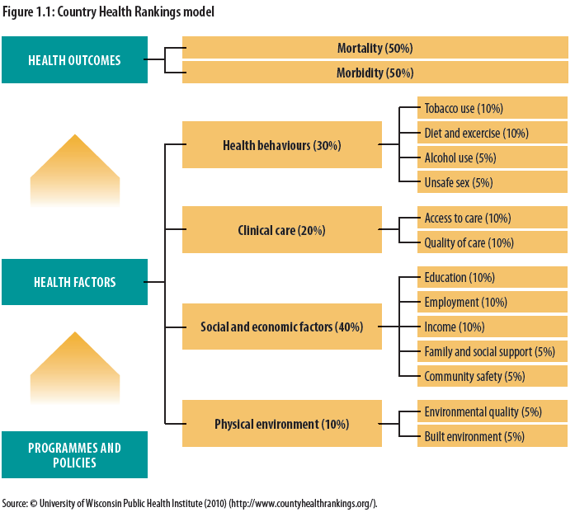

Slide 12
Social model of health
The context of people’s lives determines their health
Blaming individuals for having poor health or crediting them for good health is inappropriate.
Individuals are unlikely to be able to directly control many of the determinants of health.

Slide 13
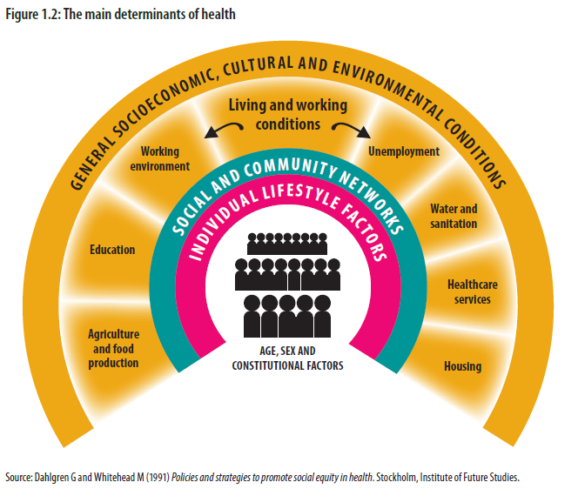

Slide 14
Video:
Social determinants of health
http://www.who.int/social_determinants/mediacentre/en/

Slide 15
Questions and feedback

Slide 16
Comfort break
•Please feel free to stretch or use the facilities for:
5 minutes

