Slide 1
Health in All
Policies
A collaboration between the World Health Organization Western Pacific Region and the University of Otago, Wellington
With:
Carmel Williams, South Australia
Anjana Bhushan, WHO
Anna Stevenson, Christchurch, New Zealand
Rob Quigley, Wellington, New Zealand
Louise Signal, Wellington, New Zealand
Public Health Summer School 15 – 17 February 2016
Notes:
Key themes in the ECHO report
Focus on healthy eating – why major part of the problem
Children up to 18 as UNCROC
Guiding principles - …
Strategic Objectives – list and highlight first “tackle the obesogenic environment and norms
Reading - preface
Fiscal measures,
Environments - particular focus as ECHO does on school envirionment
Advertising
Pleasing to see the focus on access to healthy foods in disadvantaged communities
Focus on first set of recommendations – tax, advertising, healthy food environments, access to healthy foods
Cover off child poverty as a key factor in the obesity epidemic as ECHO acknowledges
5.1-5.3
Comprehensive programmes
Something on stakeholder’s roles
Wrap up with submit to ASA review

Slide 2
1. The Determinants of Health
Louise Signal
Associate Professor
University of Otago, Wellington

Slide 3
What is health?
Notes:
What is health to you?
Talk with your neighbour
Few call outs

Slide 4
Health is a contested concept
Medical “clockwork” model
Health as defined by the people
Critical understandings of health
Health as an outcome
Health as a characteristic of place or environment
(Baum 2008)
Notes:
Read Baum p. 3 para 1. from 3rd sentence
1. The body as a machine. What biomedicine has not done well is to considered disease within the context of peoples’ lives
Disease and illness. Although there has been a system of social medicine. By medicine has limited emphasis on mental health
2. Ordinary people’s perspectives requote page 6 and page 7 and spiritual aspectsP.10
3.Critical perspective P.10/11
4. Health as outcome
5. Health and place-places or ecosystems

Slide 5
World Health Organization Definition
Health is "the complete state of physical, mental and social well-being, and not merely the absence of disease or infirmity" (World Health Organization)
Notes:
Discuss with neighbour
Rootman and Raeburn begin their article on the concept of health by saying "even a cursory look at the literature on the concept of health shows that it is a minefield". Health is both personal and social and it consumes enormous amount of public and private money.
Many definitions
The medical definition has dominated the health arena for most of the century. What is it? "The absence of disease".
Next to medical definitions of health they state that, "undoubtedly the most influential definition in the century has been that of the World Health Organisation". It has been profoundly influential in health promotion and has paved the way for the social model of health.
World Health Organization definition: health is "the complete state of physical, mental and social well-being, and not merely the absence of disease or infirmity" World Health Organization constitution, 1947.
Criticisms: relate to this definition’s generalisation that "health is more than the absence of disease". This definition puts no boundaries on what it is possible to encompass by the term health hence, there is no limit on what we do in health and no limit on expenditure either. Largely comes from those with traditional medical perspective. Clear evidence that broad approach is critical to addressing health and to reducing inequalities in health.

Slide 6
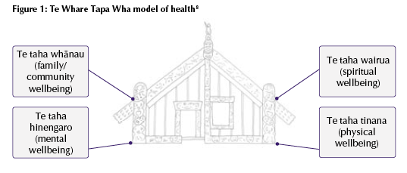
Te Whare Tapa Wha (Durie, 1994)
Notes:
A Māori view of health encompasses tinana (the physical element), hinengaro (the mental state), wairua (the spirit) and whänau (the immediate and wider family) within the health pounamu (Murchie, 1984). Also known as the Whare Tapa Wha (Durie, 1994), these aspects occur in the context of Te Whenua (land providing a sense of identity and belonging), Te Reo (the language of communication), Te Ao Turoa (environment) and Whanaungatanga (extended family) (Tamariki Ora, 1993:24) 1992). Māori health is therefore more than the absence of disease; there is a focus on well-being.

Slide 7
Māori models of health
Whare Tapa Wha
Taha wairua
Taha hinengaro
Taha tinana
Taha whānau
WHO definition consistent with Māori health perspectives
Notes:
Model of health in New Zealand.
In the early eighties Mason articulated a view of health which accorded with contemporary Maori thinking. Can anyone outline contemporary Māori model of health? Would anyone like to describe that model?
Whare Tapu Wha – p. 69 table 12. Follow in readings. Four walls of a house. All four necessary for health
Concludes, page 78, "Generally, however, Maori health perspectives were consistent with new originations and global trends". – consistent with WHO definition –although what would we add - spirituality/culture
First prinicple of health promotion
While definitions of health vary: Health promotion has a broad definition of health. It views health as consisting of physical, mental, spiritual, social, and whanau/family wellness, not merely the absence of disease or infirmity. This definition of health has implications for what we do as health promoters, and why we do it. We work in a broad way because we understand that health is a broad concept.

Slide 8
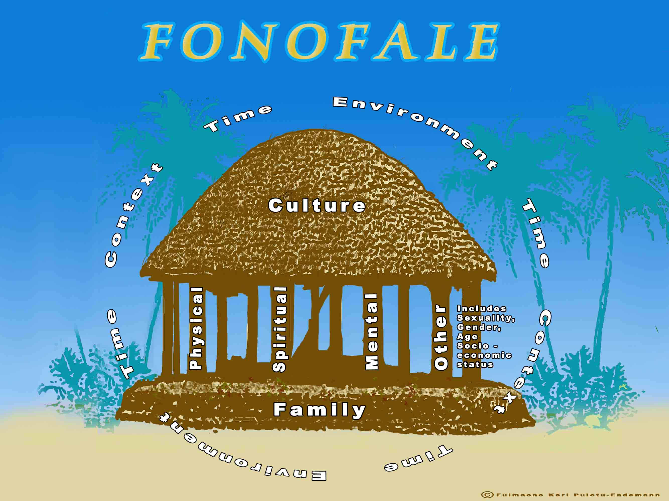
Notes:
Karl Pouluto-Endemann
Fonofale Model of health – broader than te whare tapa wha

Slide 9
Health in Summary
Range of definitions
Health in All Policies approach takes broad perspective
Interested in people’s own perspectives
Balance this with demands of funders/managers/health experts who may be more focused on mechanistic, medical, physical definition
Analyse the meaning of health in your context as we work over the next three days

Slide 10
What determines health?
Notes:
What determines health?
What do we need to be healthy?
Talk with your neighbour
Call out

Slide 11
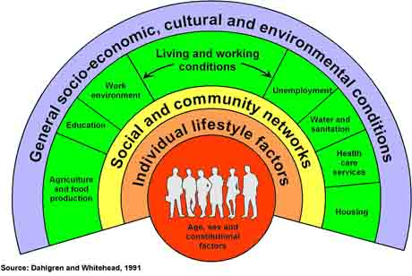
The main determinants of health
Notes:
Tg p. 62
Understand the context in which people live their lives
Range of determinants of health
HP has range of strategies hpp, community, individual
COMPREHENSIVE APPROACH
Suggests an relationship between determinants
Tones p. 64 importance of determinants over the lifecycle - - the health career Figure 2.8

Slide 12
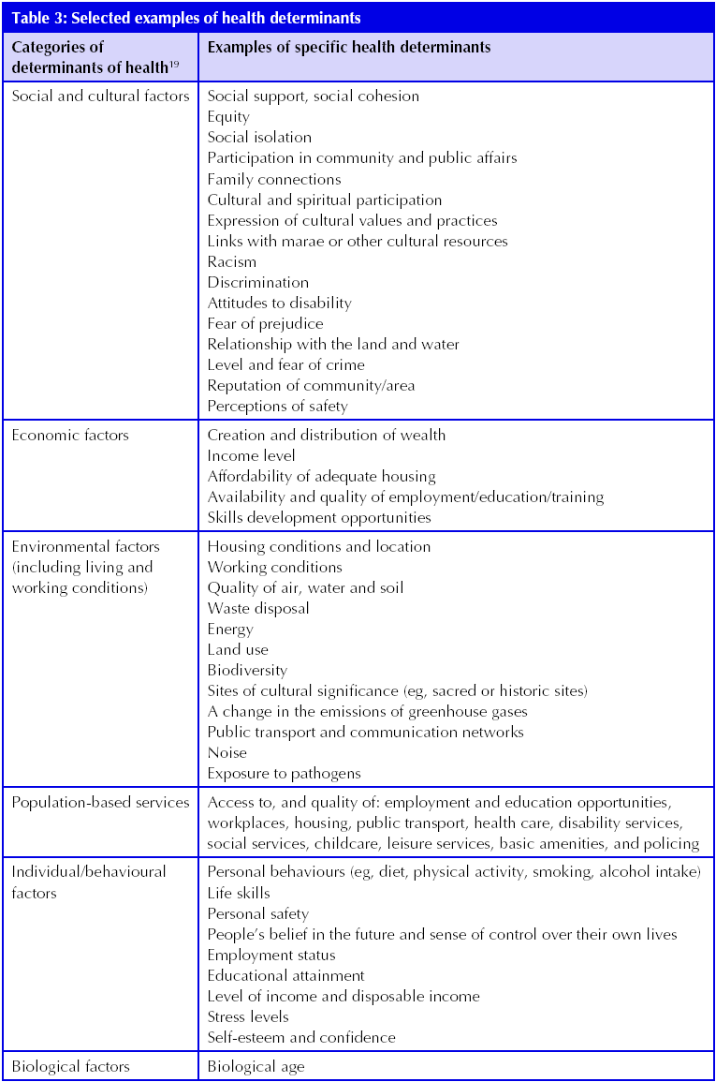
Notes:
Handout
This gives us a very broad agenda for health in all policies because we are concerned with all of these determinants and how they influence health.

Slide 13
The Power Walk

