Slide 1


AFRO Health in All Policies Training
Module 1 – Introduction and the determinants of health

Slide 2
Learning objectives of the session
1. To explain the concepts of health and well-being
2. To recognize the responsibility of states to uphold the health of their population
3. To identify socioeconomic, biological and behavioural factors that influence health
4. To explain the social determinants of health

Slide 3
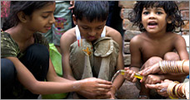
Social Determinants of Health Unit

Slide 4
Outline
The problem: Global health inequities
Social determinants of health (SDH)
SDH and equity as central to global agendas
Global achievements on SDH
WHO’s Secretariat priority areas to support SDH country implementation

Slide 5
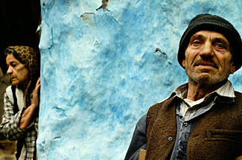
1. Overview of global health inequities
WHO/ Zoltan Balogh

Slide 6
Trends in life expectancy
Inequities in
rate of improvement!
(Houweling et al, 2007)
Notes:
Central and Eastern Europe
Commonwealth of Independent States (former Soviet Republics)

Slide 7
Life expectancy at birth (men)
Glasgow, Scotland (deprived suburb) | 54
India | 61
Philippines | 65
Korea | 65
Lithuania | 66
Poland | 71
Mexico | 72
Cuba | 75
US | 75
UK | 76
Glasgow, Scotland (affluent suburb) | 82
Inequities within countries!
(WHO World Health Report 2006; Hanlon, P., Walsh, D. & Whyte, B., 2006)

Slide 8
Under 5 year mortality (per 1000 life births)
by wealth group
Inequities occur along a gradient!
(Houweling et al, 2007)

Slide 9
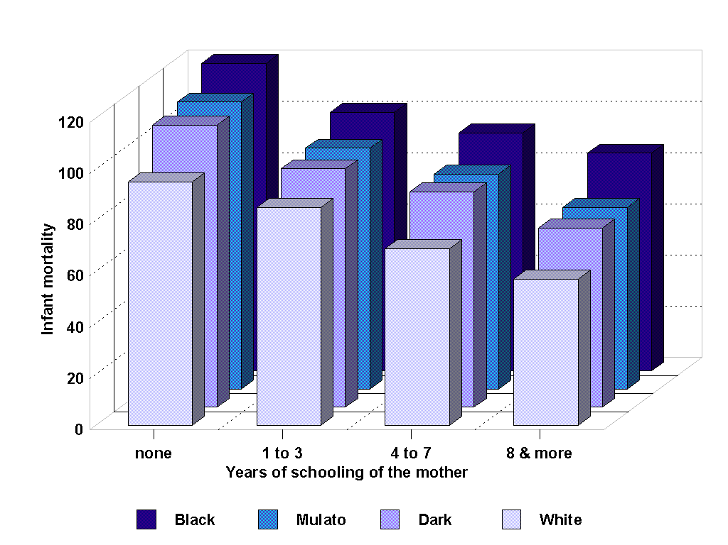
Infant mortality in Brazil by race and
mother's education, 1990
Inequities interact with each other!
(Pinto da Cunha, 1997)
Notes:
The combination of disadvantaged circumstances and difficulties in securing access to appropriate services.
Cycles of disadvantage over life course and inter-generationally (stressors proliferate over the life course and across generations, widening health gaps between advantaged and disadvantaged group members.)
E.g. 1: Above. It is now well recognized that the compounding effects of lack of access to education create far reaching implications for income, access to the goods and services of society, and the physical and psychological health of women and their children.
E.g. 2: Parents with disabled children often face disadvantaged circumstances and difficulties in securing access, but these challenges particularly acute for ethnic minority families, suggesting the additional dimension of institutional racism.
E.g.3: Interconnection between locationally disadvantaged communities and limited access to private and public transport = a major contributing factor to social isolation and economic poverty that certain groups in the community experience.

Slide 10
The widening trend in mortality by education in Russia, 1989-2001
Inequities are increasing!
(probability of living to 65 yrs when aged 20 yrs)
(Murphy et al, 2005)
Notes:
A study entitled "Divided we Stand: Why Inequality Keeps Rising” by the Organisation for Economic Co-operation and Development (OECD) reported its conclusions on the causes, consequences and policy implications for the ongoing intensification of the extremes of wealth and poverty across its 22 member nations (OECD 2011-12-05).
Income inequality in OECD countries is at its highest level for the past half century. The average income of the richest 10% of the population is about nine times that of the poorest 10% across the OECD, up from seven times 25 years ago."
In the US inequality has increased further from already high levels.
Other traditionally more egalitarian countries, such as Germany, Denmark and Sweden, have seen the gap between rich and poor expand from 5 to 1 in the 1980s, to 6 to 1 today.

Slide 11
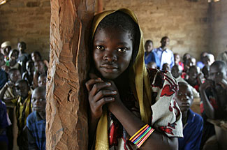
2. What Are The Social Determinants Of Health?
UNICEF/Pierre Holtz

Slide 12
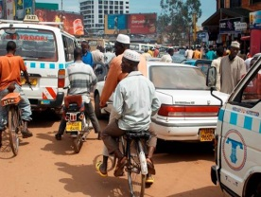
Definitions
Social determinants of health: The social determinants of health are the conditions in which people are born, grow, live, work, and age, including the health system.
Health equity: The absence of unfair and avoidable or remediable differences in health among groups defined socially, economically, demographically or geographically.
Population health interventions: Aim to change the social context that influences health (Rose in Frohlich, 2014)

Slide 13
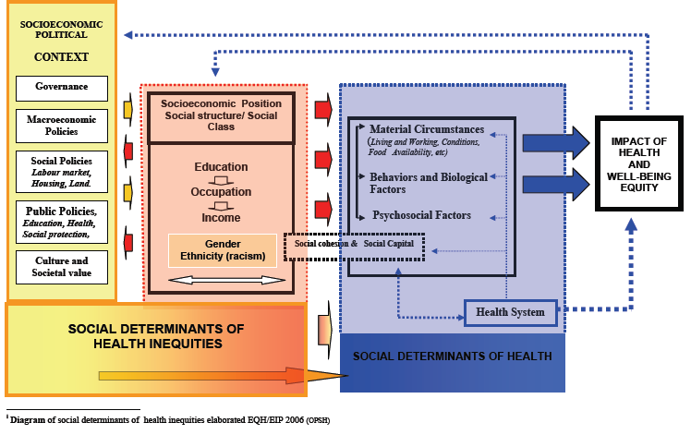
Diagram of social determinants of health inequities elaborated

Slide 14
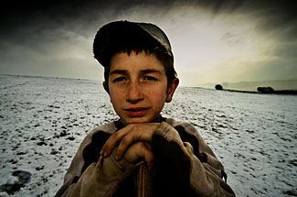
3. SDH and equity: central to global agendas
Notes:
SDH identified as both a fundamental approach and a priority area of work in the draft of the 12th WHO General Program of Work 2014-2019
Crucial need to frame and align work on SDH&HE with global health and development priorities – UHC, NCDs, Post-2015 sustainable development agenda, Global Strategy on Women’s and Children’s Health

Slide 15



Slide 16

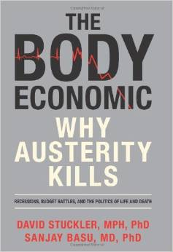

Slide 17
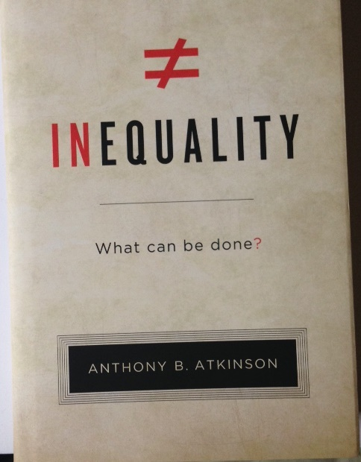
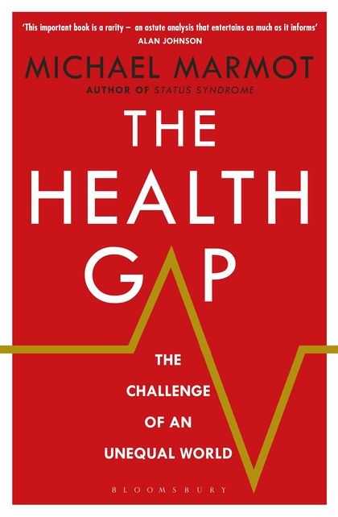

Slide 18
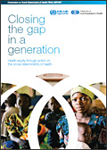

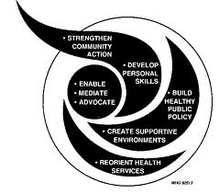
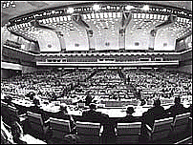

Global mandates –
History to current day
2011
2014 WHA Resolution
2008
2013 Global Conference on Health Promotion
2006
2011
Rio Political Declaration on Social Determinants of Health
1997
2008 Report of the Commission Social Determinants of Health
1988
C-PHC S-PHC Reforms & Minimum Packages MDG Scaling-up Equity and SDH NCDs SDGs
2006
Finnish Presidency of the European Union in 2006, Health in All Policies (HiAP)
2011
UN Political Declaration on NCDs
1986
1997
Intersectoral Action
for Health- a
cornerstone for health for all in the 21st century
2009
WHA Resolution Reducing Health Inequities Through Action on the Social Determinants of Health
1978
1986
World Health Organization’s Ottawa Charter for Health Promotion
1948
1999 The Gothenburg consensus Paper on Health Impact Assesment
1978
Alma-Ata Declaration Health for All agenda (1970s), action falters in 1980s
Social dimensions of health affirmed in WHO Constitution (1948), downplayed during 1950s era of disease campaigns
1988
Adelaide Recommendation on Health Public Policy
Notes:
Ideological shifts:
70s – Decade of development: consensus on health and development
80s – “Lost Decade”, proliferation of strategies: selective PHC vs. integrated health care, district health systems and Healthy Cities
90s – Decade of Reform & Globalization: efficiency of bureaucracy and introduction of market economies in health sector; also the Water Decade and the "Washington Consensus” – IMF-WB-WTO
New influence of stakeholders:
UNICEF – selective application of PHC, 1979, then moved to children's rights, 1995
WB – redefines measurements of health: WDR 93 Investing in Health
UNDP – introduces country strategy note & includes PHC. Effort for better UN coordination, MDGs
USAID – emphasizes civil society and quality
New health discipline:
Health economics introduces new ways of measuring resources and health achievements, influencing design of health systems financing and efficiency measures
National budgets for health:
Increase as % of GDP
Decrease in equitable distribution

Slide 19
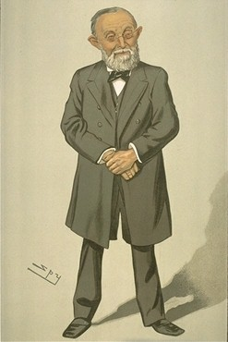
“Medicine is a social science and politics is nothing else but medicine on a large scale”- Rudolf Virchow (1821-1902).
.

Slide 20
Dr Andrija STAMPAR, President of the foundational WHA (1948)

Slide 21
WHO constitution - definition of health
Health is a state of complete physical, mental and social well-being and not merely the absence of disease or infirmity.

Slide 22
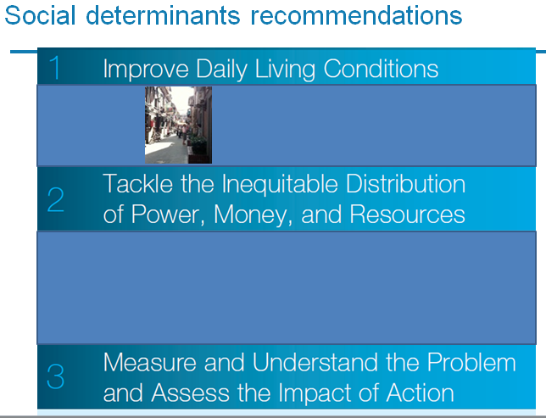
Commission on Social Determinants of Health
Inequalities are killing on a grand scale…
The circumstances in which people are born, grow up, live, work and age, and the systems in place to deal with illness.
These circumstances are shaped by a wider set of forces: economics, social policies, and politics (health system, one force).
Largely responsible for
health inequities.

Slide 23
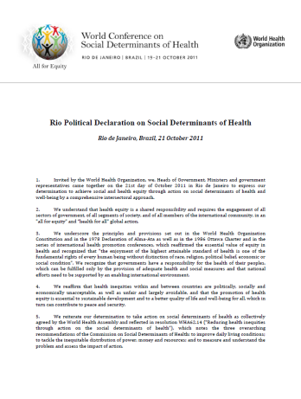
Implementing the
Rio Political Declaration on SDH
To adopt better governance for
health and development
To promote participation in
policy-making and implementation
To further reorient the health sector towards reducing health inequities
To strengthen global governance and collaboration
To monitor progress and increase accountability
Notes:
Action Area 1: Adopt a “health in all policies” approach and foster intersectoral action for health
Action Area 2: Promote social participation in policy-making and implementation
Action Area 3: Further reorient the health sector towards reducing health inequities
Action Area 4: Align global and national priorities and stakeholders
Action Area 5: Monitor progress and increase accountability

Slide 24
Helsinki definition of HiAP
"Health in All Policies is an approach to public policies across sectors that systematically takes into account the health implications of decisions, seeks synergies, and avoids harmful health impacts, in order to improve population health and health equity."

Slide 25
SDH and health equity are intrinsically linked to:
Universal Health Care
Health care systems are a vital determinant of health
Health systems can exacerbate and create inequities
Progressive realization of equity-oriented UHC requires inequities to be monitored and addressed
Primary Health Care
Emphasis on prevention and promotion
Priority to intersectoral actions
Notes:
SDH – PHC: Much common ground
Both advance holistic view of health, health equity as primary value
Strong prevention focus
Declaration of Alma implicitly referred to SDH
Universal Health Coverage:
UHC aims to ensure that all people have access to needed quality health services, across the continuum of care, without the risk of experiencing financial hardship.
Health care systems are a vital determinant of Health!
Health Care Systems are frequently chronically under-resourced and inequitable
In many countries (poor and rich), costs of health care can lead to disastrous impoverishment
The health care systems must be designed and financed to ensure equitable, UHC with adequate human resources.
Working towards UHC means identifying and making changes to overcome coverage gaps. Health programmes, within the wider context of HSS reforms for UHC, need to be equipped to do this. i.e. operationalising action on SDH

Slide 26
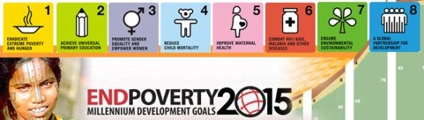
SDH and health equity are intrinsically linked to:
Millennium Development Goals
  Failure to address SDH and equity in the MDGs
Post- 2015 & Sustainable Development Goals
  SDH is the bridge between health and development
  Place equity (and SDH) as central to the global development agenda
Notes:
SDH/HE the natural health bridge to broader economic inequities and to Post 2015/SDGs national and global debates

Slide 27
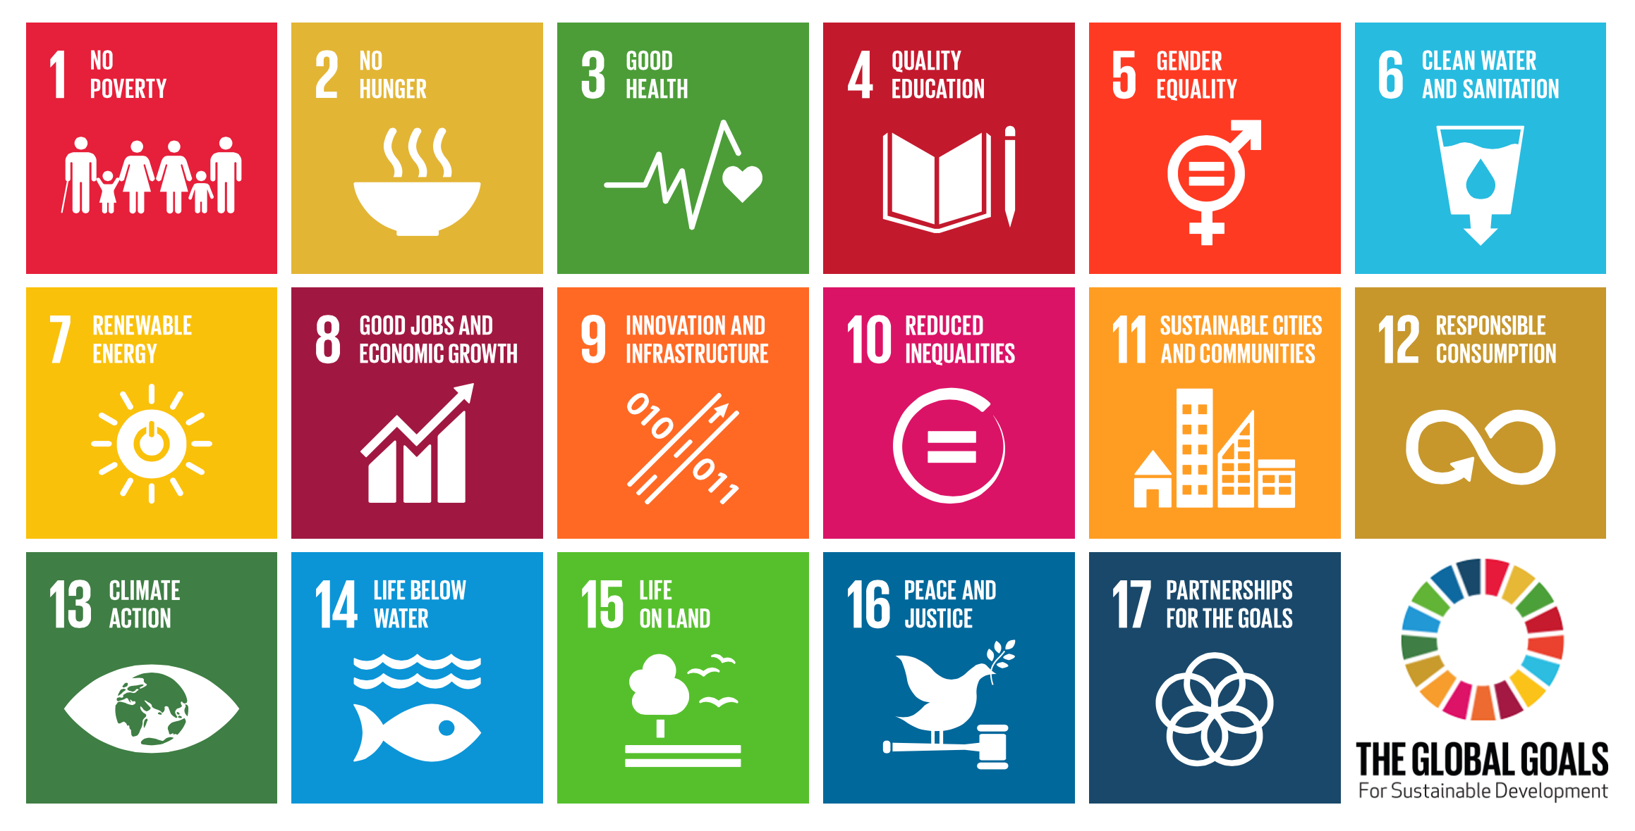
Sustainable Development Goals

Slide 28
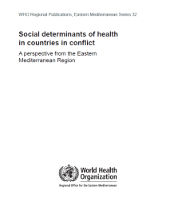
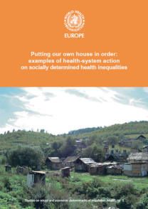
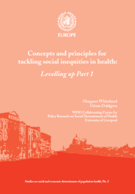
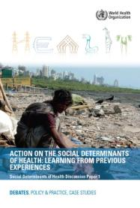
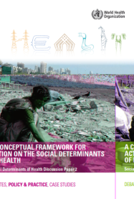
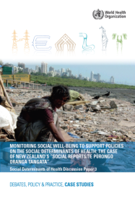
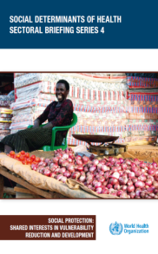
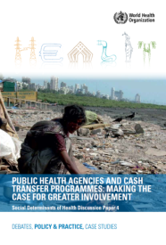
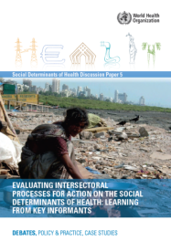
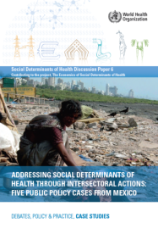
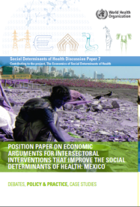

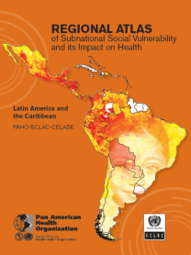
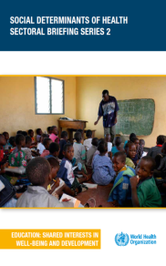
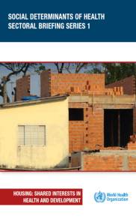
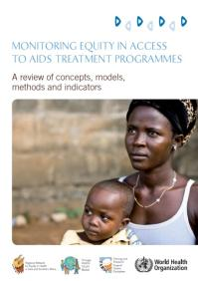

4. Global achievements on SDH

Slide 29


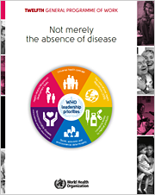
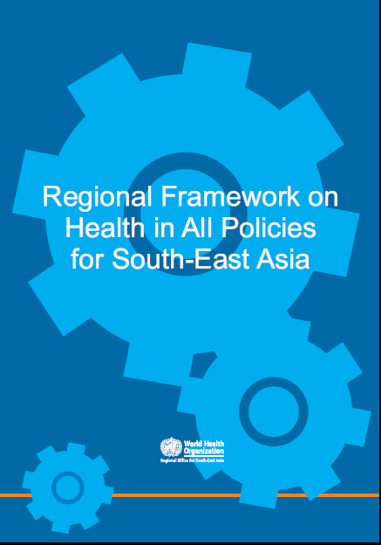
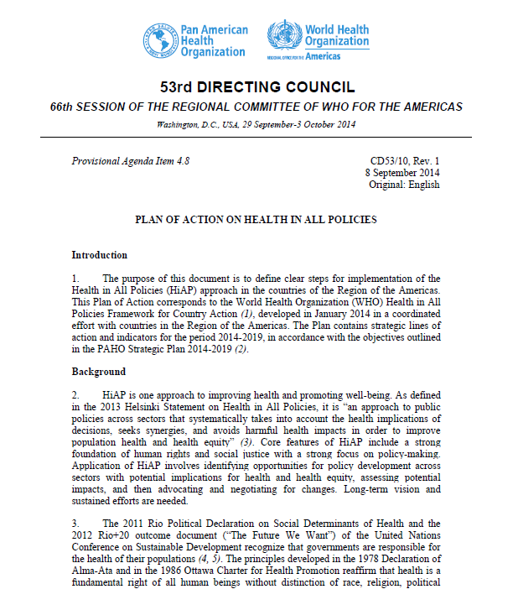
Improved political commitments
Social, economic and environmental determinants of health as one of the 6 leadership priorities
Notes:
Social, economic and environmental determinants of health is a fundamental approach and one of the six leadership priorities of the 12th WHO General Programme of Work 2014-2019.
The conference resulted in the Helsinki Statement on Health in All Policies and was followed by resolution WHA67.12 in 2014, Contributing to Social and Economic Development: sustainable action across sectors to improve health and health equity. The Secretariat is now developing a Framework for Country Action Across Sectors for Health and Health Equity that will be presented to Member States at the 68th WHA.
In September 2014, PAHO’s 53rd Directing Council adopted a Regional Plan on Health in All Policies, considered a key instrument to implement the Rio Political Declaration on Social Determinants of Health.
A Regional Framework on Health in All Policies for South-East Asia was adopted at a Regional Consultation in April 2013.
The Regional Committee for Europe adopted Health2020: a European policy framework at its 62nd session in 2012, which supports action across government and society for improved health and well-being for all and the reduction of health inequalities.

Slide 30

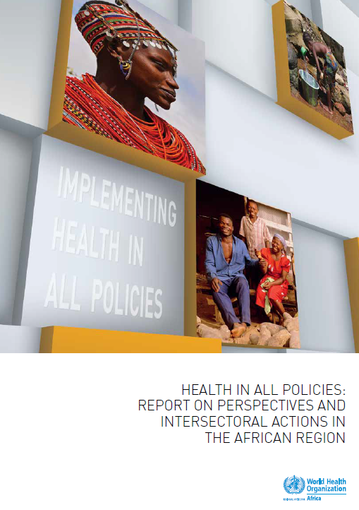
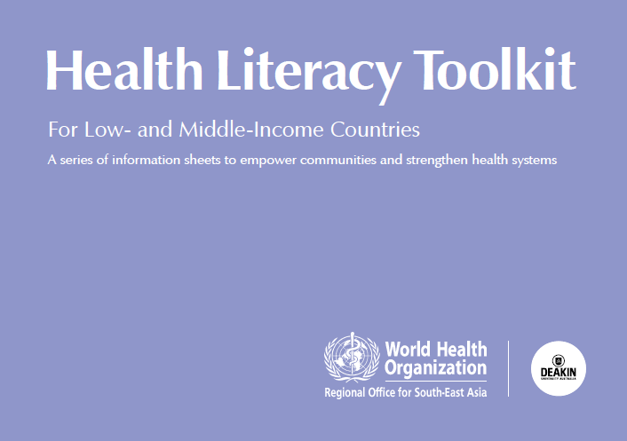
Increased capacity building
Notes:
The Ministry of Public Health in Thailand continued to take leadership in strengthening national, regional and global governance for health. This includes the development of a capacity building programme on Universal Health Coverage (CapUHC), to provide technical assistance to ASEAN and Member States.
. In 2014 AFRO established a resource group of technical experts to support regional and country work on social determinants in the African region.
In SEARO, a “Health Literacy Toolkits for Low- and Middle-Income Countries” aimed at strengthening the capacity of people, institutions and professions to effectively participate in health systems is in the process of being published

Slide 31
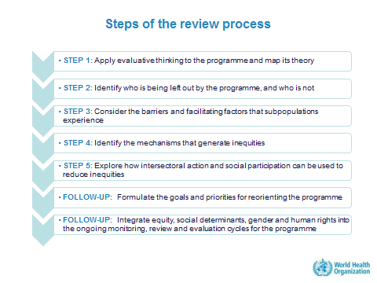
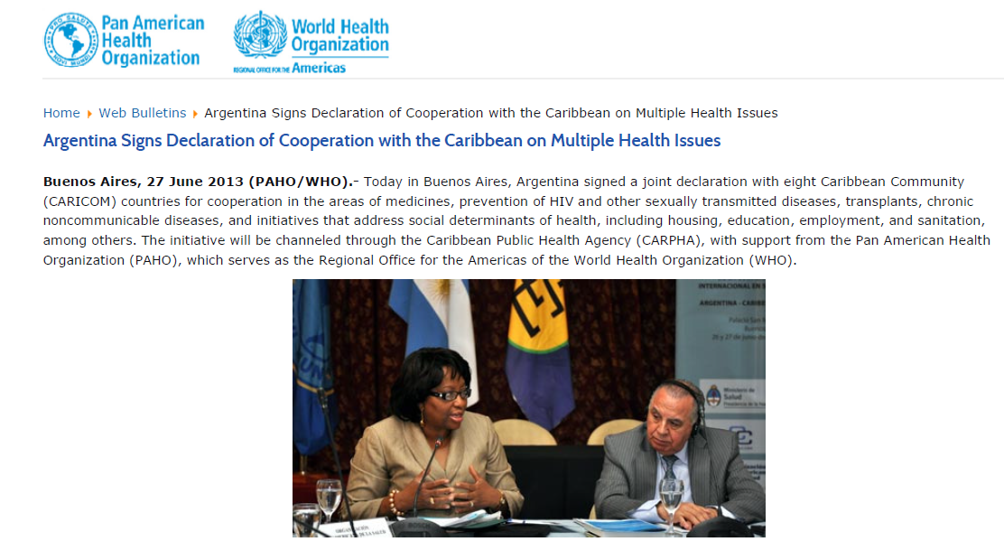
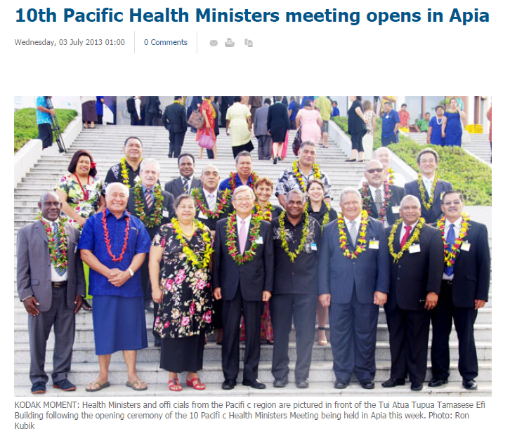
Mainstreaming SDH and equity in health programmes
Piloted in Indonesia and EURO countries; further piloting planned
SDH, incuding housing, education, employment and sanitation at the heart of the cooperation agreement
Meeting included technical session on scaling up SDH
Notes:
The 10th Pacific Health Minister Meeting in Samoa in July 2013 included social determinants of health in the meeting agenda as one in top four priorities raised by Ministers. The meeting included a technical session on progress and plans for scaling-up of interventions on social determinants in the Pacific island countries and areas; framed the Healthy Islands vision as a critical vehicle for advancing national-level multisectoral actions and highlighted noncommunicable diseases as an entry point for catalyzing action on social determinants and reducing health inequities;
Significant work has also been undertaken at regional and national level aimed at reorienting the health sector towards reducing health inequities. In the Americas, a joint declaration was recently signed between Argentina and eight Caribbean Community (CARICOM) countries for cooperation in the areas of medicines, prevention of HIV and other sexually transmitted diseases, transplants, chronic non communicable diseases, and initiatives that address social determinants of health, including housing, education, employment, and sanitation, among others. The initiative will be channeled through the Caribbean Public Health Agency, with support from PAHO. The Regional Office of the Western Pacific supported the integration of social determinants of health and Health in All Policies in a workshop on health system strengthening at the subnational level in Mongolia in May 2014.

Slide 32
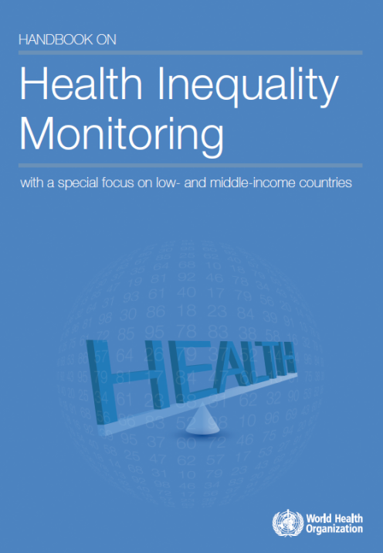
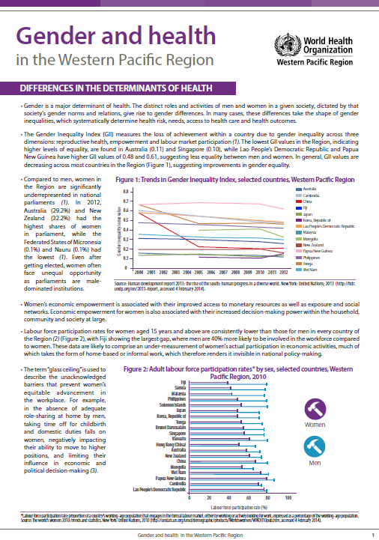
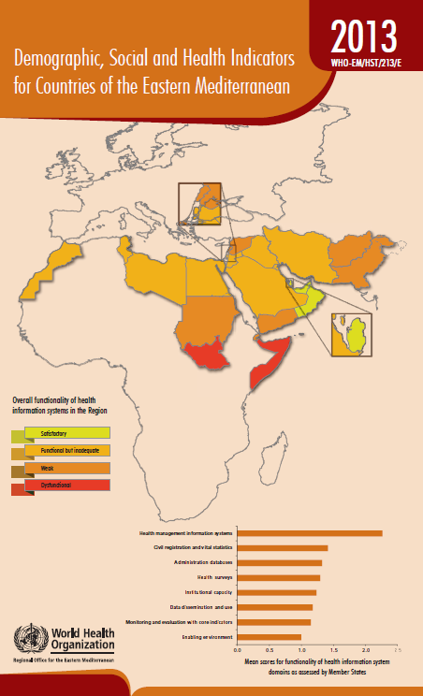
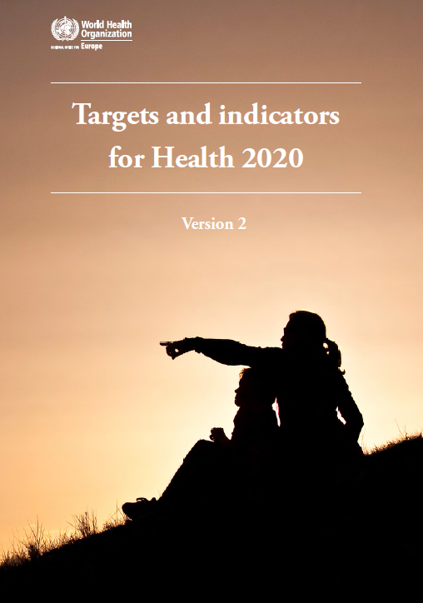
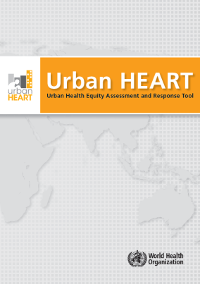
Monitoring SDH
Multisectorial consultation and training to implement UrbanHEART 2014
Notes:
Urban Health Equity Assessment and Response Tool (Urban HEART).
A handbook on how to monitor health inequalities in low- and middle-income countries.
Monitoring intersectoral factors influencing UHC and health at the country level with an equity focus: frameworks and measures
WHO capacities in monitoring trends in and impacts of social determinants of health, as well as actions of redress have advanced. A Handbook on Health Inequality Monitoring: with a special focus on low- and middle-income countries was published in 2013.
The European region held two consultations to identify objective well-being indicators that take account of social determinants and health equity (and complement the subjective well-being indicator already adopted) to support monitoring linked to the Health 2020 framework. In 2014, WPRO published a gender fact sheet describing important social factors using various indicators of determinants impacting gender health equity.
The statistical reports Demographic, Social and Health Indicators for Countries of the Eastern Mediterranean, which describe six socioeconomic indictors, continue to be published

Slide 33
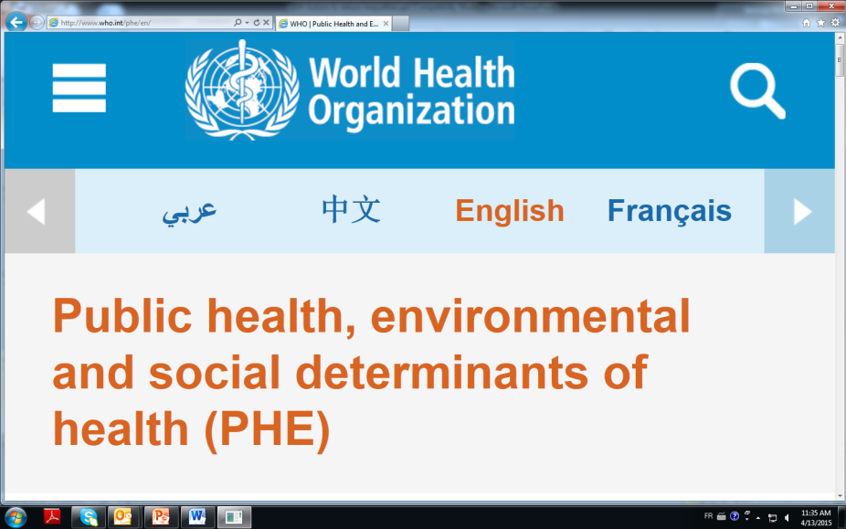
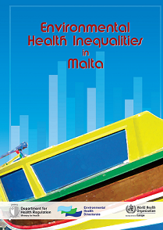
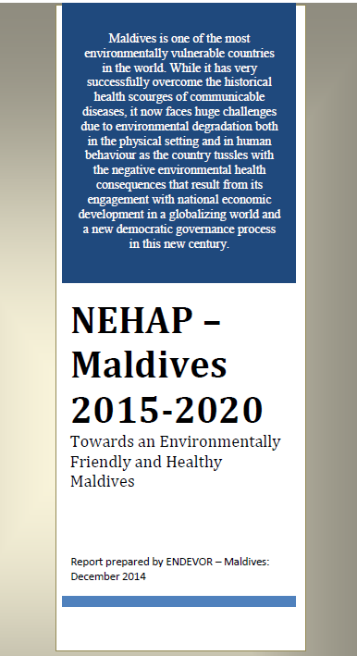

Align social and environmental determinants
Notes:
SDH/HE the natural health bridge to broader economic inequities and to Post 2015/SDGs national and global debates
At regional and country level, social determinants of health have increasingly been recognized as a key approach in the context of environmental health projects.
A co-funded EURO and UN project Networking for Physical Activity (PHAN), aimed at promoting networking and action on healthy and equitable environments for physical activity, included specific objectives to identify good practice examples and develop guidance on the promotion of physical activity in socially disadvantaged groups to address inequalities (report published 2013).
Initiatives in EMRO included the publication of a report in Jordan on environmental health activities focusing on social determinants, slum area assessments conducted in Aqaba city and capital city of Amman, and a project on walking in the Amman green gardens as a means of addressing obesity.
For example, the Maltese Environmental Health Directorate in collaboration with EURO published in November 2013 the first national assessment report of the magnitude and distribution of environmental health inequalities in the Maltese Islands.
In Maldives, WHO and the national authorities strengthened multisectoral policy dialogue for health, including to finalize the National Environmental Health Action Plan with all relevant national stakeholders. A number of UN agencies, including WHO, has also been working in the Maldives to mainstream the Low Emission Climate Resilient Development (LECReD multi-donor trust programme into local development planning and service delivery for greater community-level ownership and sustainability of the programme.

Slide 34
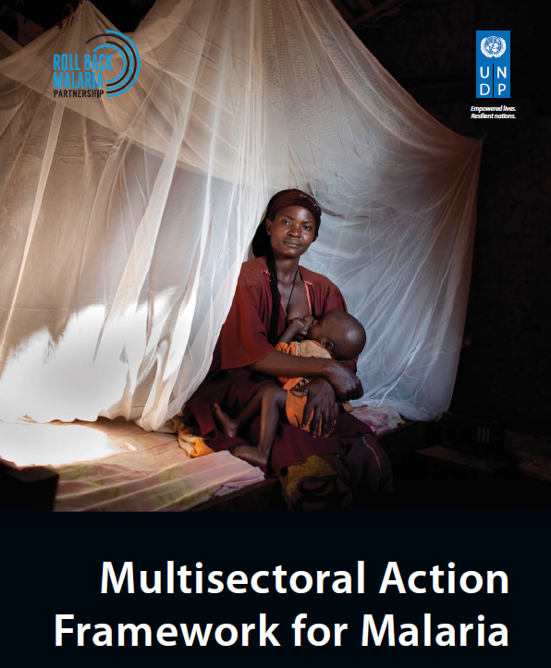


Working across the UN
Notes:
A joint UN Mission to Rwanda took place in 2013, as part of the UN Platform on Social Determinants of Health (an informal mechanism to provide coordinated support to Member States with implementation of the Rio Political Declaration on Social Determinants of Health). Headquarter and/or regional office representatives from WHO, UNDP and UNICEF met with the Minister of Health and staff from the Ministry of Health, the United Nations Country Team in Rwanda and other stakeholders, including bilateral donor agencies, national health professional and health insurance bodies and [check meeting report]. Priority initiatives for coordinated activities on social determinants in the country were agreed upon.
In 2013, UNDP published a Discussion Paper: Addressing the Social Determinants of Noncommunicable Diseases. The paper presents a typology of three types of possible multisectoral action on noncommunicable diseases and a framework that outlines more specific areas and opportunities for actors outside the health sector to take action on the social determinants of noncommunicable diseases.
The Roll Back Malaria Partnership and UNDP led, in collaboration with a range of agencies, the development of a Multisectoral Action Framework for Malaria launched in September 2013 alongside the 68th United Nations General Assembly. The framework calls for greater coordinated action among different development sectors to tackle the disease [and if informed by a social determinants and health equity approach]. Efforts are now underway to ensure that the framework will be reflected in the discussions on the Sustainable Development Goals, the Global Malaria Action Plan for 2016-2025 and national malaria strategies.

Slide 35

5. WHO’s Secretariat priority areas to support SDH country implementation

Slide 36


Implementing Health in All Policies for improving health equity
Towards a Master Global Plan for Training in Working Across Sectors
Dissemination, advocacy and demand generation in national governments
Supporting networks of institutions/trainers to deliver the training
Conducting regional and country trainings
Creating a database of resources and generating new materials – supporting communities of practice
Actively supporting course adaptation
Resourcing: active fund raising
Notes:
HiAP: An approach to public policies across sectors that systematically takes into account the health implications of decision, seeks synergies, and avoids harmful health impacts, in order to improves population health & health equity.
Shift in perspective so that all actors consider improved health and wellbeing as an overarching social goal that requires shared action.
FRAMEWORK: Aiming to elaborate a common set of concepts underpinning intersectoral work across countries and to identify those most relevant to implementing a HiAP approach, with examples provided from countries in 3 WHO regions (Africa, SE Asia and Western Pacific).
Identifying the need for a HiAP approach, and how to best improve health equity, requires a framework to aid understanding and prioritization. An analytic framework provides a diagnostic checklist that can help planning policies and interventions undertaken with a
HiAP approach.
WHO HiAP training manual: A resource for training to increase the understanding of HiAP by health and other professionals.

Slide 37



Mainstreaming equity, social determinants of health, gender and human rights into public health programmes
Development of a methodology to strengthen equity focus in national health programmes
Enhanced capacity. Use an “applied learning” approach linked to health professionals’ ongoing programmatic work to strengthen their capacity to understand and apply key related concepts and underlying principles.
Entry points for action. Through a guided analysis conducted by a multidisciplinary review team, identify entry points to strengthen how the programme addresses equity, social determinants of health, gender and human rights.
Sustained change. Improve a programme’s ongoing planning, monitoring, review and evaluation cycles by integrating measures on equity, social determinants of health, gender and human rights.
Notes:
Continuing work on evidence generation, implementation, and evaluation on integrating the SDH approach in public health programs
Methodology: Approach for reviewing and adjusting health programmes to improve health equity by identifying populations being missed, analysing critical access barriers and their drivers, and proposing potential solutions within and beyond the health sector for redress (for increased capacity of Member States and WHO). Outputs include a reorientation tool, training package(s), global and regional train-the-trainers sessions, national programme review sessions, case studies and evaluations, and a linked network of institutes with capacity to support application of the reorientation approach globally.
Benefits of this reorientation approach:
Contribute to addressing health inequities;
Improving results (better meet its own objectives and targets);
Contribute to equity-oriented progressive realization of UHC;
Operationalizing intersectoral action for health and HiAP and building the health sector’s stewardship for health;
Applying a Human Rights Based Approach, with particular attention to accountability and participation.
Rationale: Why reorient health programmes for equity?
Needed for the progressive realization of the right to health for all (called for by WHO Constitution). Reorientation enables us to systematically look at key issues in progressive realization linked to human rights standards for availability, accessibility, acceptability and quality.
Also at core of an equity-oriented approach towards UHC. UHC aims to ensure that all people have access to needed quality health services, across the continuum of care, without the risk of experiencing financial hardship. Working towards UHC means identifying and making changes to overcome coverage gaps. Health programmes, within the wider context of HSS reforms for UHC, need to be equipped to do this.
Also about identifying the needs and entry points for operationalizing action on key SDH. By looking at differential health needs and coverage gaps experienced by populations, the barriers that cause them, and the determinants of those barriers, health programmes can see when and where cooperation with other sector is essential in order to meet health goals.

Slide 38


Slide 39



Enhancing pro equity linkages between social and environmental determinants of health
Identification of priority areas based on evidence, available tools and global commitments
Stronger integration of social determinants in existing activities and tools: WHO Housing and health guidelines; GLAAS report on water and sanitation; The Environmental Burden of Disease.
Development of concrete project proposals focussing on social determinants of environmental health risks - Improving housing conditions in informal settlements
SECTORAL FOCUS: HOUSING
Notes:
HiAP: An approach to public policies across sectors that systematically takes into account the health implications of decision, seeks synergies, and avoids harmful health impacts, in order to improves population health & health equity.
Shift in perspective so that all actors consider improved health and wellbeing as an overarching social goal that requires shared action.
FRAMEWORK: Aiming to elaborate a common set of concepts underpinning intersectoral work across countries and to identify those most relevant to implementing a HiAP approach, with examples provided from countries in 3 WHO regions (Africa, SE Asia and Western Pacific).
Identifying the need for a HiAP approach, and how to best improve health equity, requires a framework to aid understanding and prioritization. An analytic framework provides a diagnostic checklist that can help planning policies and interventions undertaken with a
HiAP approach.
WHO HiAP training manual: A resource for training to increase the understanding of HiAP by health and other professionals.

Slide 40
Monitoring and measuring health determinants/barriers to improve health and access to health services
Monitoring Health in All Policies
Social determinants impacts on health equity
What factors in broader society are impacting health equity, and what is being done to address this?
Monitoring intersectoral factors influencing univeral health coverage
Social determinants impact on coverage inequalities
What factors in broader society are contributing to incomplete coverage of health services, and what is being done to address this?
Monitoring health status and coverage
Health outcomes for health status or coverage by socioeconomic position
How large are health inequalities between social groups?
Notes:
Equity-oriented accountability between health and other sectors

Slide 41
The EQuAL lens for designing policies, and monitoring and evaluation
More visible
Community spaces,products
Amenities
Housing
Work conditions
Environment Quality
Accountability
Discrimination
Gender equality
Social support
Accountability and inclusion
Income and wealth
Intergenerational equity
Employment conditions
Social protection
Livelihoods and social protection
Under-
lying social
causes
Source: WHO. Forthcoming 2015. Monitoring health determinants for equity. Geneva.
Notes:
indicators do we use from available data sources to assess health determinants trends?
Quality Environment
Are there adequate standards for drinking water and sanitation? Univseral santitation provision -.special measures to improve equity in access.
Coverage of basic amenities, durable housing, and quality of air, soil, water (green spaces); working week
Accountability, inclusion
Percent women experiencing violence in the home; Does the constitution make guarantees of equal rights
Livelihoods, skills
Do adequate minimum wage to meet basic needs?; Household income by demographic structure of household
Coverage of organized learning or early child education programs
What indicators do we use to assess demand factors contributing to incomplete health service coverage?
Quality Environment
Travel time to facilities
Accountability, inclusion
Percentage of women who say that they do not have the final say in decisions on their own health care
Livelihoods, skills
Income protection available for sickness, unemploymt, old age?
Comprehensive correct knowledge about AIDS / breast-feeding
Supply-side (not shown)

Slide 42

Thank you! Merci !
* * * * *
“No one should be denied access to life-saving or health promoting interventions for unfair reasons, including those with economic or social causes. ... When health is concerned, equity really is a matter of life and death.”
* * * * *
For further information: www.who.int/social_determinants

Slide 43
Questions for the discussion
1. Is health equity, and the SDH ( its causes of the causes) a priority in your country? Why you think is it or why it is not?
2. Who might be the actors in favor and against making it a real priority?
3. How important are the new SDGs for your country? For health how is seen SDG 3 and the others?
4. Do you think Universal Health Coverage (UHC) is opposed or complementary to the SDH for reducing health inequities? What are their linkages and tensions between them?

Slide 44

Thank you for your attention!
Q&A?
villare@who.int

