Slide 1
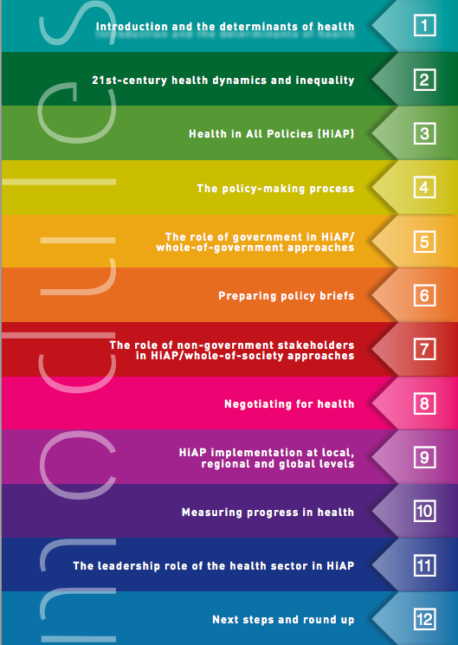
Health in All Policies Training Manual Modules

Slide 2
Identify socioeconomic and environmental factors that influence health
Describe some of the major contemporary health challenges
Recognize the complex and political nature of the policy-making process
Identify the characteristics of a “window of opportunity” for policy change
Frame a complex health issue and identify its policy challenges and opportunities
List principles for effective and accountable stakeholder consultation
Identify mechanisms for non-governmental stakeholders involvement in HiAP
Prepare a stakeholder analysis and conduct intersectoral negotiations
Explain the roles of the health and non-health sectors in HiAP
Training Manual Content Overview

