Slide 1
HIAP Training Manual The role of government in the HiAP
WORKSHOP: PREPARING FOR TRAINING IN HEALTH IN ALL POLICIES (HIAP) USING THE NEWLY LAUNCHED WHO HIAP TRAINING MANUAL
Kuopio, Finland, 2015

Slide 2
The Central principles of HiAP
Dynamics and complexity
Health Equity
Framing
Whole of government//society
Collective impact
Mutual gain, Negotiation, health diplomacy

Slide 3
HiAP approach
Focuses on the social, economic and environment determinants of health
Targets inequalities
Promotes integration and collaboration across sectors and other non-government stakeholders.

Slide 4
Health and governments
“Governments have a responsibility for the health of their peoples which can be fulfilled only by the provision of adequate health and social measures”
Health is an individual right and a social justice issue;
Health is a public good; and
Governments have a responsibility for the health of their peoples.
WHO Constitution (1948). Available from: http://apps.who.int/gb/bd/PDF/bd47/EN/constitution-en.pdf

Slide 5
Collective impact
‘Commitment of a group of important actors from different sectors to a common agenda for solving a specific social problem’
A common agenda
Shared measurement systems
Mutually reinforcing activities
Continuous communication
Back bone support organizations

Slide 6
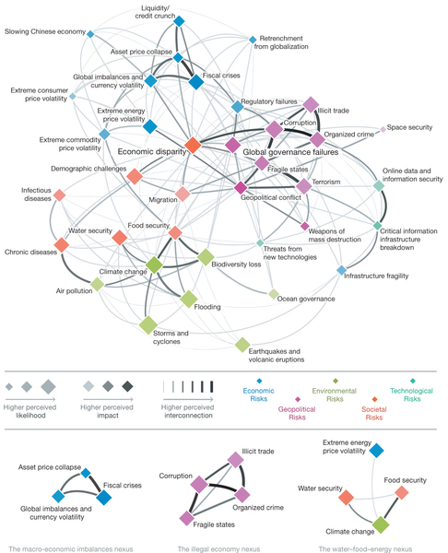
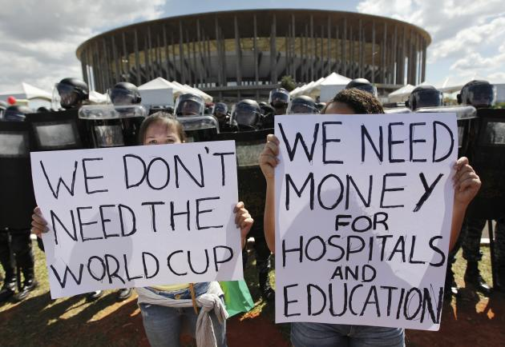
Interconnectedness
Interconnectedness of
issues and of
governance levels

Slide 7
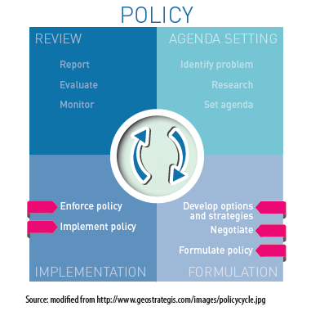
The role of governments
Governance
Ways individuals & institutions manage common affairs
Continuing process
Conflicting or diverse interests accommodated /cooperation
Formal institutions empowered to enforce compliance
Informal arrangements
Notes:
“The sum of the many ways individuals and institutions, public and private, manage their common affairs.
It is a continuing process through which conflicting or diverse interests may be accommodated and cooperative action may be taken. It includes formal institutions and regimes empowered to enforce compliance, as well as informal arrangements that people and institutions either have agreed to or perceive to be in their interest.”
(The Commission in Global Governance, 1995)

Slide 8
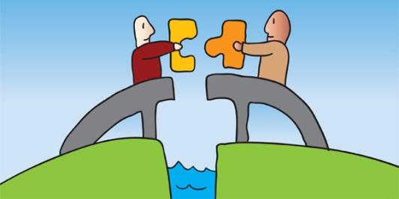
Health Diplomacy
Negotiating for health in the face of other interests
Building relationships and alliances for health
outcomes and addressing health determinants
Creating opportunities for mutual gain

