Slide 1

Session 2. HIAP Training Manual
WHO’s HiAP Framework for Country Action, HiAP for equity
WORKSHOP: PREPARING FOR TRAINING IN HEALTH IN ALL POLICIES (HIAP) USING THE NEWLY LAUNCHED WHO HIAP TRAINING MANUAL
Kuopio, Finland, 2015

Slide 2
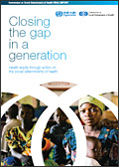

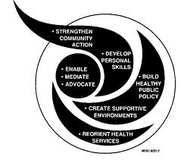
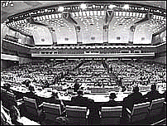

Global mandates
2011
2014 WHA Resolution
2008
2013 Global Conference on Health Promotion
2006
2011
Rio Political Declaration on Social Determinants of Health
1997
2008 Report of the Commission Social Determinants of Health
1988
C-PHC S-PHC Reforms & Minimum Packages MDG Scaling-up Equity and SDH NCDs post-2015
2006
Finnish Presidency of the European Union in 2006, Health in All Policies (HiAP)
2011
UN Political Declaration on NCDs
1986
1997
Intersectoral Action
for Health- a
cornerstone for health for all in the 21st century
2009
WHA Resolution Reducing Health Inequities Through Action on the Social Determinants of Health
1978
1986
World Health Organization’s Ottawa Charter for Health Promotion
1948
1999 The Gothenburg consensus Paper on Health Impact Assesment
1978
Alma-Ata Declaration Health for All agenda (1970s), action falters in 1980s
Social dimensions of health affirmed in WHO Constitution (1948), downplayed during 1950s era of disease campaigns
1988
Adelaide Recommendation on Health Public Policy
Notes:
Ideological shifts:
70s – Decade of development: consensus on health and development
80s – “Lost Decade”, proliferation of strategies: selective PHC vs. integrated health care, district health systems and Healthy Cities
90s – Decade of Reform & Globalization: efficiency of bureaucracy and introduction of market economies in health sector; also the Water Decade and the "Washington Consensus” – IMF-WB-WTO
New influence of stakeholders:
UNICEF – selective application of PHC, 1979, then moved to children's rights, 1995
WB – redefines measurements of health: WDR 93 Investing in Health
UNDP – introduces country strategy note & includes PHC. Effort for better UN coordination, MDGs
USAID – emphasizes civil society and quality
New health discipline:
Health economics introduces new ways of measuring resources and health achievements, influencing design of health systems financing and efficiency measures
National budgets for health:
Increase as % of GDP
Decrease in equitable distribution

Slide 3
2014 Resolution 67.12
Urges Member States :
to champion health and the promotion of health equity as a priority and take action on the social, economic and environmental determinants of health;
to take steps that enable societal policies which take into account and address their impacts on health determinants, health protection, health equity and health systems functioning;
to develop sustainable institutional capacity with adequate knowledge and skills in assessing health impacts of policy initiatives in all sectors;
to take action to enhance health and safeguard public health interests from undue influence by any form of real, perceived or potential conflict of interest;
to include relevant stakeholders in the development, implementation and monitoring of policies across sectors;
to contribute to the development of the post-2015 development agenda by emphasizing that policies in sectors other than health have a significant impact on health outcomes, and by identifying synergies between health and other sector policy objectives.
Requests the WHO Director-General:
to prepare a “Framework for country action across sectors for health and health equity” for adaptation to different contexts, taking into account the Helsinki statement on health in all policies;
to provide guidance and technical assistance to MS in order to integrate health perspectives in non-health sector policies;
to strengthen WHO’s role, capacities and knowledge resources, to give guidance and technical assistance for implementation of policies across sectors and to ensure coherence and collaboration across programmes and initiatives within WHO;
to continue to work with and provide leadership for the organizations in the United Nations system, development banks, other international organizations and foundations;
to report on the progress made in implementing this resolution to the Sixty-ninth World Health Assembly through the Executive Board.

Slide 4
1. Development of Framework for country action across sectors for health and health equity
A discussion paper developed and posted on the web 2014 for comments
First draft opened for comments until 3 March 2015.
Technical reference group met in March 2015 to provide final recommendations
Now!
Second Draft put together by the Secretariat and presented to WHA in May 2015
2. Guidance and technical assistance to Member States in order to integrate health perspectives in non-health sector policies
Working with Member States for developing, implementing and monitoring “National Multisectoral Action Plans for NCD Prevention and Control”
PAHO Member States endorsement of the PAHO Plan of Action for HiAP in its Directing Council in 2014
Meeting with ministers of finance regarding FCTC
Notes:
The technical reference group will meet next week. It will be chaired by Finland and WHO PND

Slide 5

3. Strengthen WHO’s role, capacities and knowledge resources
Health in All Policies Trainers' Meeting in Geneva: 24-26th → Master Global Plan for Training in Working Across Sectors
Working with University Networks and the WHOCCs for health promotion
4. Work with UN agencies
  WHO discussed the role of UN agencies in actions across sectors for health during the last UN Interagency Taskforce for the Prevention and Control of NCDs meeting in Rome in February 2015
5. Report on the progress made in implementing this resolution to the Sixty-ninth World Health Assembly through the Executive Board

Slide 6
Towards a Master Global Plan for Training in Working Across Sectors
Dissemination, advocacy and demand generation
Facilitating networks of institutions/trainers
Actively supporting rapid adaptation of Training Manual
Conducting regional and country trainings
Creating shared resources
Fund-raising

Slide 7
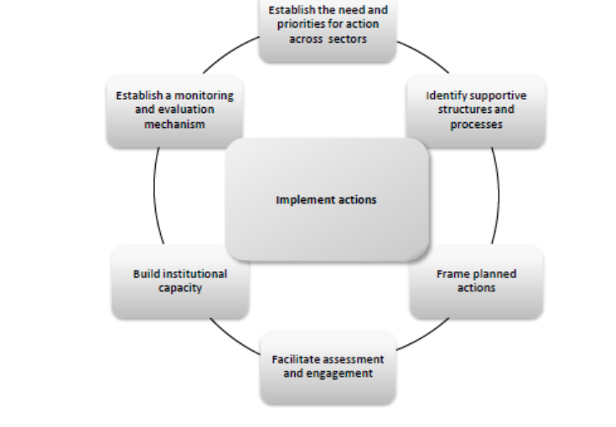
Country Action

Slide 8
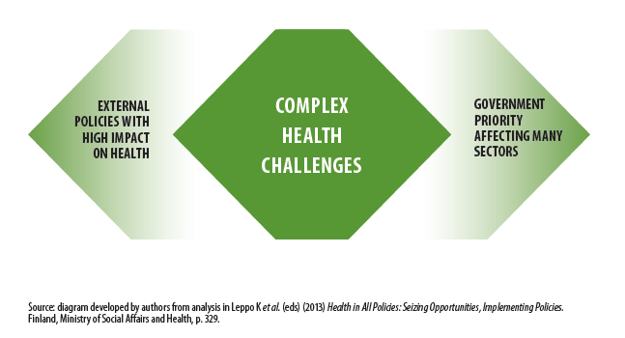
Identifying challenges for HiAP approach
• Problem or issue is of major public health importance;
• Problem or issue is amenable to change and change is feasible;
• Potential solutions are politically and socially acceptable.
Focuses on the social, economic and environment determinants of health;
Targets inequalities;
Promotes integration and collaboration across sectors and other non-government stakeholders.

Slide 9
Approaches to public health
Biomedical- focus on control and treatment, especially diseases of communicable nature.
Sanitary-environmental – industrializing Europe and nutrition, water, healthy living conditions
Social-behavioural approach – life styles and behaviour change focus drawing on psychological theories to reduce disease risk factors
Notes:
Intersectoral action refers to the coordinated efforts of two or more sectors within government to improve health outcomes. This can include working across different levels of government such as district, provincial and national jurisdictions.
The term intergovernmental (joined-up government and healthy public policies) is used to refer to horizontal and vertical linkages between levels of government within a country.
A whole-of-society approach refers to coordinated efforts to improve health by multiple stakeholders within and outside government that may also be from several sectors. This dimension of HiAP is discussed at length in Module 7.

Slide 10
HiAP approach
Focuses on the social, economic and environment determinants of health
Targets inequalities
Promotes integration and collaboration across sectors and other non-government stakeholders.

Slide 11
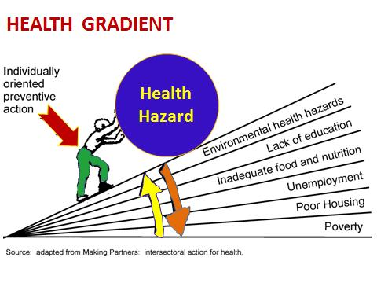

Thank you!

