Slide 1

Session 1. The Central Principles of HiAP
WORKSHOP: PREPARING FOR TRAINING IN HEALTH IN ALL POLICIES (HiAP) USING THE NEWLY LAUNCHED WHO HiAP TRAINING MANUAL
Kuopio, Finland, 2015

Slide 2
Outline
Session objectives Day 1 and Day 2
Workshop content Day 1 and Day 2
21st century health challenges and determinants
The HiAP approach and key principles
The Manual design

Slide 3
Workshop content
Day 1
  Central principles of Health in All Policies and overview of the manual (mod. 1,2)
  Key linkages between health and other sectors (mod. 3)
  WHO Framework for Action Across Sectors and Health in All Policies
Day 2
  Recap and role of government in HiAP (mod. 5)
  Conditions that promote or hinder intersectoral action (mod. 5)
  Policy-making at the local level (mod. 4)
  Arguments (mod. 6) and Policy negotiation (mod. 8)
  Role play

Slide 4
Workshop objectives Day 1 and 2
Understand WHO's perspective on the Health in All Policies approach
Understand the organization of the WHO training manual
Be familiar with the importance of key issues in training: context and the use of role plays in the training approach

Slide 5
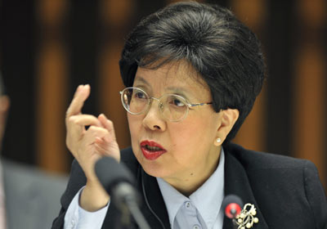
21st century dynamics: Starting point
The challenges facing public health, and the broader world context in which we struggle, have become too numerous and too complex for a business as usual approach.
Margaret Chan, DG WHO

Slide 6
Complexity
The complexity of problem requires systems approaches and networked responses at all levels and force policy makers to move beyond silos.
Wicked problems require innovative, comprehensive solutions that can be modified in the light of experience and on-the-ground feedback.
The solution depends on how the problem is framed and vice-versa (i.e. the problem definition depends on the solution)

Slide 7
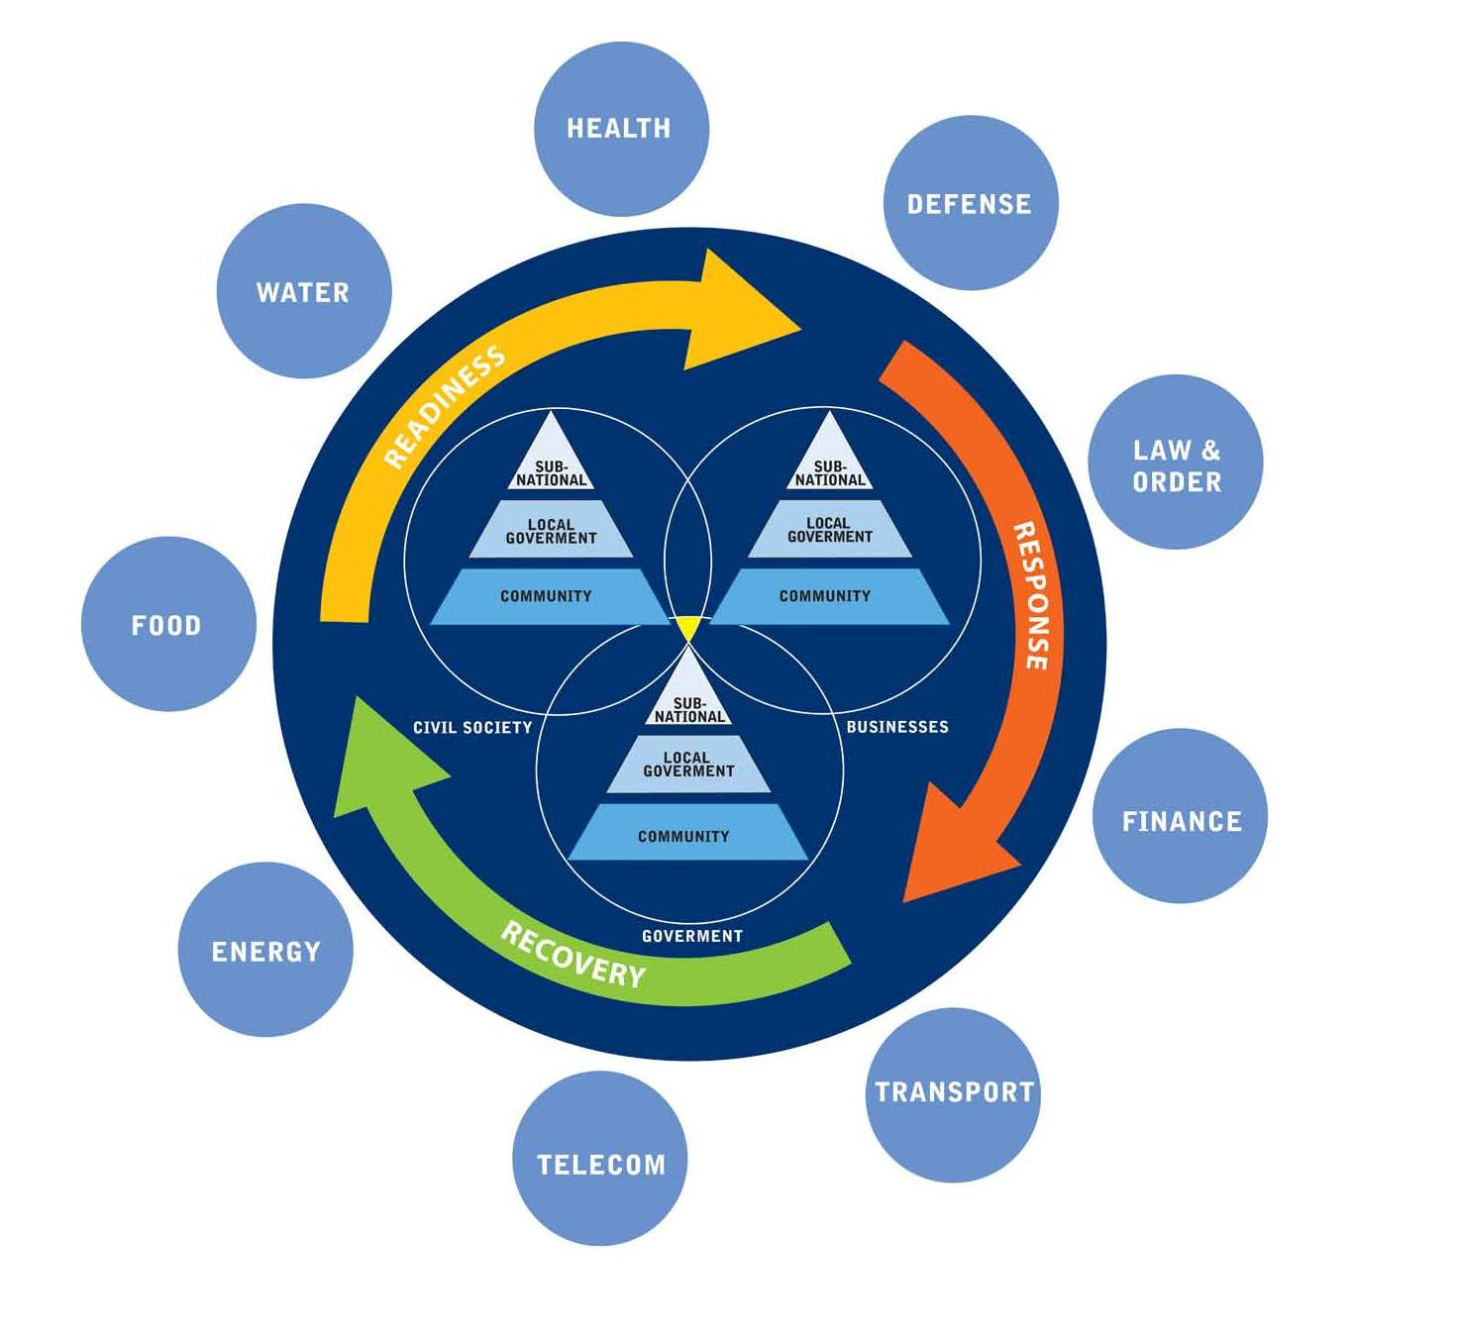
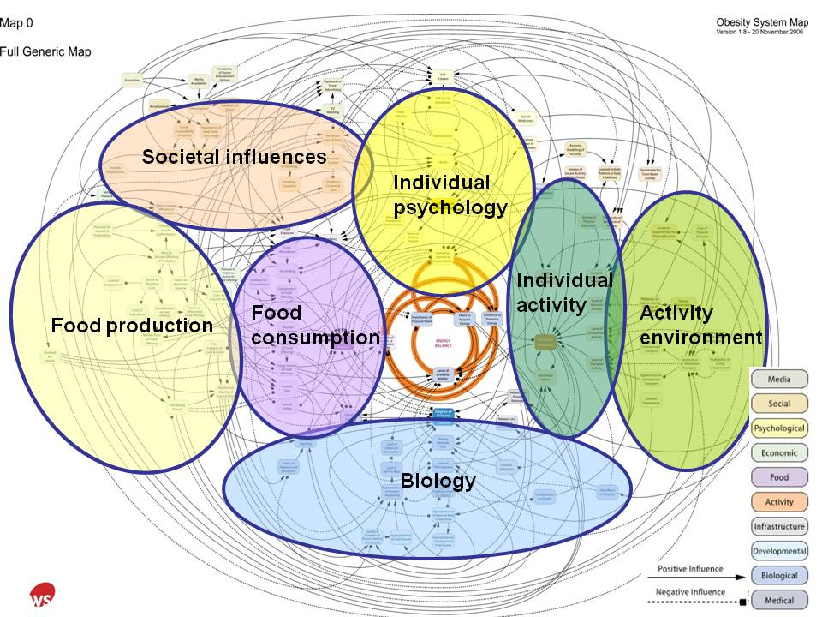
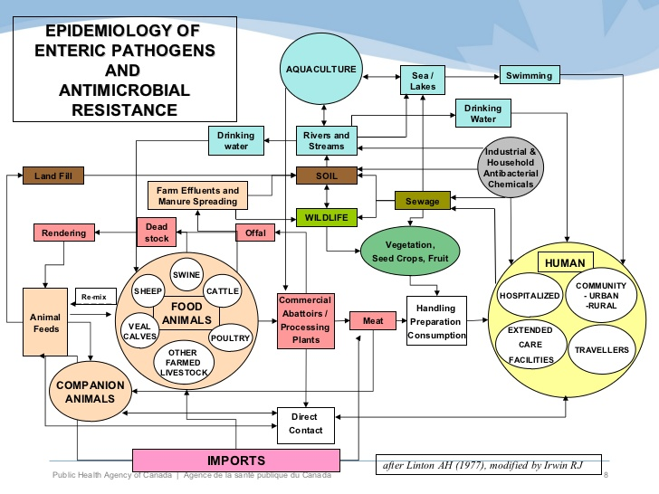
Systems response….
Population health interventions:
Aim to change the social context that gives rise to health its distribution (Rose in Frohlich, 2014) [tipping points→ large failures; risk dominos]

Slide 8
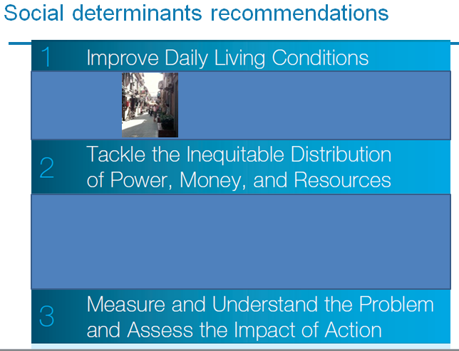

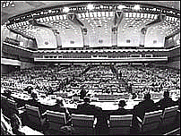
Commission on Social Determinants of Health
Inequalities are killing on a grand scale…
The circumstances in which people are born, grow up, live, work and age, and the systems in place to deal with illness.
These circumstances are shaped by a wider set of forces: economics, social policies, and politics (health system, one force).
Largely responsible for
health inequities.

Slide 9
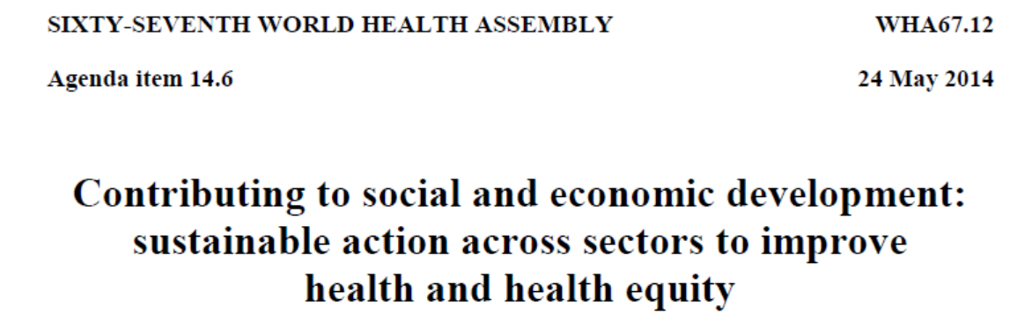
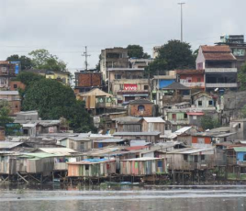
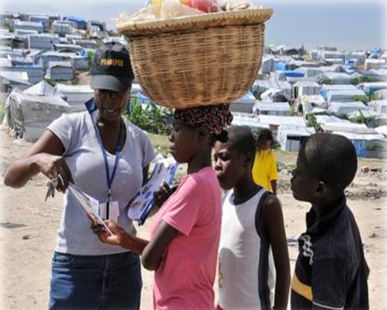
Glocal sustainable action across sectors to improve health and health equity: resolution of ministers of health
Health in All Policies is an approach to public policies across sectors that systematically takes into account the health implications of decisions, seeks synergies, and avoids harmful health impacts, in order to improve population health and health equity.
(WHO Definition adopted by the 2013 Global Health Promotion conference focusing on HiAP, and used in the World Health Assembly resolution 2014)
Notes:
Founded on rights and obligations
Improves the accountability for health impacts at all levels of policy making
Emphasis on the consequences of public policies for health care/systems
Contributes to sustainable development

Slide 10
Principles of HiAP approach
Dynamics and complexity
Health Equity
Framing
Whole of government//society
Collective impact
Mutual gain, negotiation, health diplomacy

Slide 11

Training development and design

Slide 12
WHO HIAP Training Manual
Introduction to the determinants of health
21st century health dynamics and inequalities
Health in All Policies
The policy making process
Role of government in HIAP/Whole of government approches
Preparing policy briefs
Role on non-governmental stakeholders in HIAP/Whole of society approaches
Negotiating for health
HIAP Implementation at local, regional and global levels
Measuring progress in health
The Leadership role of the health sector in HIAP
Round up

Slide 13
Central principles: reflective in policy-processes
Wicked problems are socially defined - so getting the “whole system in the room” to enable people to learn from one another is both useful and necessary.
Social learning is more likely to be successful if it evolves as stakeholders meet, interact, and inform one another’s actions.

Slide 14


AUDIENCE - FACULTY
A manual for trainers in organisations, academic institutions, NGOs, IGOs…..
To be ADAPTED to context and participants

Slide 15
FOCUS: Participants
Educational approach: highly participatory
Learn skills – conduct stakeholder analysis, prepare policy briefs, role play situations and carry out negotiations, prepare a health impact assessment

Slide 16

Module organization, Appendices
Overview
Learning objectives
Key messages
Key readings
Supporting materials
Readings for instructors
Teachiung notes
Case studies, hand outs…….

Slide 17
Purpose of the Manual
Build capacity to promote, implement and evaluate HIAP
Encourage engagement and collaboration across sectors
Facilitate exchange of experience and lessons learned
Promote regional and global collaboration on HIAP
Promote dissemination of skills to develop training courses for trainers

Slide 18

HIAP Skills
Solution seeking mindset
Invent options for mutual gain
Focus on interests not positions
High levels of inter personal and organisational sensitivity
To deal with differences and manage difficult trade offs
Capacity to acknowledge others contribution

Slide 19
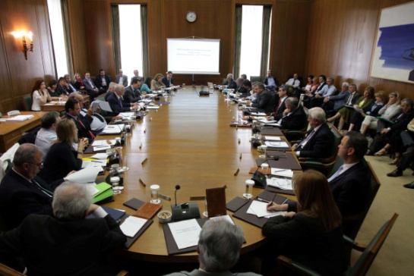

Balancing act
Health is a political choice
Health in all Policies requires a range of technical skills

Slide 20

Mindset
shift in perspective so that all actors consider improved health and wellbeing as an overarching social goal that requires shared action
create a shared mental map for participants in relation to HIAP and equip them to be policy champions for HIAP and equity

