Slide 1
What next?
Session 3.3. Dr. Eugenio Villar, Nada Osseiran, Natalie Roebbel and Nicole Valentine
Social Determinants of Health Unit
Health in All Policies Trainers' Meeting
Starling Hotel, Geneva
World Health Organization
24-26 March 2015

Slide 2
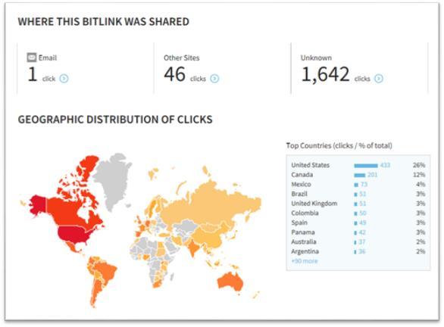
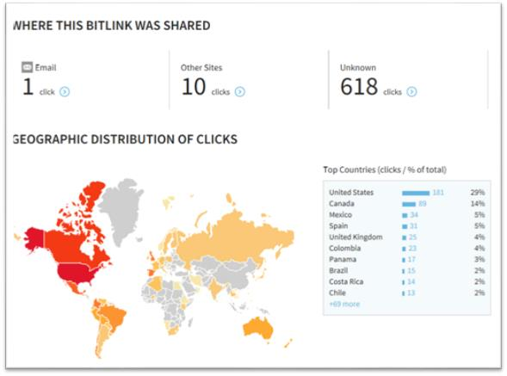
Successful launching of the Health in All Policies Training Manual
E-launch on WHO Web platform on 25 February 2015, mission briefing, HQ seminar
2 days: page visited 1590 times and 1122, unique visitors with average time spent of 4:08mn on the page.
Dissemination via Equidad:
10 days: bitlinks for contents- 1,735 clicks (PDF) and 629 (website)

Slide 3
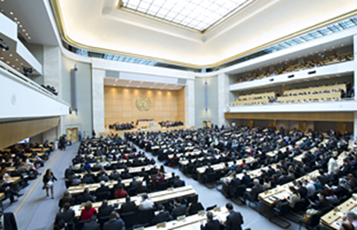
Mandates: Rio Political Declaration & Framework for Country Action Across Sectors
Follow-up to the World Health Assembly Resolutions 65.14 on RPD & 67.12 – Contributing to social and economic development
Framework for Country Action Across Sectors for Health and Health Equity
Putting action across sectors into practice- training courses

Slide 4
Towards a Master Global Plan for Training in Working Across Sectors
Dissemination, advocacy and demand generation
Facilitating networks of institutions/trainers
Actively supporting rapid adaptation of Training Manual
Conducting regional and country trainings
Creating shared resources
Fund-raising

Slide 5
1.Dissemination, advocacy, demand generation
WHO
Standard package for WRs - manual with key messages for MOH and donors
Support regional & national launches
Briefing in WHA 2015 and in WHO RCs
Holding regional sensitization workshops
Training institutions
Post e-links on their web platforms
Generate demand within existing networks
Assist WHO with short de-/briefings in countries

Slide 6
2. (1) Strengthening trainers' skills and facilitating networks of institutions/trainers
WHO
To orchestrate/facilitate networks of training institutions
Develop regional plans:regional training-of-trainers (TOT) in 6 regions by end 2017
Support building of trainer capacity in countries (priority goal 21 countries by end 2017)
Maintain record HiAP trainers profiles
Develop timetable of training 2015-2017
Support trainers' exchange-visits across regions

Slide 7
2. (2) Strengthening trainers' skills and facilitating networks of institutions/trainers
2. Training institutions, we propose:
Suggest options for expanding trainers to support country needs in the region
Develop and run courses to train trainers with WHO
Train trainers in your own institutions, broader professionals (e.g. summer schools), formal courses
Provide WHO with information on progress with TOTs beyond work with WHO
Adapt and run the HiAPs courses upon demand

Slide 8
3. Actively support rapid global and regional adaptations of Training Manual
1. Training institutions and WHO
Materials prioritized in regional trainers' networks
Translate key messages in Manual (different modules)
Case studies and contribute to quality control
Find data-based examples for determinants pathways
New role plays
Settings
Health programmes
Specific programmes:E.g.NCDs, communicable, MCH
Determinant(s) common to several programmes

Slide 9
3.(2) Actively support global and regional adaptations of Training Manual
2. WHO global priorities for adaptations
Languages
Setting: Low-income countries priority
Issue: Non-communicable diseases
Health services: Human resources

Slide 10
4. Conducting trainings and support training courses: ministry of health, other sectors
WHO:
Identify need through Regional & Country offices
Develop standard TOR for national & sub national country-level trainings
Support training institutions (not run)training programmes in ministries of health, broader government and related donors
Funding of training: country &/or donor resources
2. Training institutions, we suggest
Develop materials for specific trainings & runing trainings
Sharing of experiences on training, linked to implementation

Slide 11
5. (1) Creating shared resources and generating materials to support trainings
1. Training institutions, we suggest:
Update WHO with adapted materials and make available publically the course materials
When delivering courses, contribute to case studies - https://extranet.who.int/isacs/
Newsletter
Accountability: if working with WHO in supporting MOH process, training evaluation reports should be provided
Use annual professional conferences to disseminate training

Slide 12
5. (2) Creating shared resources and generating materials to support trainings
2. WHO
Download all resources in Manual on single USB
Updates of WHO materials, governing body resolutions, key strategies
Support opportunities in annual professional conferences
Support quality control process for case studies (outcomes, health equity)
Consolidate adapted materials
Reconvene trainers and update Training Manual
2-3 years with most active trainers from the previous years, -- starting, China Health Promotion meeting (2017)

Slide 13
6. Fund-raising
Funding of country training: country &/or donor resources
WHO to start global fund raising & to support training institutions fundraising efforts especially for core ToT activities, training shared resources &data bases.
Need to marketing HiAP training to governments, donors, health programmes and non-health sectors/donors
Joint budgets with health programmes
In-kind contributions of trainers and training institutes E.g Finland

Slide 14
Practical considerations (1): Use of WHO logo or reference to WHO
Can only use WHO logo if you are running a course with a WHO office or if you are already a collaborating centre
Summer schools cannot use WHO logo unless very specifically run with WHO
Can refer to using the WHO Training Manual

Slide 15
Group exercise
Discuss how you (and your institution) can contribute to the WHO plan for scaling-up training capacity in your region?
Summarize discussion and suggestions for WHO

Slide 16
Thank you!

